Slide 1
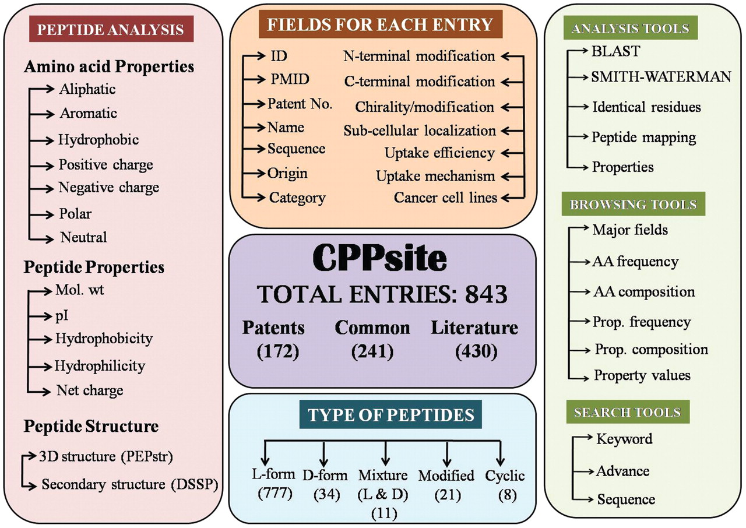
Figure 1. Overall architecture of CPPsite database.
Notes:
Figure 1. Overall architecture of CPPsite database.
Unless provided in the caption above, the following copyright applies to the content of this slide: © The Author(s) 2012. Published by Oxford University Press.This is an Open Access article distributed under the terms of the Creative Commons Attribution Non-Commercial License (http://creativecommons.org/licenses/by-nc/3.0), which permits unrestricted non-commercial use, distribution, and reproduction in any medium, provided the original work is properly cited.

Slide 2
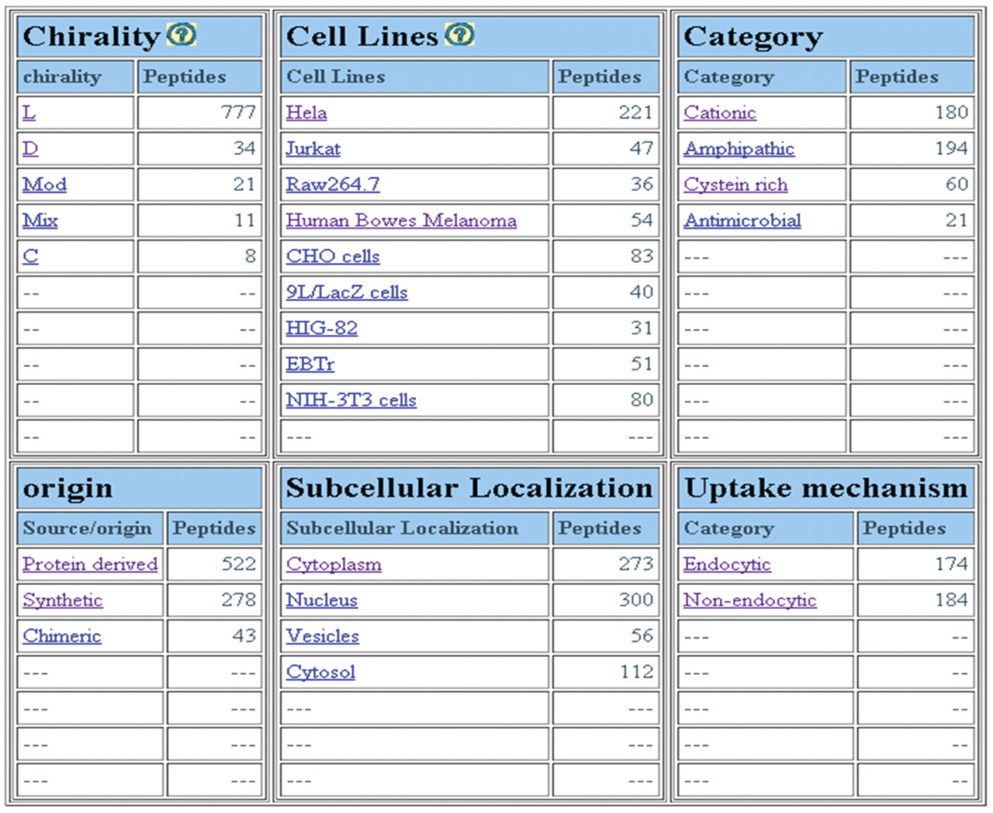
Figure 2. Screenshot of major fields page of CPPsite.
Notes:
Figure 2. Screenshot of major fields page of CPPsite.
Unless provided in the caption above, the following copyright applies to the content of this slide: © The Author(s) 2012. Published by Oxford University Press.This is an Open Access article distributed under the terms of the Creative Commons Attribution Non-Commercial License (http://creativecommons.org/licenses/by-nc/3.0), which permits unrestricted non-commercial use, distribution, and reproduction in any medium, provided the original work is properly cited.

Slide 3
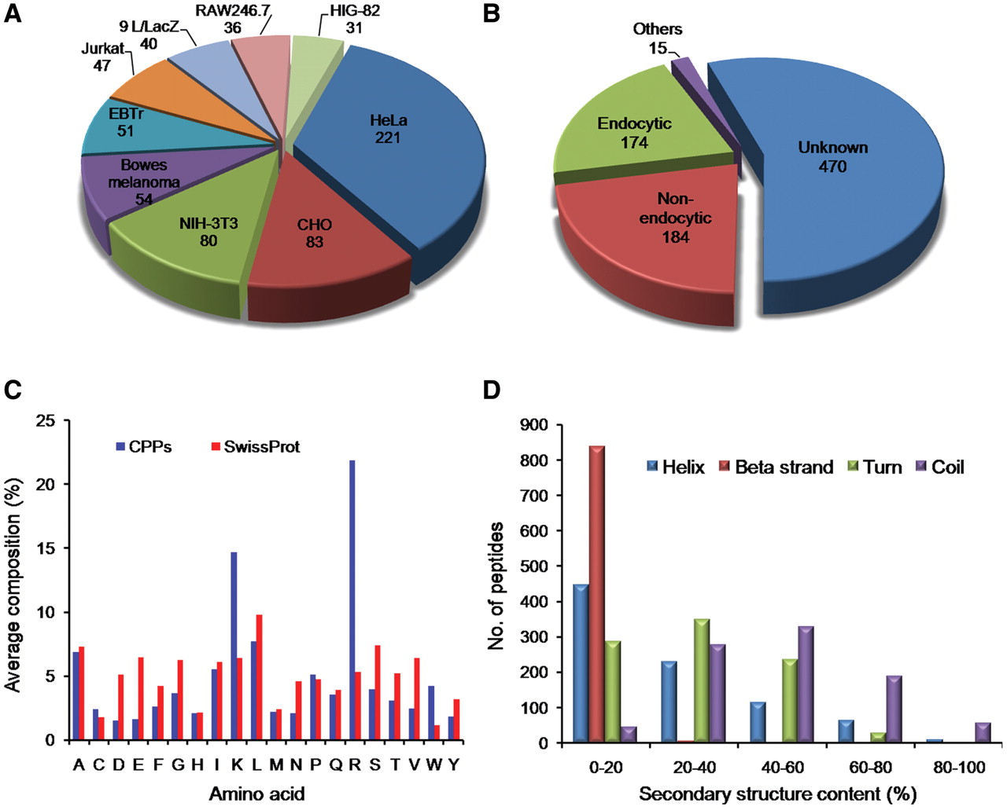
Figure 3. Distribution of CPPs in CPPsite. (A) distribution of peptides based on cell lines, (B) distribution of CPPs ...
Notes:
Figure 3. Distribution of CPPs in CPPsite. (A) distribution of peptides based on cell lines, (B) distribution of CPPs based on uptake mechanism, (C) average amino acid composition of peptides and (D) distribution of peptides based on secondary structure composition.
Unless provided in the caption above, the following copyright applies to the content of this slide: © The Author(s) 2012. Published by Oxford University Press.This is an Open Access article distributed under the terms of the Creative Commons Attribution Non-Commercial License (http://creativecommons.org/licenses/by-nc/3.0), which permits unrestricted non-commercial use, distribution, and reproduction in any medium, provided the original work is properly cited.

