Slide 1
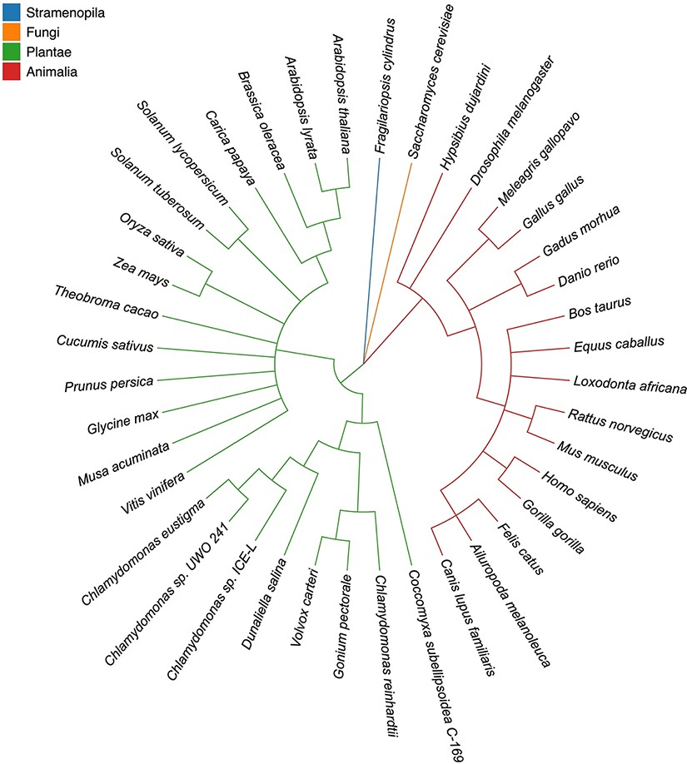
Figure 1. Taxonomic tree of 40 eukaryotic species in four highlighted categories. Stramenopila, Plantae , Fungi and ...
Notes:
Figure 1. Taxonomic tree of 40 eukaryotic species in four highlighted categories. Stramenopila, Plantae , Fungi and Animalia are in blue, orange, green and red, respectively. The tree topologies were inferred by Taxonomy Common Tree from NCBI (https://www.ncbi.nlm.nih.gov/Taxonomy/CommonTree/wwwcmt.cgi).
Unless provided in the caption above, the following copyright applies to the content of this slide: © The Author(s) 2022. Published by Oxford University Press.This is an Open Access article distributed under the terms of the Creative Commons Attribution-NonCommercial License (https://creativecommons.org/licenses/by-nc/4.0/), which permits non-commercial re-use, distribution, and reproduction in any medium, provided the original work is properly cited. For commercial re-use, please contact journals.permissions@oup.com

Slide 2
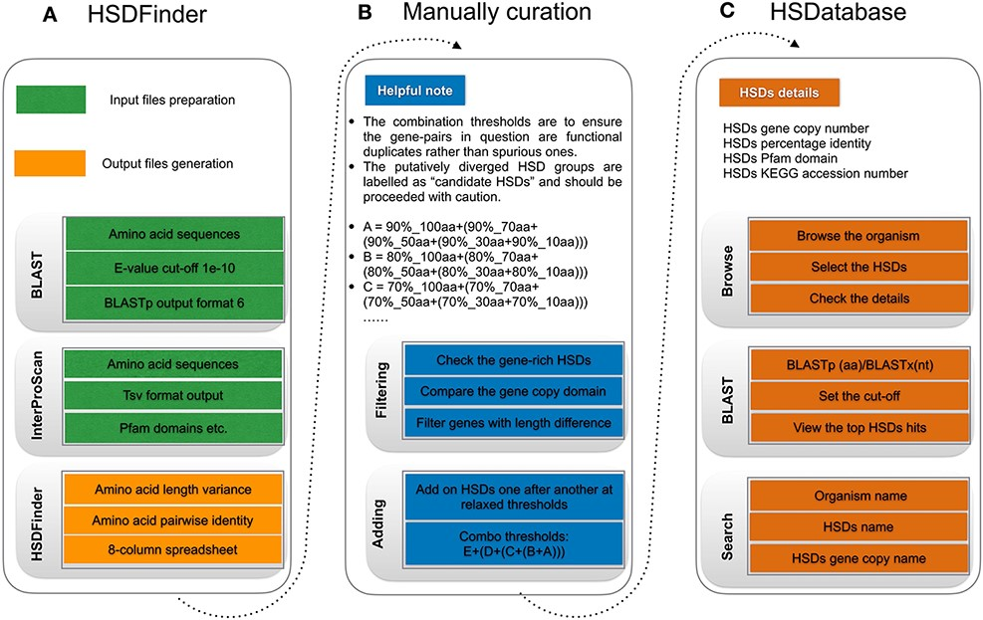
Figure 2. The workflow of HSDatabase. (A) Steps for using HSDFinder to collect candidate HSDs. (B) Manual curation of ...
Notes:
Figure 2. The workflow of HSDatabase. (A) Steps for using HSDFinder to collect candidate HSDs. (B) Manual curation of HSDs via filtering and adding new HSD candidates prior to being deposited into HSDatabase. (C) Steps of accessing HSD data in HSDatabase, including browsing via organism name, blasting query sequences against the database and searching through the HSD and gene copy IDs.
Unless provided in the caption above, the following copyright applies to the content of this slide: © The Author(s) 2022. Published by Oxford University Press.This is an Open Access article distributed under the terms of the Creative Commons Attribution-NonCommercial License (https://creativecommons.org/licenses/by-nc/4.0/), which permits non-commercial re-use, distribution, and reproduction in any medium, provided the original work is properly cited. For commercial re-use, please contact journals.permissions@oup.com

Slide 3
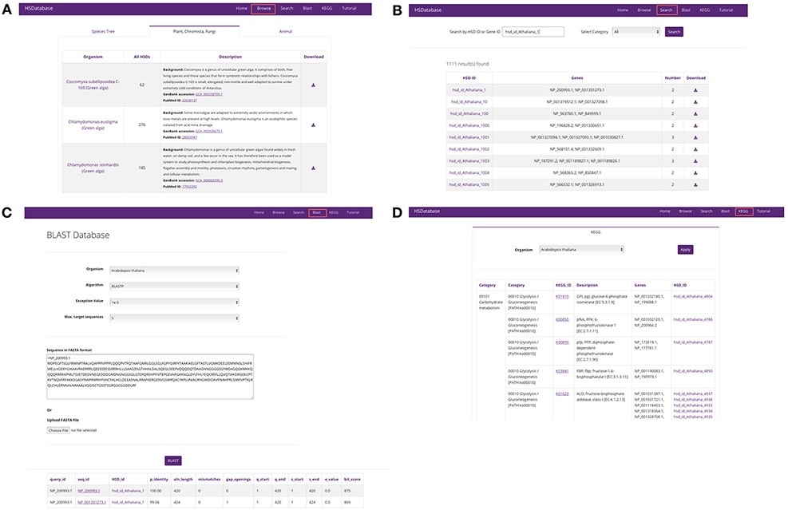
Figure 3. Screenshots of the HSDatabase interface. There are four main functions in the menu page: (A) Browse the ...
Notes:
Figure 3. Screenshots of the HSDatabase interface. There are four main functions in the menu page: (A) Browse the database via species entries; (B) search the database via the HSDatabase unique ID (e.g. hsd_id_Athaliana_1) or gene ID (e.g. NP_200993.1); (C) use BLAST to search the database via amino acid sequence in FASTA format; and (D) categorize the gene copies and HSDs under the KEGG pathway functional categories.
Unless provided in the caption above, the following copyright applies to the content of this slide: © The Author(s) 2022. Published by Oxford University Press.This is an Open Access article distributed under the terms of the Creative Commons Attribution-NonCommercial License (https://creativecommons.org/licenses/by-nc/4.0/), which permits non-commercial re-use, distribution, and reproduction in any medium, provided the original work is properly cited. For commercial re-use, please contact journals.permissions@oup.com

Slide 4
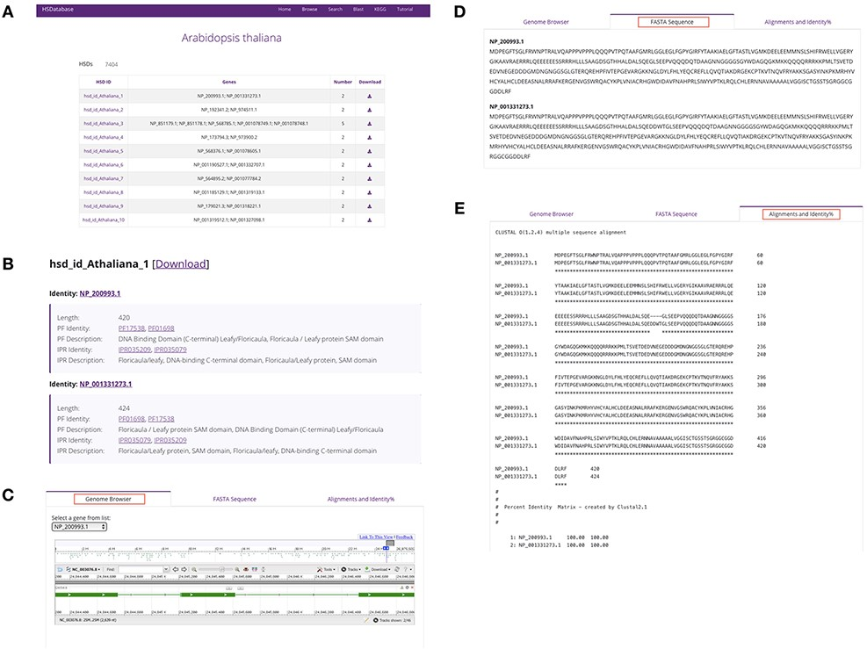
Figure 4. Summary of database information for a selected species. (A) HSDs collected in a table for a specific species. ...
Notes:
Figure 4. Summary of database information for a selected species. (A) HSDs collected in a table for a specific species. (B) Basic information of the unique HSD ID, gene copy ID and the associated links to Pfam domains and InterPro databases. (C) Linking gene copies to the genome browser. (D) The FASTA sequence downloads of gene copies. (E) Alignments and percentage sequence identities of gene copies.
Unless provided in the caption above, the following copyright applies to the content of this slide: © The Author(s) 2022. Published by Oxford University Press.This is an Open Access article distributed under the terms of the Creative Commons Attribution-NonCommercial License (https://creativecommons.org/licenses/by-nc/4.0/), which permits non-commercial re-use, distribution, and reproduction in any medium, provided the original work is properly cited. For commercial re-use, please contact journals.permissions@oup.com

