Slide 1
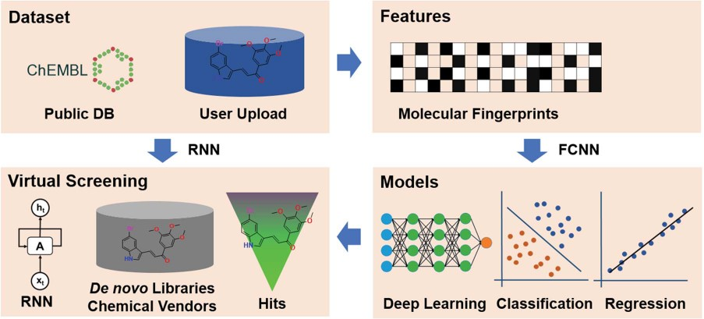
Figure 1 The framework of the DeepScreening. RNN: recurrent neural network. FCNN: fully connected neuron network.
Notes:
Figure 1 The framework of the DeepScreening. RNN: recurrent neural network. FCNN: fully connected neuron network.
Unless provided in the caption above, the following copyright applies to the content of this slide: © The Author(s) 2019. Published by Oxford University Press.This is an Open Access article distributed under the terms of the Creative Commons Attribution License (http://creativecommons.org/licenses/by/4.0/), which permits unrestricted reuse, distribution, and reproduction in any medium, provided the original work is properly cited.

Slide 2
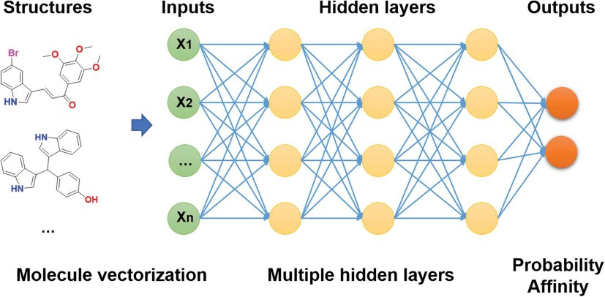
Figure 2 Architecture of DNNs in DeepScreening.
Notes:
Figure 2 Architecture of DNNs in DeepScreening.
Unless provided in the caption above, the following copyright applies to the content of this slide: © The Author(s) 2019. Published by Oxford University Press.This is an Open Access article distributed under the terms of the Creative Commons Attribution License (http://creativecommons.org/licenses/by/4.0/), which permits unrestricted reuse, distribution, and reproduction in any medium, provided the original work is properly cited.

Slide 3
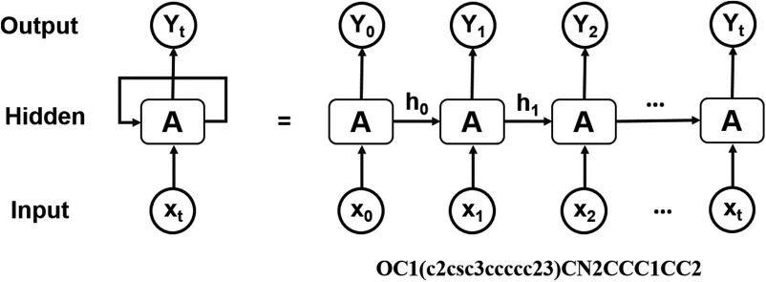
Figure 3 Architecture of RNN operating on the SMILES representation of molecules.
Notes:
Figure 3 Architecture of RNN operating on the SMILES representation of molecules.
Unless provided in the caption above, the following copyright applies to the content of this slide: © The Author(s) 2019. Published by Oxford University Press.This is an Open Access article distributed under the terms of the Creative Commons Attribution License (http://creativecommons.org/licenses/by/4.0/), which permits unrestricted reuse, distribution, and reproduction in any medium, provided the original work is properly cited.

Slide 4
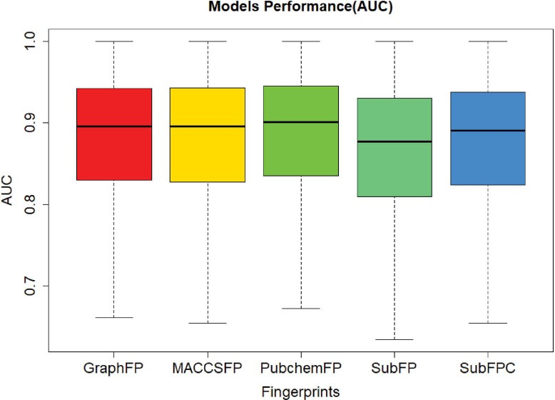
Figure 4 The classification model performance.
Notes:
Figure 4 The classification model performance.
Unless provided in the caption above, the following copyright applies to the content of this slide: © The Author(s) 2019. Published by Oxford University Press.This is an Open Access article distributed under the terms of the Creative Commons Attribution License (http://creativecommons.org/licenses/by/4.0/), which permits unrestricted reuse, distribution, and reproduction in any medium, provided the original work is properly cited.

Slide 5
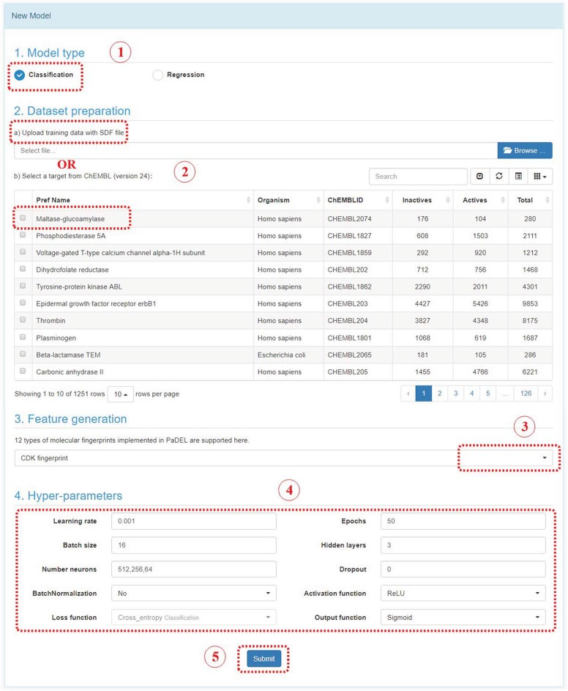
Figure 5 Steps to construct a deep learning model in DeepScreening.
Notes:
Figure 5 Steps to construct a deep learning model in DeepScreening.
Unless provided in the caption above, the following copyright applies to the content of this slide: © The Author(s) 2019. Published by Oxford University Press.This is an Open Access article distributed under the terms of the Creative Commons Attribution License (http://creativecommons.org/licenses/by/4.0/), which permits unrestricted reuse, distribution, and reproduction in any medium, provided the original work is properly cited.

Slide 6
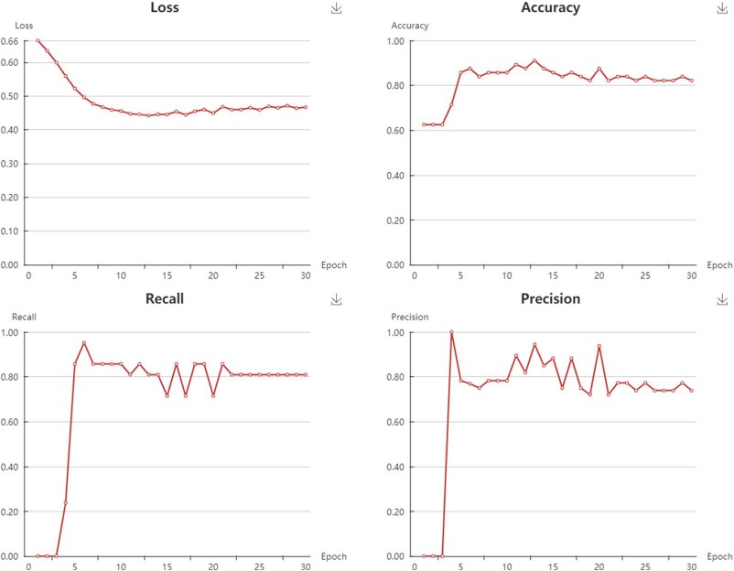
Figure 6 Snapshot of classification models performance.
Notes:
Figure 6 Snapshot of classification models performance.
Unless provided in the caption above, the following copyright applies to the content of this slide: © The Author(s) 2019. Published by Oxford University Press.This is an Open Access article distributed under the terms of the Creative Commons Attribution License (http://creativecommons.org/licenses/by/4.0/), which permits unrestricted reuse, distribution, and reproduction in any medium, provided the original work is properly cited.

Slide 7
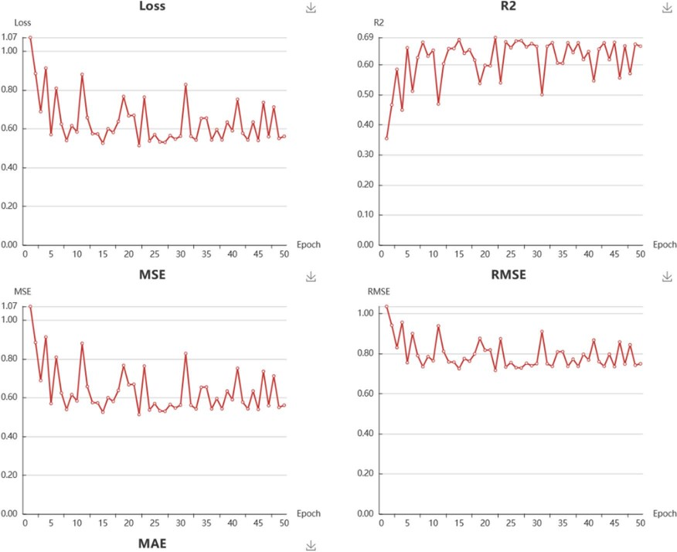
Figure 7 Snapshot of regressions models performance.
Notes:
Figure 7 Snapshot of regressions models performance.
Unless provided in the caption above, the following copyright applies to the content of this slide: © The Author(s) 2019. Published by Oxford University Press.This is an Open Access article distributed under the terms of the Creative Commons Attribution License (http://creativecommons.org/licenses/by/4.0/), which permits unrestricted reuse, distribution, and reproduction in any medium, provided the original work is properly cited.

Slide 8
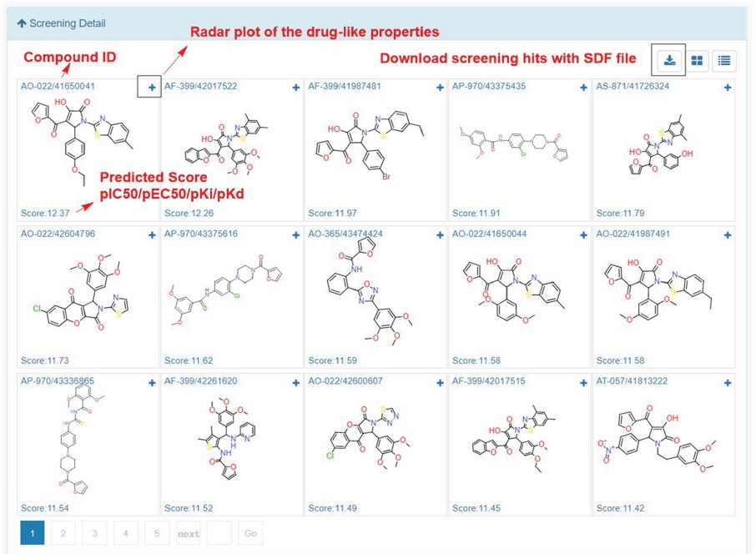
Figure 8 Snapshot of screening details.
Notes:
Figure 8 Snapshot of screening details.
Unless provided in the caption above, the following copyright applies to the content of this slide: © The Author(s) 2019. Published by Oxford University Press.This is an Open Access article distributed under the terms of the Creative Commons Attribution License (http://creativecommons.org/licenses/by/4.0/), which permits unrestricted reuse, distribution, and reproduction in any medium, provided the original work is properly cited.

Slide 9
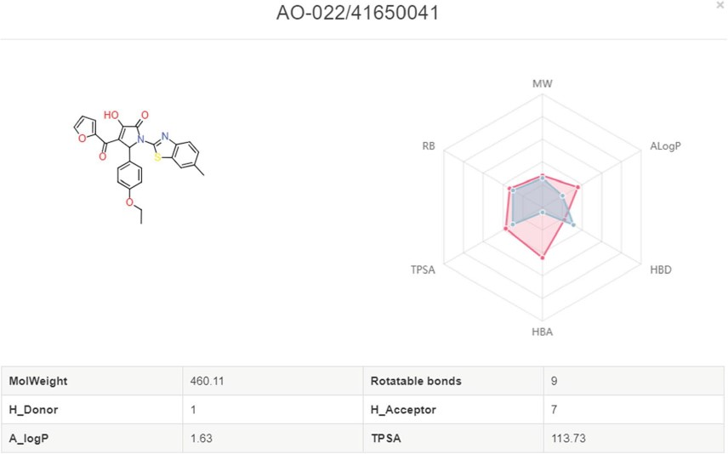
Figure 9 Radar plot of molecules with the drug-like properties. Red present the desired drug-like properties (MW: ...
Notes:
Figure 9 Radar plot of molecules with the drug-like properties. Red present the desired drug-like properties (MW: 500 g/mol, ALogP: 5, HBA: 10, HBD: 5, TPSA: 140, RB: 10) according to the Lipinski’s rule of 5.
Unless provided in the caption above, the following copyright applies to the content of this slide: © The Author(s) 2019. Published by Oxford University Press.This is an Open Access article distributed under the terms of the Creative Commons Attribution License (http://creativecommons.org/licenses/by/4.0/), which permits unrestricted reuse, distribution, and reproduction in any medium, provided the original work is properly cited.

Slide 10
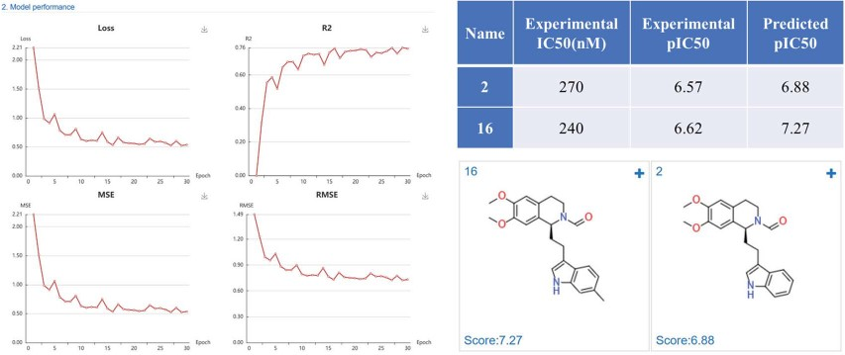
Figure 10 PDE4D inhibitors regression model performance and the prediction results of PDE4D inhibitors.
Notes:
Figure 10 PDE4D inhibitors regression model performance and the prediction results of PDE4D inhibitors.
Unless provided in the caption above, the following copyright applies to the content of this slide: © The Author(s) 2019. Published by Oxford University Press.This is an Open Access article distributed under the terms of the Creative Commons Attribution License (http://creativecommons.org/licenses/by/4.0/), which permits unrestricted reuse, distribution, and reproduction in any medium, provided the original work is properly cited.

Slide 11
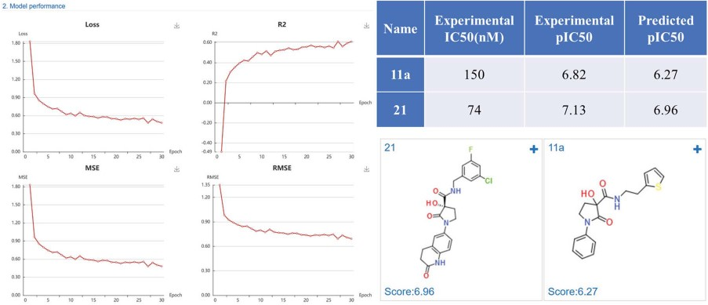
Figure 11 MetAP-2 inhibitors regression model performance and the prediction results of MetAP-2 inhibitors.
Notes:
Figure 11 MetAP-2 inhibitors regression model performance and the prediction results of MetAP-2 inhibitors.
Unless provided in the caption above, the following copyright applies to the content of this slide: © The Author(s) 2019. Published by Oxford University Press.This is an Open Access article distributed under the terms of the Creative Commons Attribution License (http://creativecommons.org/licenses/by/4.0/), which permits unrestricted reuse, distribution, and reproduction in any medium, provided the original work is properly cited.

Slide 12
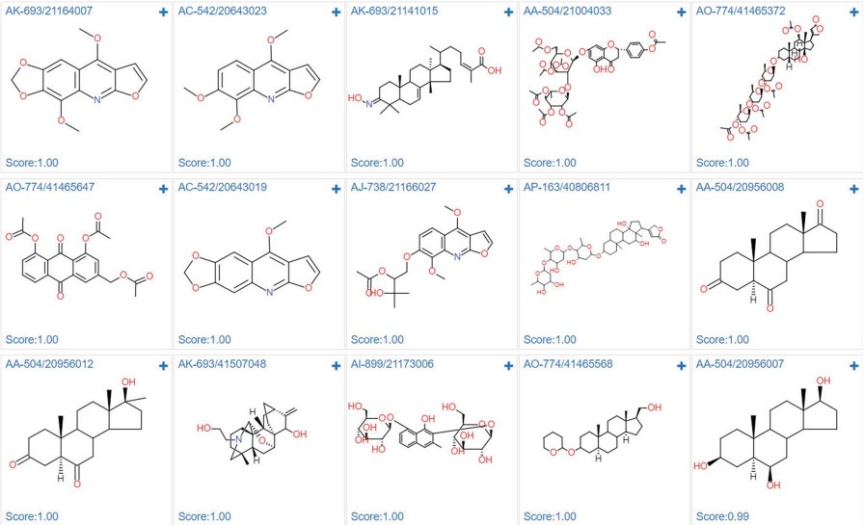
Figure 12 Screening results of estrogen receptor alpha model against specs natural product library.
Notes:
Figure 12 Screening results of estrogen receptor alpha model against specs natural product library.
Unless provided in the caption above, the following copyright applies to the content of this slide: © The Author(s) 2019. Published by Oxford University Press.This is an Open Access article distributed under the terms of the Creative Commons Attribution License (http://creativecommons.org/licenses/by/4.0/), which permits unrestricted reuse, distribution, and reproduction in any medium, provided the original work is properly cited.

