Slide 1
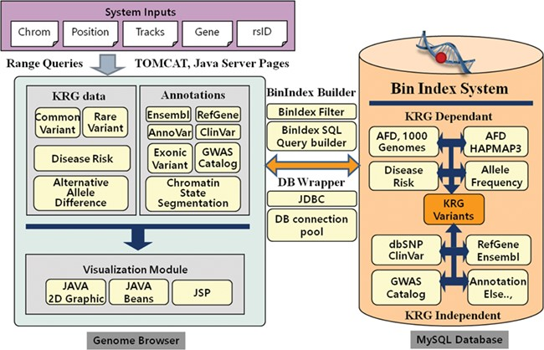
Figure 1 System architecture of KRGDB and Genome Browser. The system mainly consists of variation/annotation database ...
Notes:
Figure 1 System architecture of KRGDB and Genome Browser. The system mainly consists of variation/annotation database and its genome browser.
Unless provided in the caption above, the following copyright applies to the content of this slide: © The Author(s) 2020. Published by Oxford University Press.This is an Open Access article distributed under the terms of the Creative Commons Attribution License (http://creativecommons.org/licenses/by/4.0/), which permits unrestricted reuse, distribution, and reproduction in any medium, provided the original work is properly cited.

Slide 2
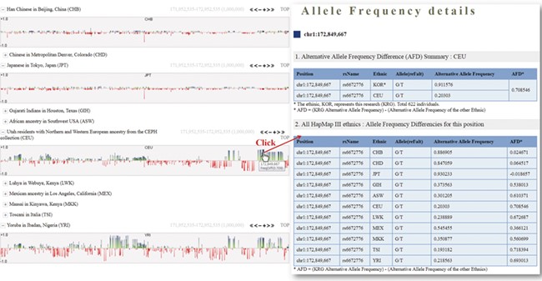
Figure 2 Alternative allele frequency difference between KRG and HapMap III ethnics. The horizontal axis denotes the ...
Notes:
Figure 2 Alternative allele frequency difference between KRG and HapMap III ethnics. The horizontal axis denotes the genomic positions of the chosen chromosome (chr1).
Unless provided in the caption above, the following copyright applies to the content of this slide: © The Author(s) 2020. Published by Oxford University Press.This is an Open Access article distributed under the terms of the Creative Commons Attribution License (http://creativecommons.org/licenses/by/4.0/), which permits unrestricted reuse, distribution, and reproduction in any medium, provided the original work is properly cited.

Slide 3
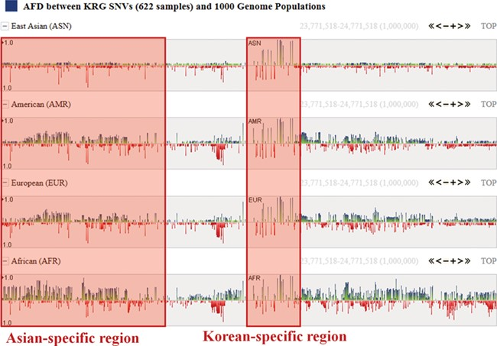
Figure 3 Alternative allele frequency difference between KRG and 1000 Genomes ethnics. The horizontal axis denotes the ...
Notes:
Figure 3 Alternative allele frequency difference between KRG and 1000 Genomes ethnics. The horizontal axis denotes the genomic positions of the chosen chromosome (chr1).
Unless provided in the caption above, the following copyright applies to the content of this slide: © The Author(s) 2020. Published by Oxford University Press.This is an Open Access article distributed under the terms of the Creative Commons Attribution License (http://creativecommons.org/licenses/by/4.0/), which permits unrestricted reuse, distribution, and reproduction in any medium, provided the original work is properly cited.

Slide 4
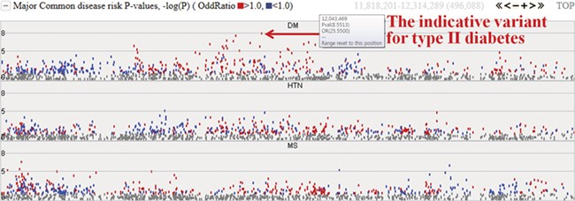
Figure 4 Disease risks of type II diabetes (DM), hypertension (HTN) and metabolic syndrome (MS). Each dot represents ...
Notes:
Figure 4 Disease risks of type II diabetes (DM), hypertension (HTN) and metabolic syndrome (MS). Each dot represents risk P values (–logP). The red and blue colour indicates odds ratio ≥1.0 and <1.0, respectively. The horizontal axis denotes the genomic positions of the chosen chromosome (chr1).
Unless provided in the caption above, the following copyright applies to the content of this slide: © The Author(s) 2020. Published by Oxford University Press.This is an Open Access article distributed under the terms of the Creative Commons Attribution License (http://creativecommons.org/licenses/by/4.0/), which permits unrestricted reuse, distribution, and reproduction in any medium, provided the original work is properly cited.

