Slide 1
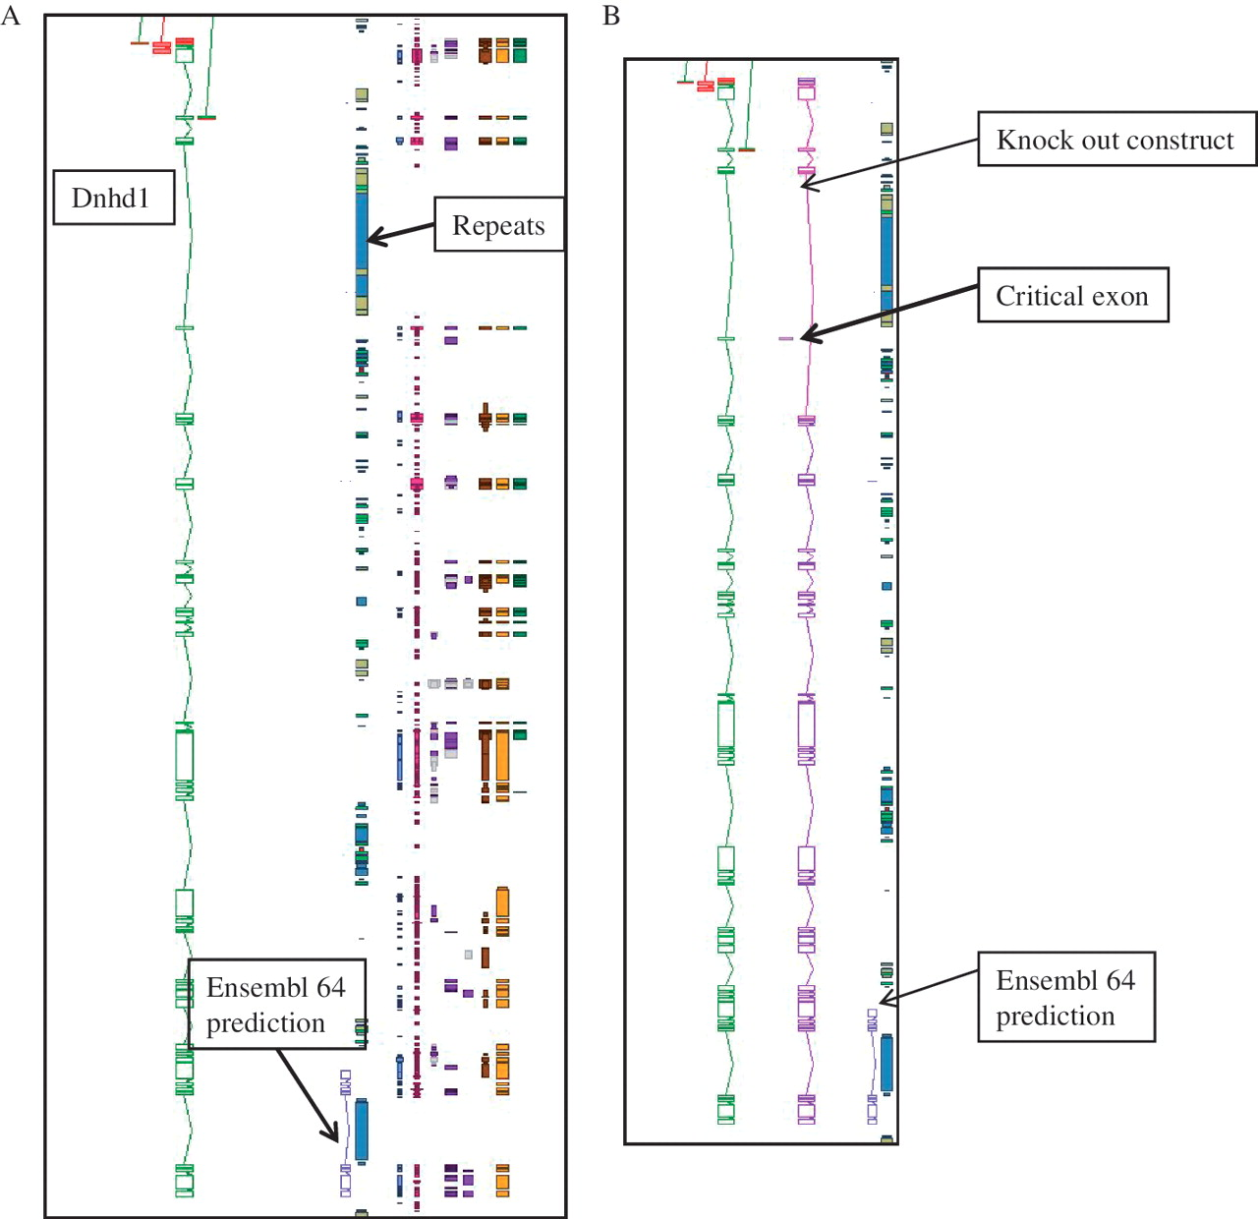
Figure 2. An example of manual annotation in mouse to identify a critical exon. (A) Dnhd1 is a KOMP target gene that is ...
Notes:
Figure 2. An example of manual annotation in mouse to identify a critical exon. (A) Dnhd1 is a KOMP target gene that is automatically chosen to create a knockout from the Ensembl prediction. A Zmap view of the Dnhd1 gene manually annotated in mouse. The Ensembl 64 prediction is partial, probably due to the highly repetitive nature of the genomic region. (B) A Zmap view of the position of the critical exon identified after completion fo the manual annotation and the associate knockout construct. If the Ensembl prediction had been used as a model to create the knockout a rage proportion of the gene would have been missed. This would have resulted in an unsuccessful knockout construct.
Unless provided in the caption above, the following copyright applies to the content of this slide: © The Author(s) 2012. Published by Oxford University Press.This is an Open Access article distributed under the terms of the Creative Commons Attribution Non-Commercial License (http://creativecommons.org/licenses/by-nc/3.0), which permits unrestricted non-commercial use, distribution, and reproduction in any medium, provided the original work is properly cited.

