Slide 1
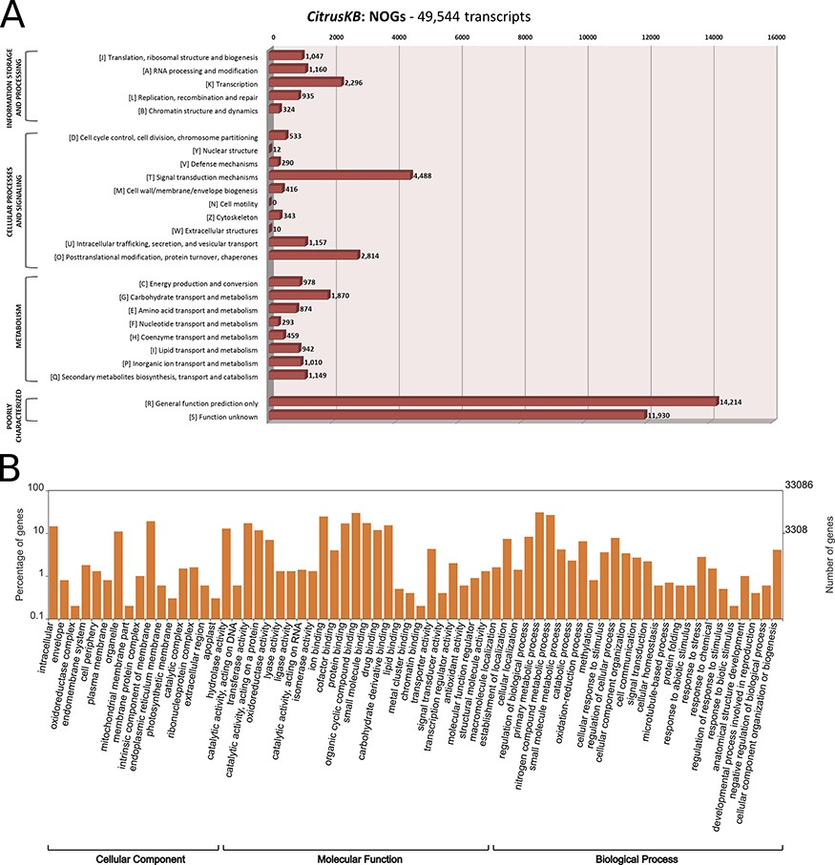
Figure 2. Annotation of Citrus sinensis CitrusKB transcriptome. EggNOG (A) and representative GO terms (B). ...
Notes:
Figure 2. Annotation of Citrus sinensis CitrusKB transcriptome. EggNOG (A) and representative GO terms (B). Functionally annotated orthologous groups are represented in the Y axis of eggNOG annotation. For each annotated group, we have the identification of the functional category of the group (J, A, K, L, B, D, Y, V, T, M, N, Z, W, U, O, C, G, E, F, H, I, P, Q, R, S) followed by its description. The Y axis of GO annotations is presented in log (10) scale. Both, eggNOG and GO terms are fully searchable trough the Gene expression tables.
Unless provided in the caption above, the following copyright applies to the content of this slide: © The Author(s) 2020. Published by Oxford University Press.This is an Open Access article distributed under the terms of the Creative Commons Attribution License (http://creativecommons.org/licenses/by/4.0/), which permits unrestricted reuse, distribution, and reproduction in any medium, provided the original work is properly cited.

