Slide 1
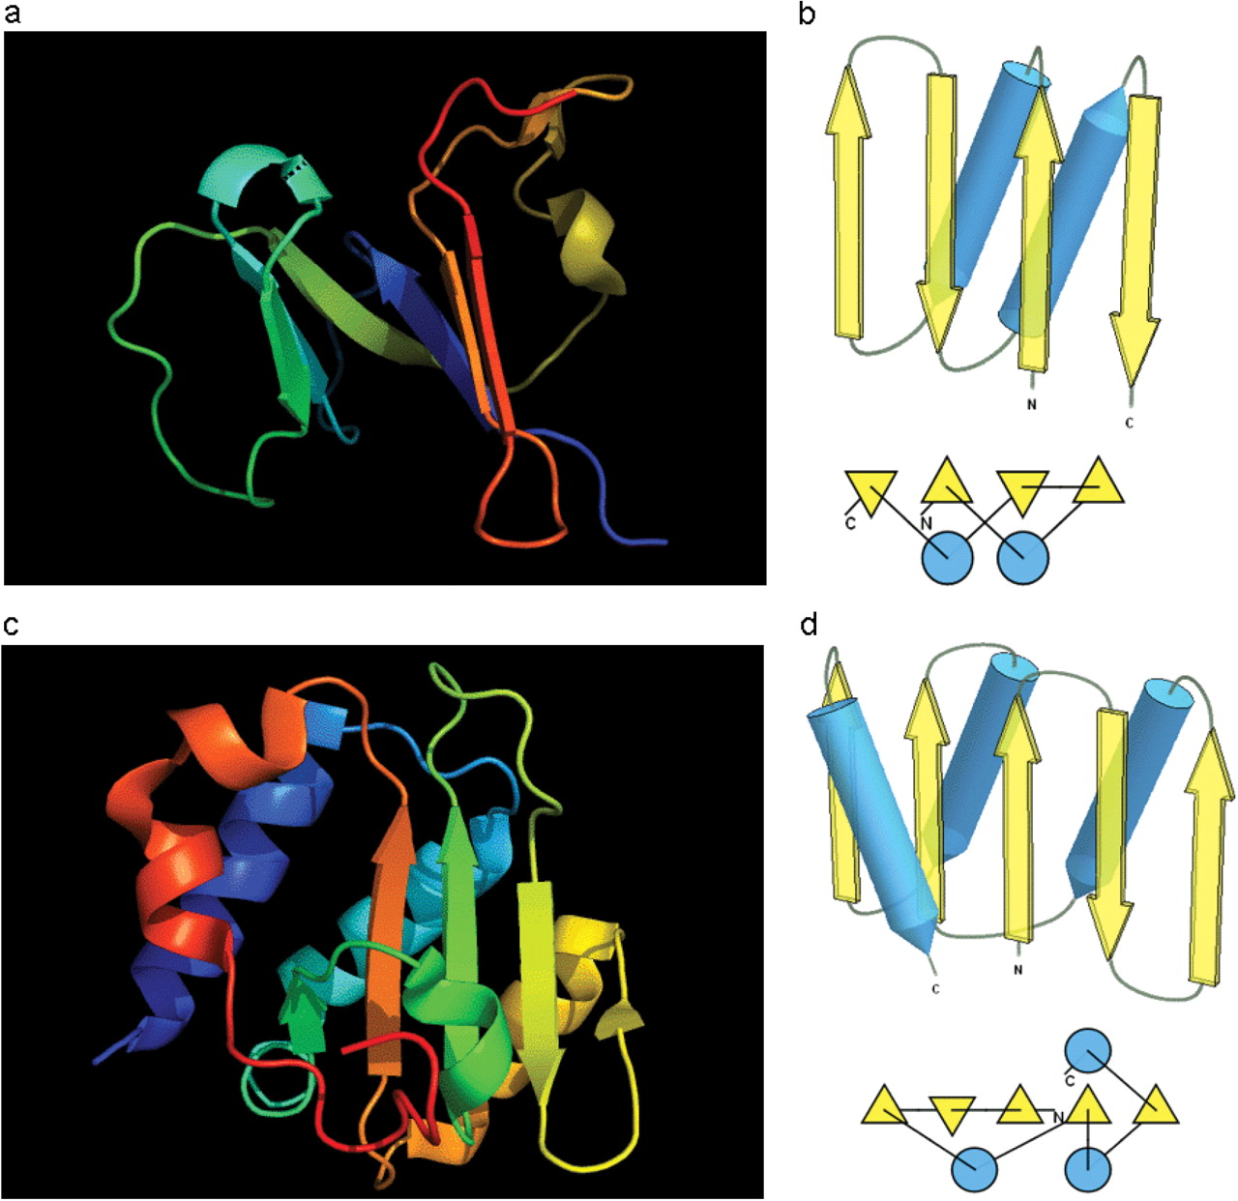
Figure 7. (a) Cartoon diagram of N-terminal domain of T0397: 3d4r chain A residues 7–82. (b) Structure and topology ...
Notes:
Figure 7. (a) Cartoon diagram of N-terminal domain of T0397: 3d4r chain A residues 7–82. (b) Structure and topology diagrams of ferredoxin fold–fold closest to T0397 N-terminal domain. (c) Ribbon diagram of N-terminal domain of T0496: 3d09 chain A, residues 4–126. (d) Structure and topology diagrams of RNAseH fold–fold closest to T0496 N domain.
Unless provided in the caption above, the following copyright applies to the content of this slide: © 2009 The Author(s).This is Open Access article distributed under the terms of the Creative Commons Attribution Non-Commercial License (http://creativecommons.org/licenses/by-nc/2.0/uk/) which permits unrestricted non-commercial use, distribution, and reproduction in any medium, provided the original work is properly cited.

