Slide 1
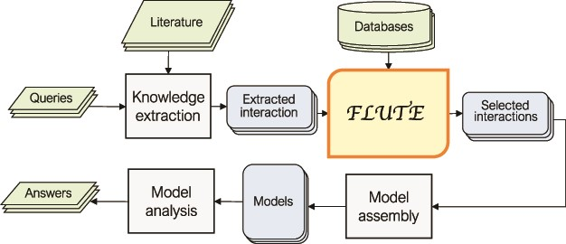
Figure 1 An outline of the role of FLUTE in the automated information extraction and the model assembly and analysis ...
Notes:
Figure 1 An outline of the role of FLUTE in the automated information extraction and the model assembly and analysis flow: FLUTE uses available databases to filter extracted interactions obtained as output of knowledge extraction process from available literature, which is usually initiated by user queries. The selected interactions from FLUTE are inputs to model assembly that creates models, which are then explored with model analysis in order to provide answers to user questions.
Unless provided in the caption above, the following copyright applies to the content of this slide: © The Author(s) 2020. Published by Oxford University Press.This is an Open Access article distributed under the terms of the Creative Commons Attribution License (http://creativecommons.org/licenses/by/4.0/), which permits unrestricted reuse, distribution, and reproduction in any medium, provided the original work is properly cited.

