Slide 1
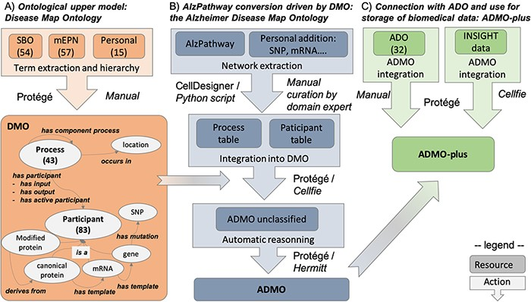
Figure 1. Summary of the workflow for AlzPathway conversion in OWL, from the DMO design to ADO instantiation and data ...
Notes:
Figure 1. Summary of the workflow for AlzPathway conversion in OWL, from the DMO design to ADO instantiation and data integration. (A) DMO design. (B) AlzPathway export into a structured table and its integration with DMO, resulting in ADMO. (C) Integration of ADO and biomedical experiment data resulting in ADMO-plus. This is not a pipeline, but a step-by-step process, in which manual and automatic steps are specified. Specifically, for each step, we indicate whether it was done manually (Manual) or mention which tool was used to do it automatically (Protégé, Cell designer, Python script, Cellfie, Hermitt).
Unless provided in the caption above, the following copyright applies to the content of this slide: © The Author(s) 2021. Published by Oxford University Press. All rights reserved. For permissions, please e-mail: journals.permissions@oup.comThis article is published and distributed under the terms of the Oxford University Press, Standard Journals Publication Model (https://academic.oup.com/journals/pages/open_access/funder_policies/chorus/standard_publication_model)

