Slide 1
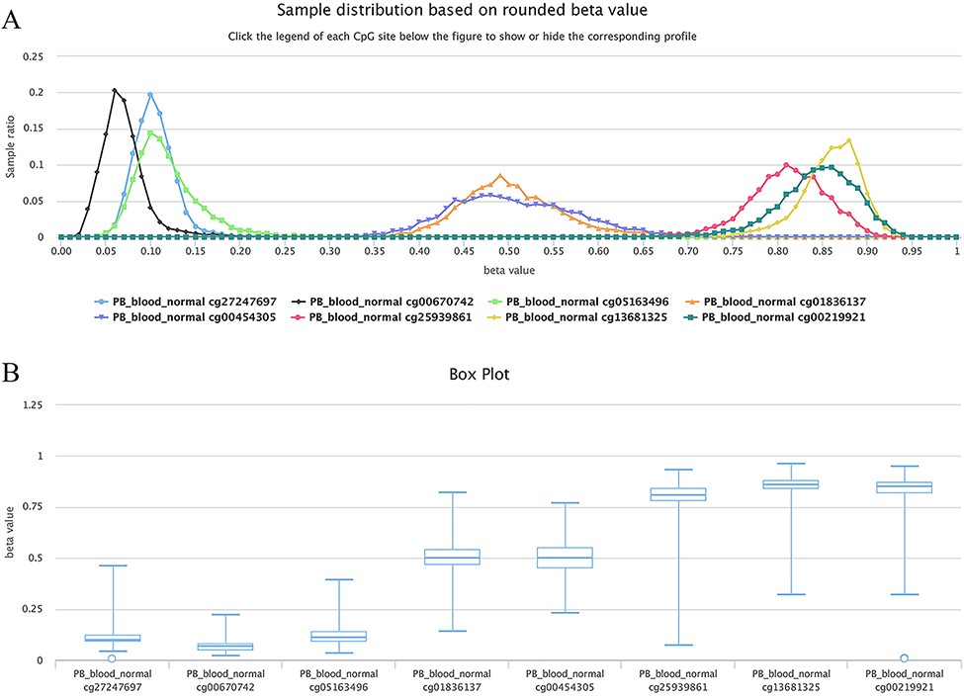
Figure 6. Examples showing methylation sites with differential methylation tendencies. (A) Methylation profiles showing ...
Notes:
Figure 6. Examples showing methylation sites with differential methylation tendencies. (A) Methylation profiles showing differential methylation tendencies. (B) Box plots showing differential methylation tendencies of the same sites in Figure A. Datasets are from the 450k platform.
Unless provided in the caption above, the following copyright applies to the content of this slide: © The Author(s) 2022. Published by Oxford University Press.This is an Open Access article distributed under the terms of the Creative Commons Attribution License (https://creativecommons.org/licenses/by/4.0/), which permits unrestricted reuse, distribution, and reproduction in any medium, provided the original work is properly cited.

