Slide 1
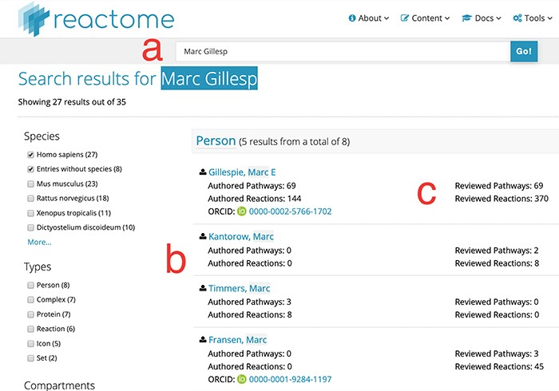
Figure 1 Search results for partial author name ‘Marc Gillesp’. Direct access URL ...
Notes:
Figure 1 Search results for partial author name ‘Marc Gillesp’. Direct access URL https://reactome.org/content/query?q=Marc+Gillesp&species=Homo+sapiens&species=Entries+without+species&cluster=true, accessed 2019/08/15. Within the figure, label ‘a’ marks the mis-spelt contributor name, label ‘b’ marks the list of other contributor names matching the search terms and label ‘c’ marks the fine-grained ‘contribution matrix’, distinguishing between pathways and reactions in one dimension and authoring/reviewing in the other dimension.
Unless provided in the caption above, the following copyright applies to the content of this slide: © The Author(s) 2019. Published by Oxford University Press.This is an Open Access article distributed under the terms of the Creative Commons Attribution License (http://creativecommons.org/licenses/by/4.0/), which permits unrestricted reuse, distribution, and reproduction in any medium, provided the original work is properly cited.

Slide 2
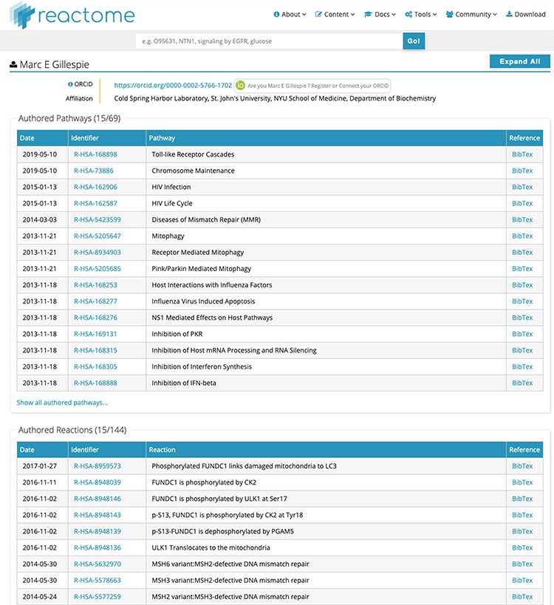
Figure 2 Detailed list of contributions for ‘Marc E Gillespie’. Unique identifiers in the ‘Identifier’ column directly ...
Notes:
Figure 2 Detailed list of contributions for ‘Marc E Gillespie’. Unique identifiers in the ‘Identifier’ column directly link to the relevant pathway/reaction. BibTex records can be downloaded for each data object if desired. After ORCID authentication at the top of the page, all contributions can be claimed to the contributor’s ORCID record with a single click, or individual data object can be claimed for finer granularity.
Unless provided in the caption above, the following copyright applies to the content of this slide: © The Author(s) 2019. Published by Oxford University Press.This is an Open Access article distributed under the terms of the Creative Commons Attribution License (http://creativecommons.org/licenses/by/4.0/), which permits unrestricted reuse, distribution, and reproduction in any medium, provided the original work is properly cited.

Slide 3
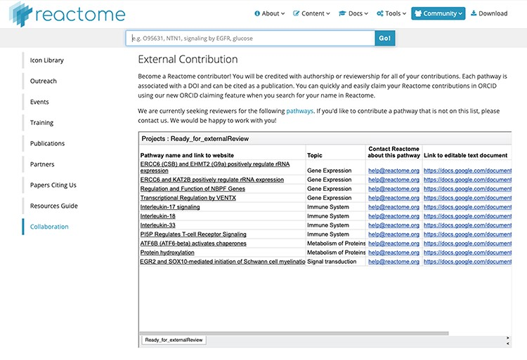
Figure 3 Reactome ‘External Contribution’ page. Direct access URL https://reactome.org/community/collaboration, ...
Notes:
Figure 3 Reactome ‘External Contribution’ page. Direct access URL https://reactome.org/community/collaboration, accessed 2019/08/15. This page lists pathways which have passed internal validation, and for which we are eager to find an external reviewer. The links in the leftmost column show the preliminary pathway in the Reactome ‘reviewer view’, which is slightly simpler than the final web view. The links in the rightmost column lead to text documents which can be copied for local editing. We would like to encourage any domain experts to contribute to the correct representation of ‘their’ pathways by contributing to these pending reviews.
Unless provided in the caption above, the following copyright applies to the content of this slide: © The Author(s) 2019. Published by Oxford University Press.This is an Open Access article distributed under the terms of the Creative Commons Attribution License (http://creativecommons.org/licenses/by/4.0/), which permits unrestricted reuse, distribution, and reproduction in any medium, provided the original work is properly cited.

