Slide 1
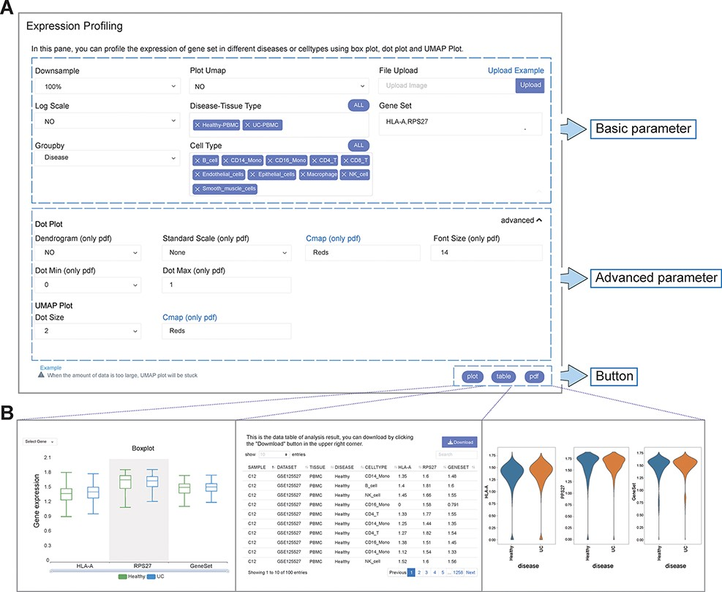
Figure 2. User-defined platform for functional analyses and output of analysis results. (A) The user-defined platform ...
Notes:
Figure 2. User-defined platform for functional analyses and output of analysis results. (A) The user-defined platform consists of three parts: basic parameters, advanced parameters and a button. The basic parameters include the parameters necessary for analysis, and the advanced parameters include several optional parameters. There are three buttons, corresponding to three types of results. (B) The ‘plot’ button returns the interactive analysis interface (left). The ‘table’ button returns the data table of the analysis results (middle). The ‘pdf’ button returns the PDF graph generated by the analysis results (right).
Unless provided in the caption above, the following copyright applies to the content of this slide: © The Author(s) 2022. Published by Oxford University Press.This is an Open Access article distributed under the terms of the Creative Commons Attribution-NonCommercial License (https://creativecommons.org/licenses/by-nc/4.0/), which permits non-commercial re-use, distribution, and reproduction in any medium, provided the original work is properly cited. For commercial re-use, please contact journals.permissions@oup.com

