Slide 1
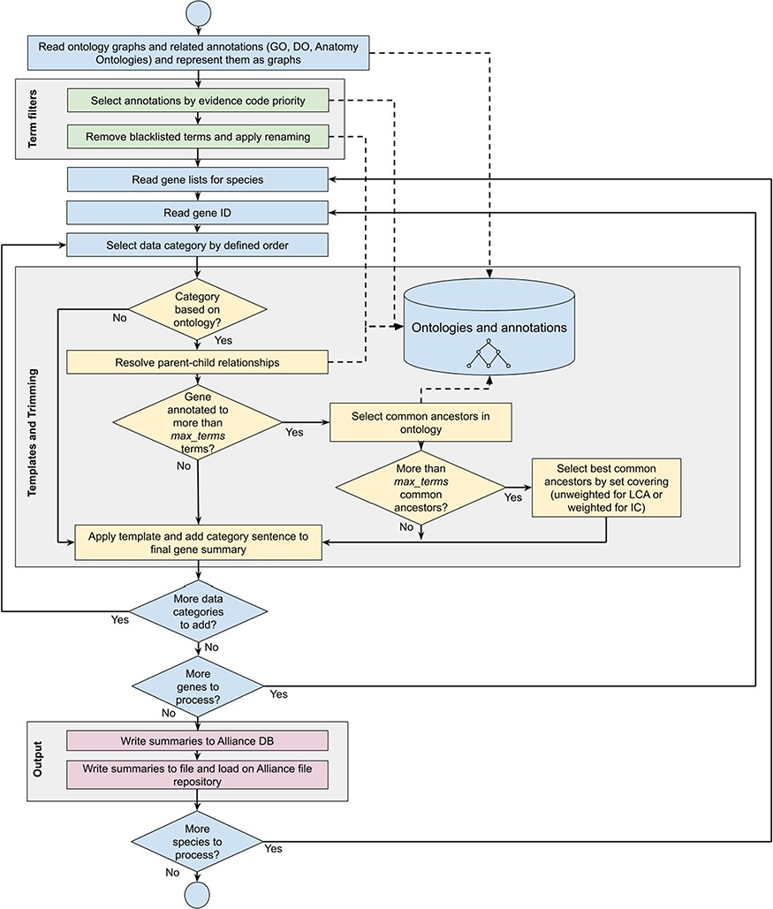
Figure 1 Workflow diagram of the gene summary generation process at the Alliance of Genome Resources. Solid arrows ...
Notes:
Figure 1 Workflow diagram of the gene summary generation process at the Alliance of Genome Resources. Solid arrows represent sequential steps followed by the software to generate the summaries, whereas dashed arrows represent data flow from/to the algorithm to data stores. Ontologies and annotations are loaded and represented as graphs. Then, term filters and renaming are applied to the annotations and to the ontology graphs. For each gene, basic information such as gene ID, name and additional information such as orthology data are fetched. The list of terms associated with the gene is extracted from the Alliance database and sentences are generated according to the templates defined for each data category. If the list of terms exceeds the defined maximum number, the trimming algorithm reduces the length of the sentence by traversing the related ontology graph and by selecting the common ancestors that best group the initial set of terms. Ontology graphs are also used to resolve parent–child relationships to avoid including both parent and child terms in the final summaries. The final summaries are generated by concatenating the data category specific sentences and are written to the Alliance database and to the download files available on the Alliance website.
Unless provided in the caption above, the following copyright applies to the content of this slide: © The Author(s) 2020. Published by Oxford University Press.This is an Open Access article distributed under the terms of the Creative Commons Attribution License (http://creativecommons.org/licenses/by/4.0/), which permits unrestricted reuse, distribution, and reproduction in any medium, provided the original work is properly cited.

