Slide 1
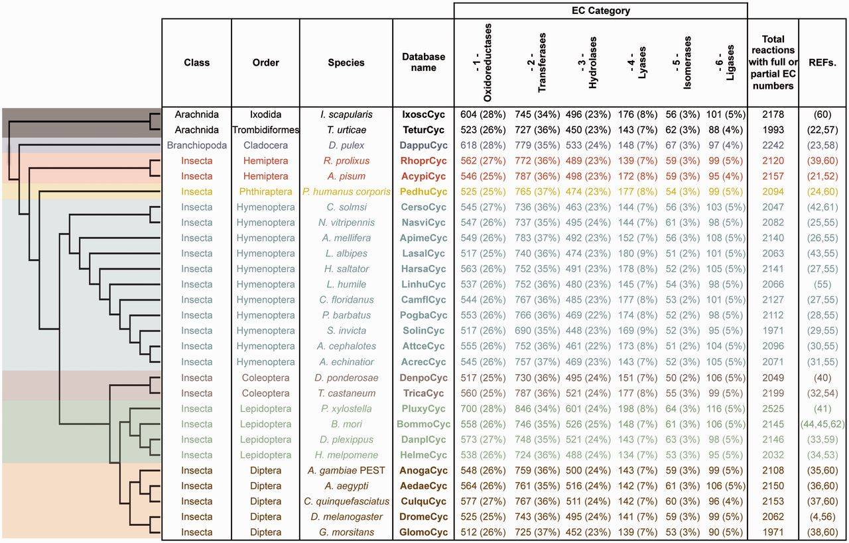
Figure 1. ArthropodaCyc databases list and summary. This table shows the distribution of reactions in the Cyc databases ...
Notes:
Figure 1. ArthropodaCyc databases list and summary. This table shows the distribution of reactions in the Cyc databases across the six top-level categories identified by the Enzyme Commission (E.C.). Included in this table are all reactions in each database which have been assigned either full or partial E.C. numbers, and for which an enzyme has been identified (these statistics do not include pathway holes). Phylogenetic relationships between species are displayed using a cladogram based on available data (46–50).
Unless provided in the caption above, the following copyright applies to the content of this slide: © The Author(s) 2016. Published by Oxford University Press.This is an Open Access article distributed under the terms of the Creative Commons Attribution License (http://creativecommons.org/licenses/by/4.0/), which permits unrestricted reuse, distribution, and reproduction in any medium, provided the original work is properly cited.

