Slide 1
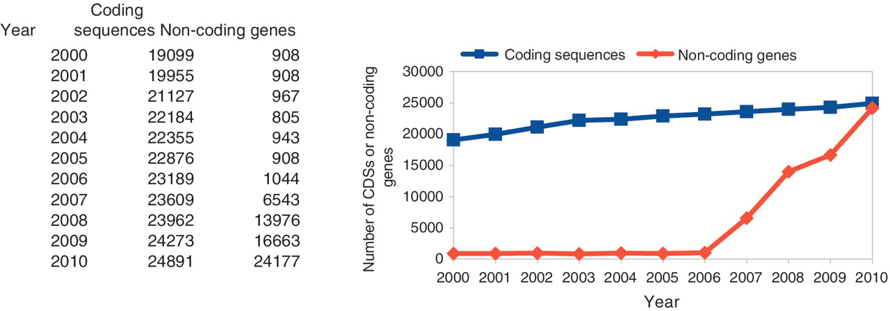
Figure 1. The number of curated CDSs and non-coding genes in C. elegans.
Notes:
Figure 1. The number of curated CDSs and non-coding genes in C. elegans.
Unless provided in the caption above, the following copyright applies to the content of this slide: © The Author(s) 2011. Published by Oxford University Press.This is Open Access article distributed under the terms of the Creative Commons Attribution Non-Commercial License (http://creativecommons.org/licenses/by-nc/2.5), which permits unrestricted non-commercial use, distribution, and reproduction in any medium, provided the original work is properly cited.

Slide 2
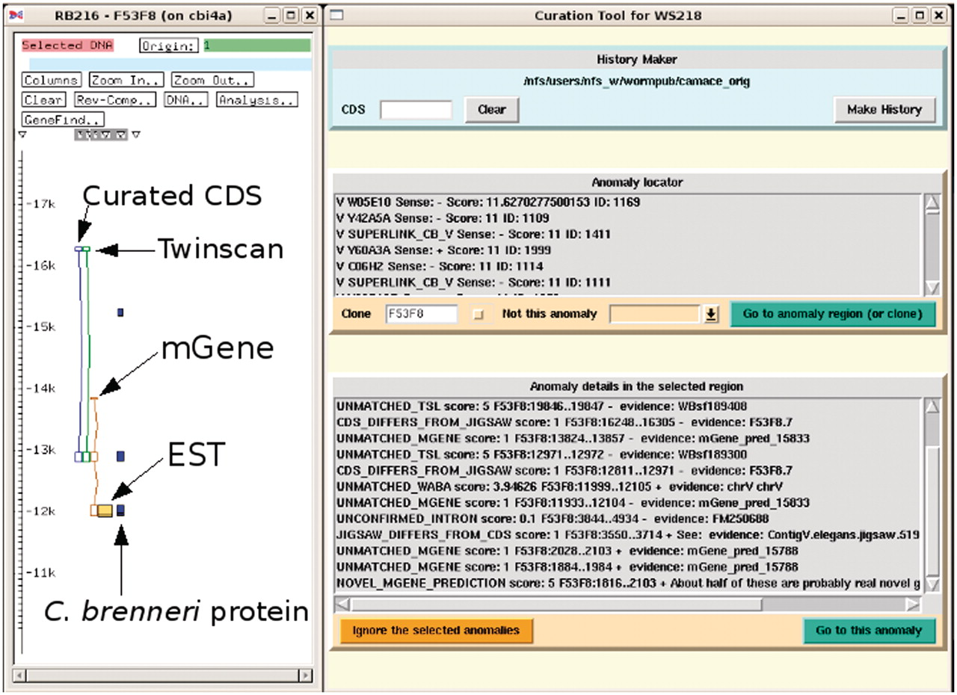
Figure 2. Screenshot of the curation system (to the right) in action with the ACeDB FMAP editor (to the left) ...
Notes:
Figure 2. Screenshot of the curation system (to the right) in action with the ACeDB FMAP editor (to the left) displaying a simplified and annotated view of a typical anomaly of a curated CDS structure together with the structures predicted by Twinscan and mGene. There is evidence from the mGene prediction, EST alignment and a weak C. brenneri protein homology for an extra exon at the 3′-end. The curation system has been set to find all the anomalies in the clone F53F8 and some of these can be seen in the list at the bottom. Many of these anomalies are currently outside of the current FMAP view, which is centred around the CDS F53F8.7.
Unless provided in the caption above, the following copyright applies to the content of this slide: © The Author(s) 2011. Published by Oxford University Press.This is Open Access article distributed under the terms of the Creative Commons Attribution Non-Commercial License (http://creativecommons.org/licenses/by-nc/2.5), which permits unrestricted non-commercial use, distribution, and reproduction in any medium, provided the original work is properly cited.

Slide 3
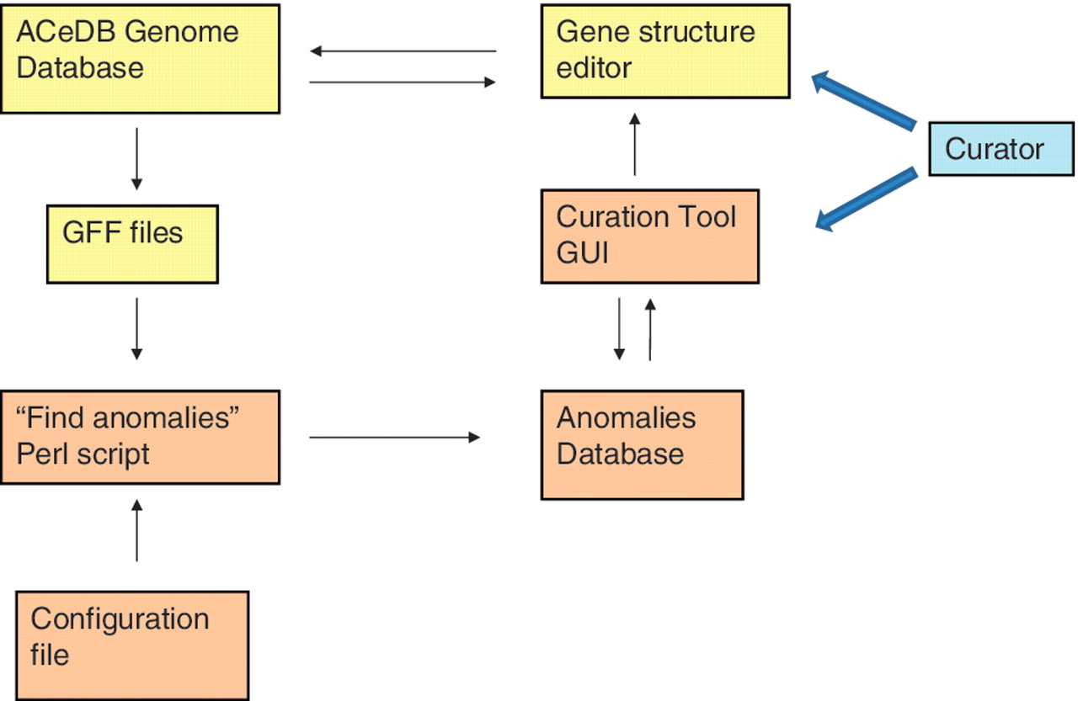
Figure 3. Relationships of the various components of the curation tool and the genome database. The components of the ...
Notes:
Figure 3. Relationships of the various components of the curation tool and the genome database. The components of the ACeDB database are shown in yellow and the components of the curation tool are shown in brown. The curator interacts with both the curation tool GUI to find regions with anomalies and the ACeDB FMAP genome editor to correct those regions.
Unless provided in the caption above, the following copyright applies to the content of this slide: © The Author(s) 2011. Published by Oxford University Press.This is Open Access article distributed under the terms of the Creative Commons Attribution Non-Commercial License (http://creativecommons.org/licenses/by-nc/2.5), which permits unrestricted non-commercial use, distribution, and reproduction in any medium, provided the original work is properly cited.

Slide 4
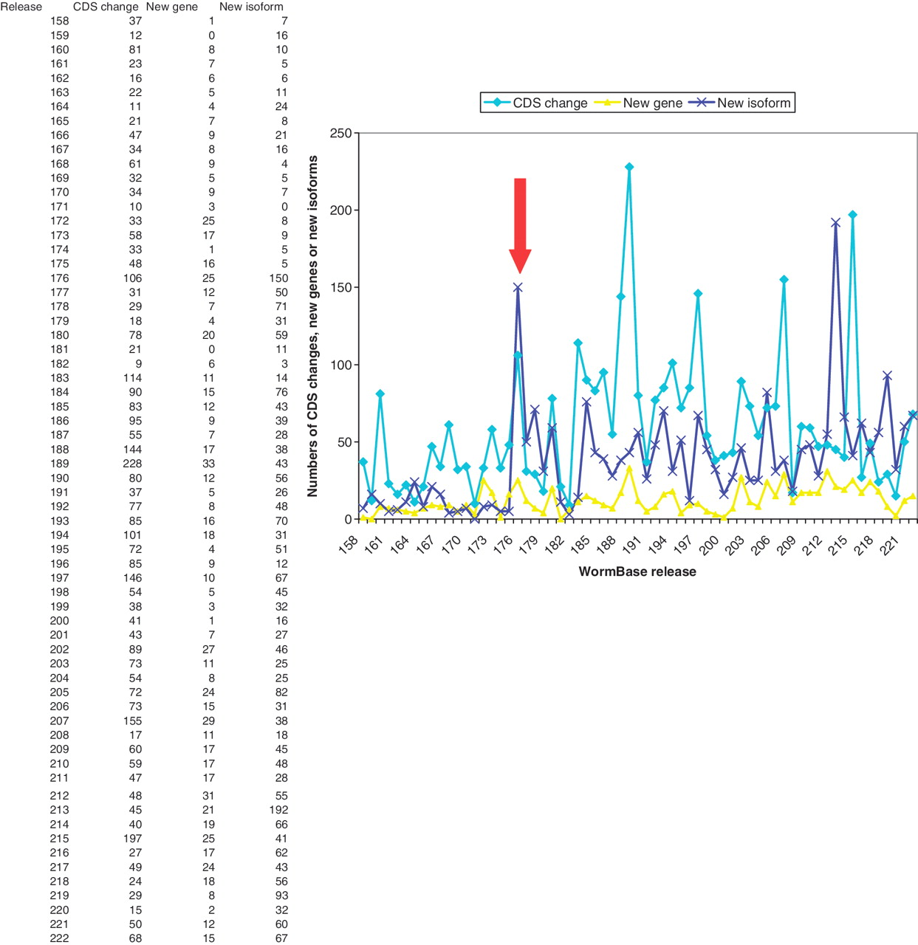
Figure 4. Numbers of changes to CDS structures, new protein-coding genes and new isoforms created in each WormBase ...
Notes:
Figure 4. Numbers of changes to CDS structures, new protein-coding genes and new isoforms created in each WormBase release, showing a marked rise in curation activity from release 176 (marked by the arrow) onwards.
Unless provided in the caption above, the following copyright applies to the content of this slide: © The Author(s) 2011. Published by Oxford University Press.This is Open Access article distributed under the terms of the Creative Commons Attribution Non-Commercial License (http://creativecommons.org/licenses/by-nc/2.5), which permits unrestricted non-commercial use, distribution, and reproduction in any medium, provided the original work is properly cited.

