Slide 1
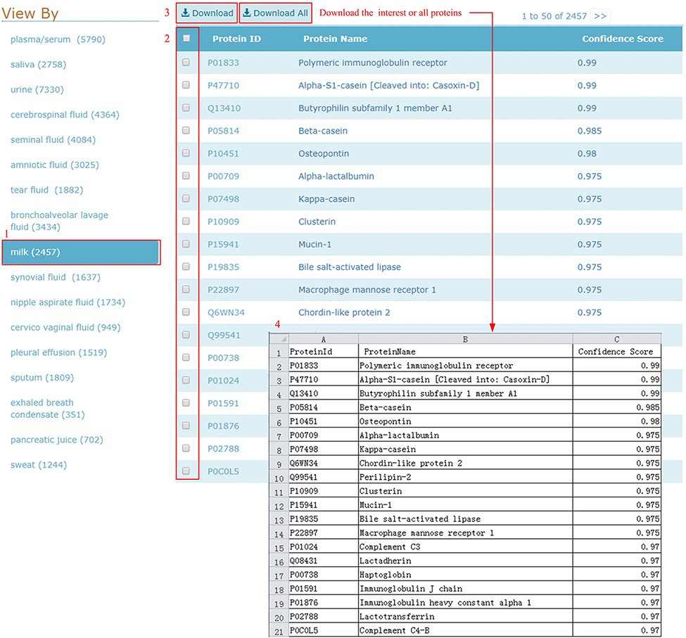
Figure 5. Download illustration where user can choose the body fluid name and download the proteins of interest or all ...
Notes:
Figure 5. Download illustration where user can choose the body fluid name and download the proteins of interest or all proteins.
Unless provided in the caption above, the following copyright applies to the content of this slide: © The Author(s) 2021. Published by Oxford University Press.This is an Open Access article distributed under the terms of the Creative Commons Attribution License (https://creativecommons.org/licenses/by/4.0/), which permits unrestricted reuse, distribution, and reproduction in any medium, provided the original work is properly cited.

