Slide 1
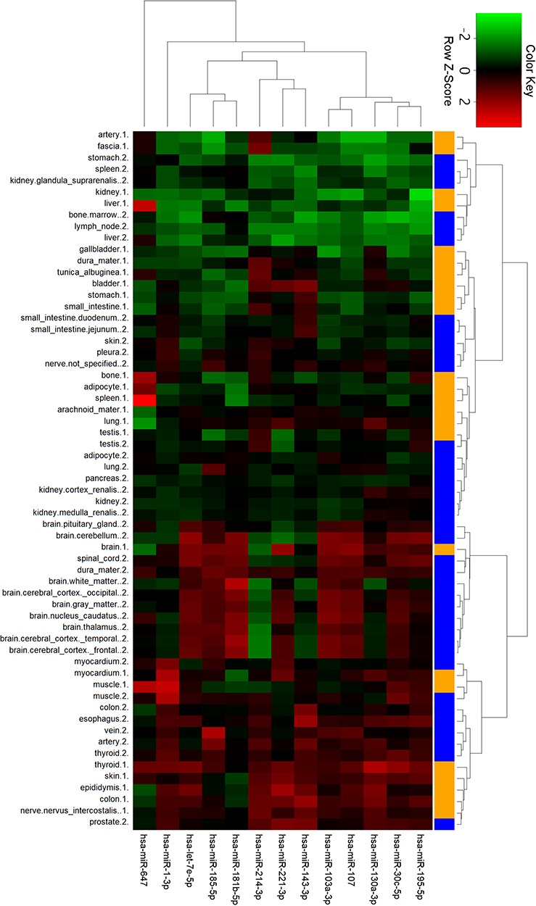
Figure 6 Cluster analysis of miRNA tissue expression profiles in ternary network. The orange and blue codes on the ...
Notes:
Figure 6 Cluster analysis of miRNA tissue expression profiles in ternary network. The orange and blue codes on the right side represent the tissue samples from two male bodies, i.e., a patient with myeloma and a male under a natural death.
Unless provided in the caption above, the following copyright applies to the content of this slide: © The Author(s) 2020. Published by Oxford University Press.This is an Open Access article distributed under the terms of the Creative Commons Attribution License (http://creativecommons.org/licenses/by/4.0/), which permits unrestricted reuse, distribution, and reproduction in any medium, provided the original work is properly cited.

