Slide 1
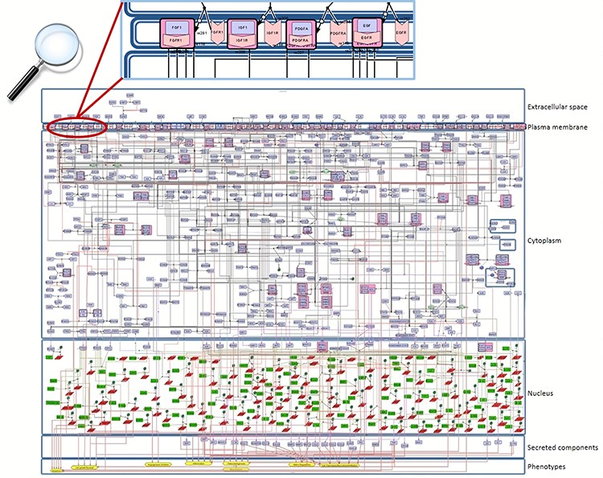
Figure 2 Snapshot of the SBGN-compliant RA map. The map is colour-coded with proteins in purple, genes in green, RNAs ...
Notes:
Figure 2 Snapshot of the SBGN-compliant RA map. The map is colour-coded with proteins in purple, genes in green, RNAs in red and phenotypes in yellow. State transitions and catalysis reactions are displayed in black, and the inhibitions are in red. Compartments are distinguished as bounding boxes. The map was built using CellDesigner, version 4.4 (18). Modifications to the SBGN format: translation arcs are used to keep the representation compact, as well as the gene and RNA shapes.
Unless provided in the caption above, the following copyright applies to the content of this slide: © The Author(s) 2020. Published by Oxford University Press.This is an Open Access article distributed under the terms of the Creative Commons Attribution License (http://creativecommons.org/licenses/by/4.0/), which permits unrestricted reuse, distribution, and reproduction in any medium, provided the original work is properly cited.

