Slide 1
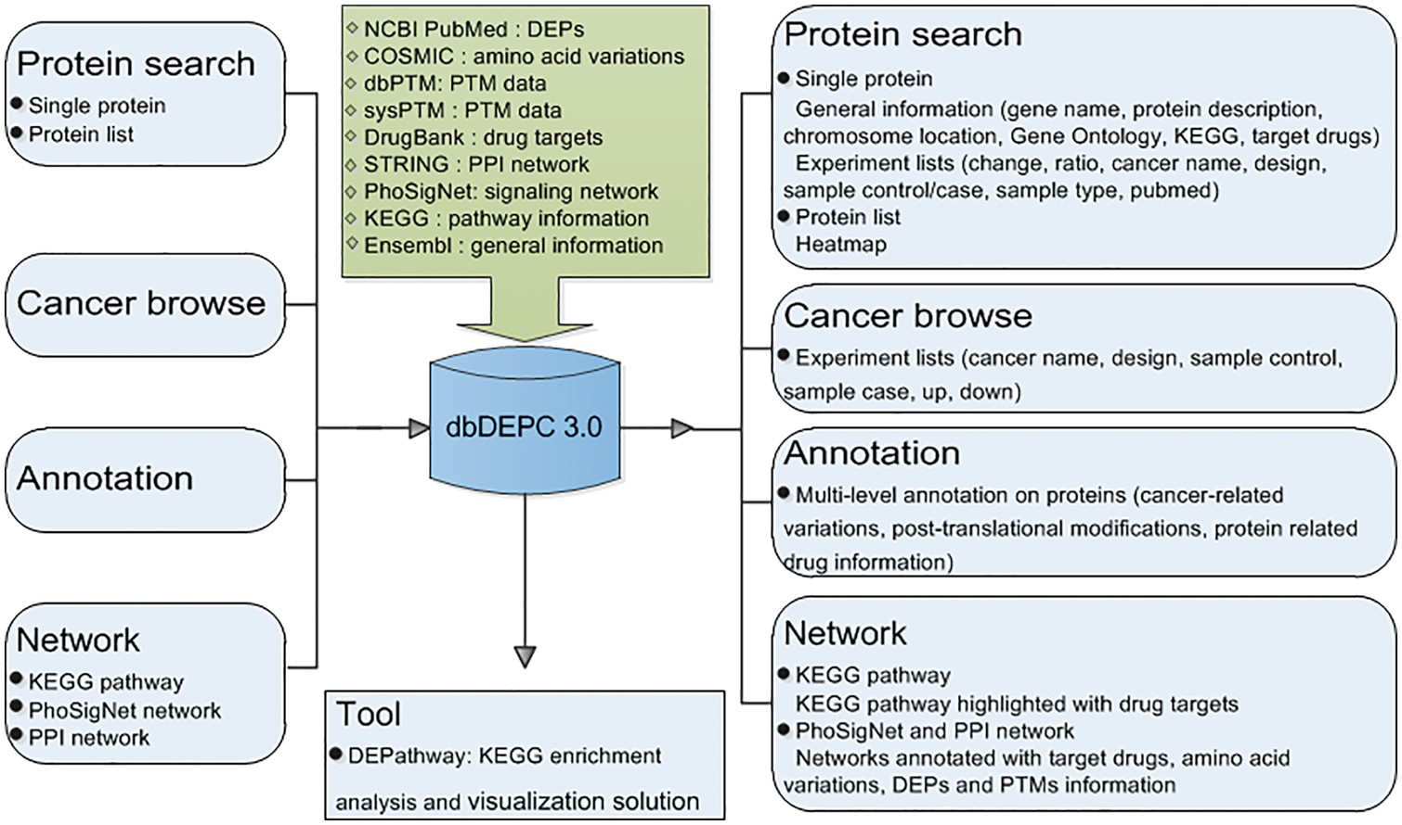
Figure 1. Overview of database construction. Query methods and corresponding output information are demonstrated.
Notes:
Figure 1. Overview of database construction. Query methods and corresponding output information are demonstrated.
Unless provided in the caption above, the following copyright applies to the content of this slide: © The Author(s) 2018. Published by Oxford University Press.This is an Open Access article distributed under the terms of the Creative Commons Attribution License (http://creativecommons.org/licenses/by/4.0/), which permits unrestricted reuse, distribution, and reproduction in any medium, provided the original work is properly cited.

Slide 2
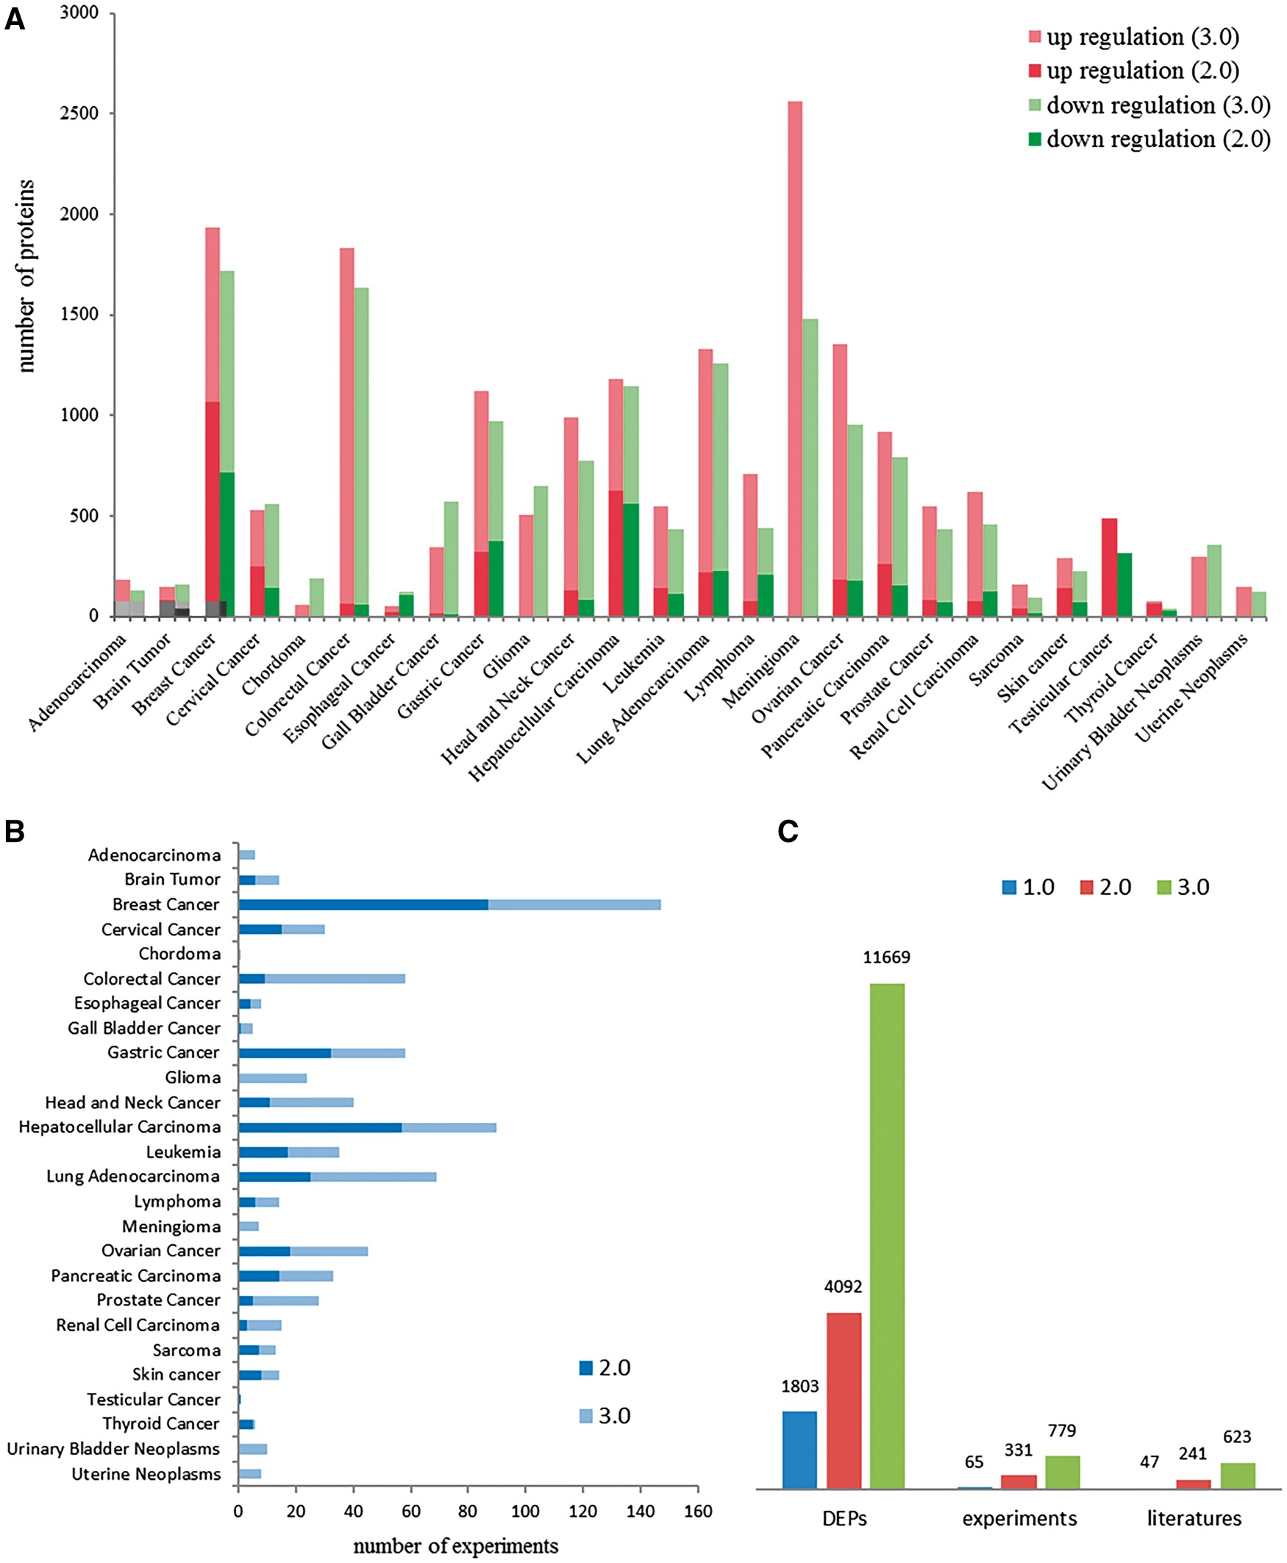
Figure 2. Data contents in dbDEPC 3.0. (A) The distribution of DEPs in each cancer in version 2.0 and 3.0. (B) Number ...
Notes:
Figure 2. Data contents in dbDEPC 3.0. (A) The distribution of DEPs in each cancer in version 2.0 and 3.0. (B) Number of experiments in each cancer. (C) Number of DEPs, MS experiments and related literatures in three version of dbDEPC.
Unless provided in the caption above, the following copyright applies to the content of this slide: © The Author(s) 2018. Published by Oxford University Press.This is an Open Access article distributed under the terms of the Creative Commons Attribution License (http://creativecommons.org/licenses/by/4.0/), which permits unrestricted reuse, distribution, and reproduction in any medium, provided the original work is properly cited.

Slide 3
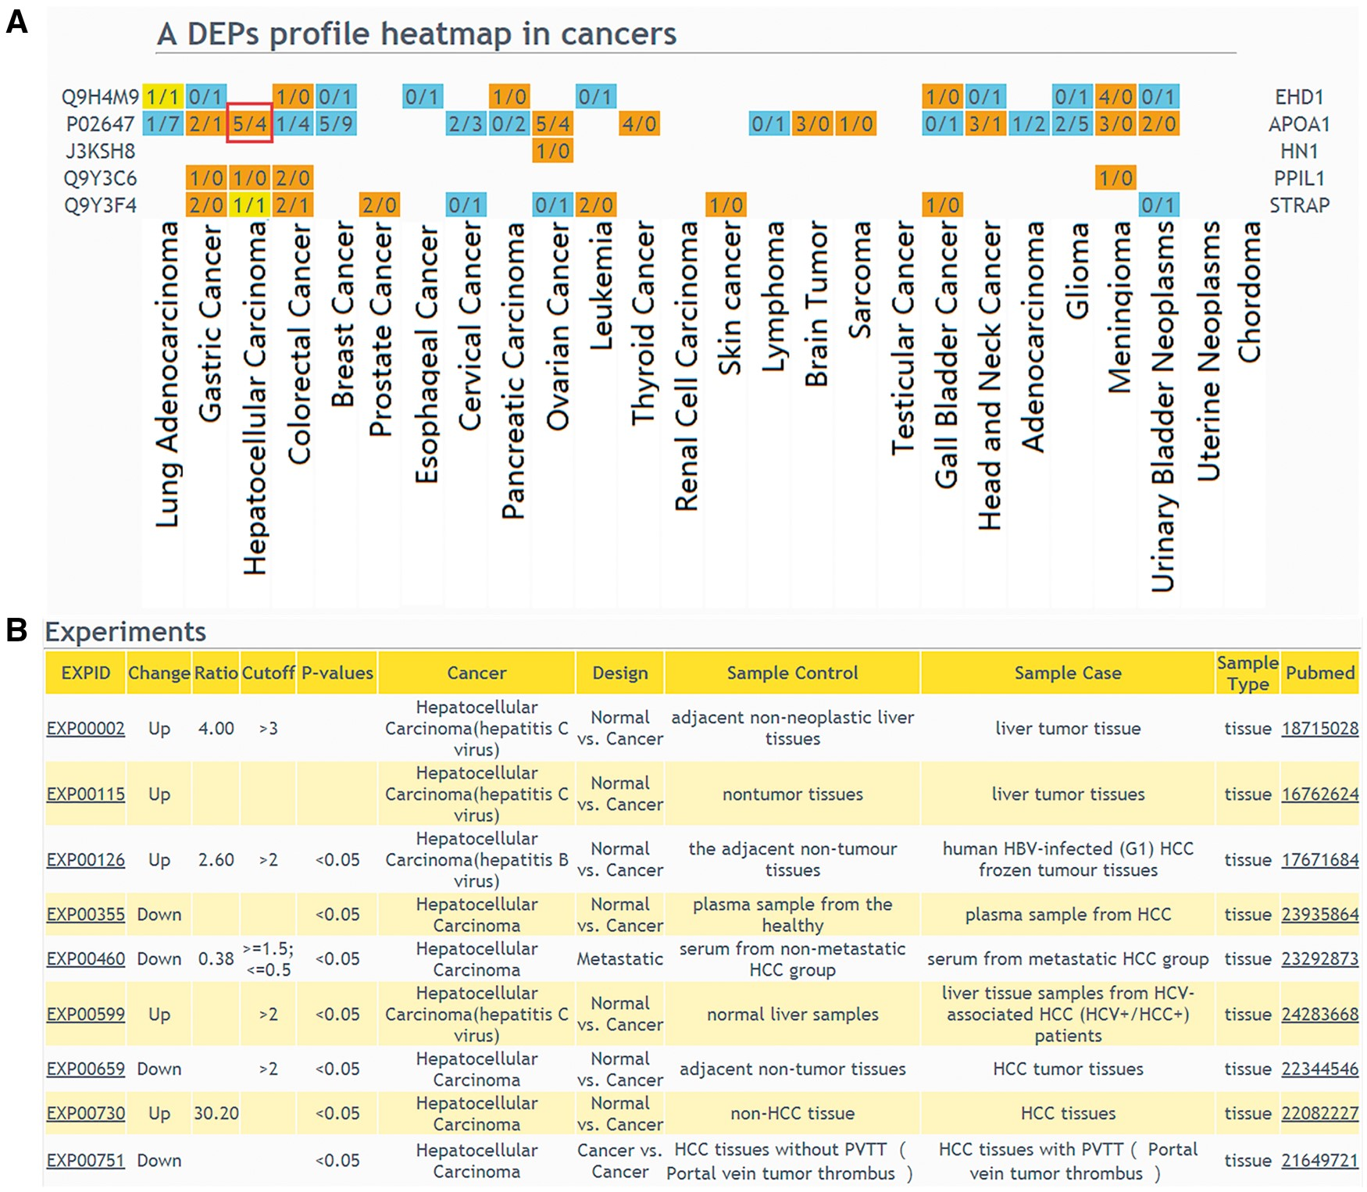
Figure 3. The result of ‘protein list’ query. (A) Users should select a design type of interested experiments first, ...
Notes:
Figure 3. The result of ‘protein list’ query. (A) Users should select a design type of interested experiments first, input protein IDs or names and then select cancers to draw a DEPs profile heatmap in cancers. If a queried protein is a DEP, the table cell will be displayed in color. Orange means that the experiments number identified this protein as up-regulated is more than the experiments number identified protein as down-regulated; blue means that the experiments number identified this protein as up-regulated is less than the experiments number identified protein as down-regulated; yellow means that the experiments number identified the protein as up-regulated is equal to the experiments number identified protein as down-regulated. (B) If the number of experiments in a specific cancer type is clicked, the detailed information of these DEPs can be displayed.
Unless provided in the caption above, the following copyright applies to the content of this slide: © The Author(s) 2018. Published by Oxford University Press.This is an Open Access article distributed under the terms of the Creative Commons Attribution License (http://creativecommons.org/licenses/by/4.0/), which permits unrestricted reuse, distribution, and reproduction in any medium, provided the original work is properly cited.

Slide 4
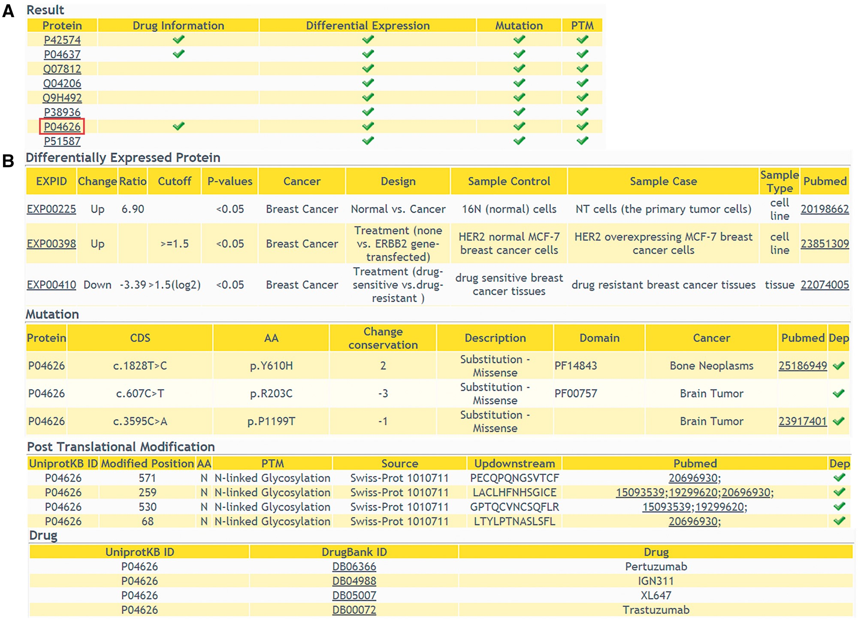
Figure 4. The returning page of ‘Annotations’ query way. (A) The status of multiple-level annotation is showed in a ...
Notes:
Figure 4. The returning page of ‘Annotations’ query way. (A) The status of multiple-level annotation is showed in a table. (B) The detailed information can be displayed with a further click.
Unless provided in the caption above, the following copyright applies to the content of this slide: © The Author(s) 2018. Published by Oxford University Press.This is an Open Access article distributed under the terms of the Creative Commons Attribution License (http://creativecommons.org/licenses/by/4.0/), which permits unrestricted reuse, distribution, and reproduction in any medium, provided the original work is properly cited.

Slide 5
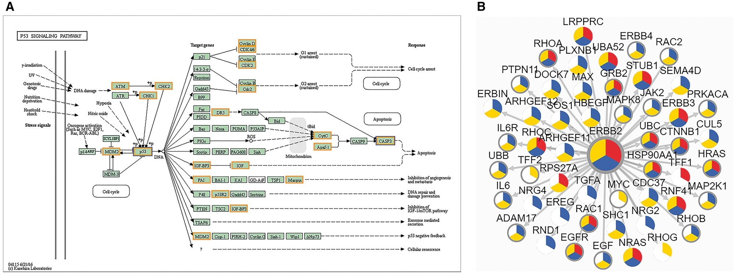
Figure 5. The result of ‘Networks’ query way. (A) The result of ‘KEGG Pathway’ query. Candidate proteins should be ...
Notes:
Figure 5. The result of ‘Networks’ query way. (A) The result of ‘KEGG Pathway’ query. Candidate proteins should be entered first and KEGG pathway ID should be selected. A colored KEGG pathway will be drawn with drug targets highlighted in the result. Orange means drug targets in our database, blue means the queried proteins. (B) The result of ‘PPI’ query. The page demonstrates association network of ERBB2 in Breast cancer with 900 score threshold of network edge and multi-level annotation of network node. Nodes are divided into three colored sectors. Red means the protein is differentially expressed. Blue means the protein is with variations. Yellow means the protein has PTMs. The gray edge means that this protein is a drug target.
Unless provided in the caption above, the following copyright applies to the content of this slide: © The Author(s) 2018. Published by Oxford University Press.This is an Open Access article distributed under the terms of the Creative Commons Attribution License (http://creativecommons.org/licenses/by/4.0/), which permits unrestricted reuse, distribution, and reproduction in any medium, provided the original work is properly cited.

Slide 6
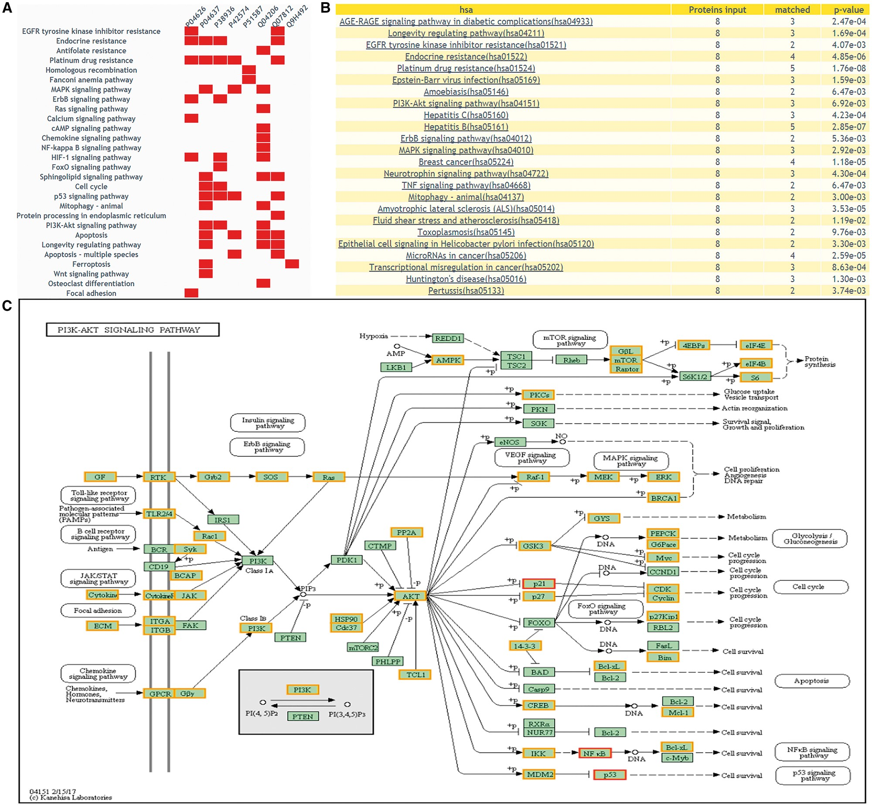
Figure 6. The returning page of enrichment analysis. (A) A heatmap is drawn showing the distribution of queried ...
Notes:
Figure 6. The returning page of enrichment analysis. (A) A heatmap is drawn showing the distribution of queried proteins in pathways. (B) The table lists those enriched pathways with a threshold of P-value <= 0.05. (C) DEPs on KEGG pathway maps. Blue means query proteins. Orange means the DEPs in our database and red means both DEPs and query proteins.
Unless provided in the caption above, the following copyright applies to the content of this slide: © The Author(s) 2018. Published by Oxford University Press.This is an Open Access article distributed under the terms of the Creative Commons Attribution License (http://creativecommons.org/licenses/by/4.0/), which permits unrestricted reuse, distribution, and reproduction in any medium, provided the original work is properly cited.

Slide 7
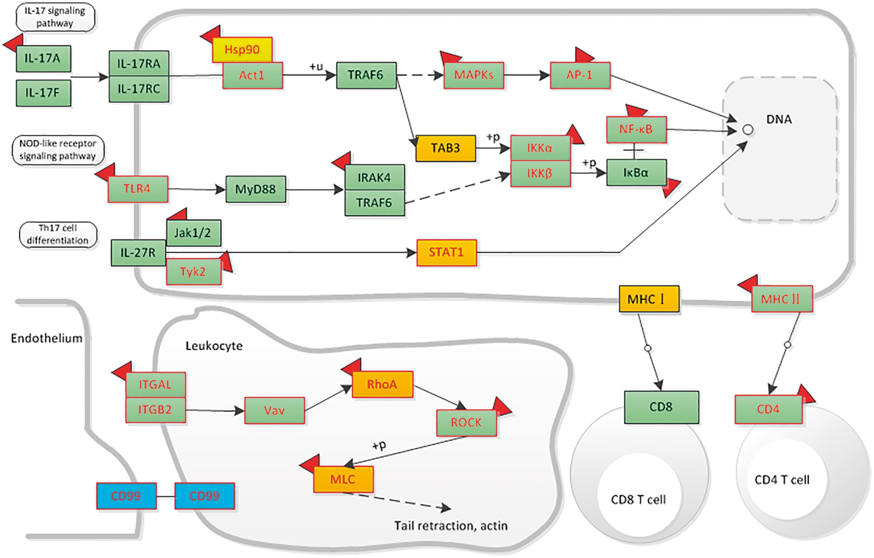
Figure 7. The distribution of liver-associated proteins in immune system related signaling networks. Orange means the ...
Notes:
Figure 7. The distribution of liver-associated proteins in immune system related signaling networks. Orange means the up-regulated protein, blue means the down-regulated protein. Protein with mutation information is colored by red frame. The drug targets are attached with a red symbol.
Unless provided in the caption above, the following copyright applies to the content of this slide: © The Author(s) 2018. Published by Oxford University Press.This is an Open Access article distributed under the terms of the Creative Commons Attribution License (http://creativecommons.org/licenses/by/4.0/), which permits unrestricted reuse, distribution, and reproduction in any medium, provided the original work is properly cited.

