Slide 1
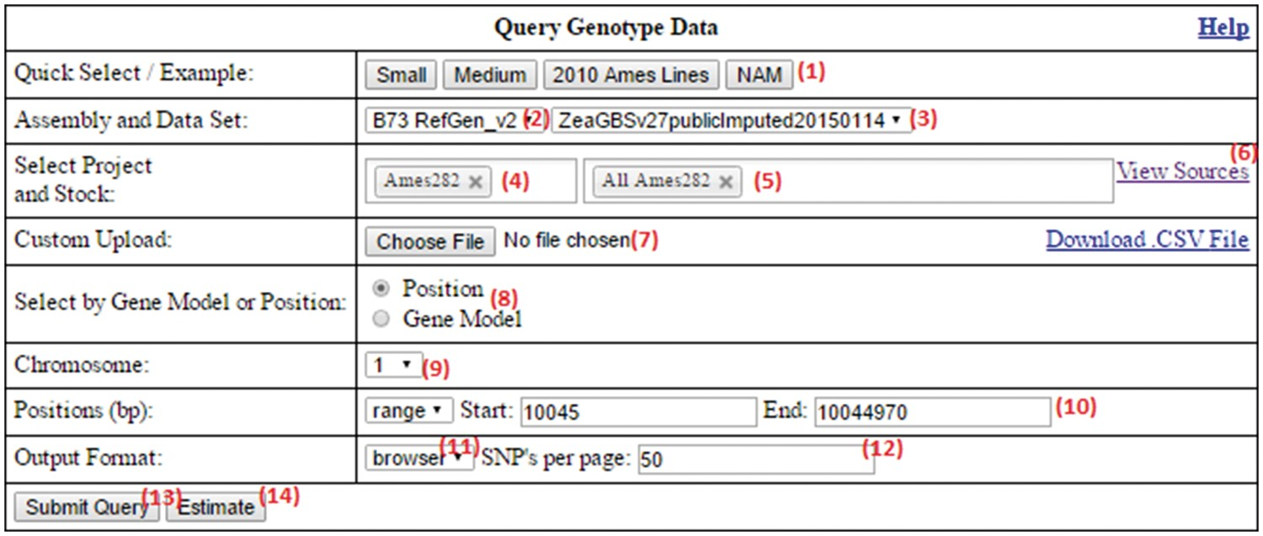
Figure 2. The SNPversity homepage form at MaizeGDB. The homepage contains many data and visualization options that ...
Notes:
Figure 2. The SNPversity homepage form at MaizeGDB. The homepage contains many data and visualization options that allow the user to reach the right data sets and display the desired information in the desired formats. Please see text for additional details.
Unless provided in the caption above, the following copyright applies to the content of this slide: Published by Oxford University Press 2018. This work is written by US Government employees and is in the public domain in the US.This article is published and distributed under the terms of the Oxford University Press, Standard Journals Publication Model (https://academic.oup.com/journals/pages/about_us/legal/notices)

