Slide 1
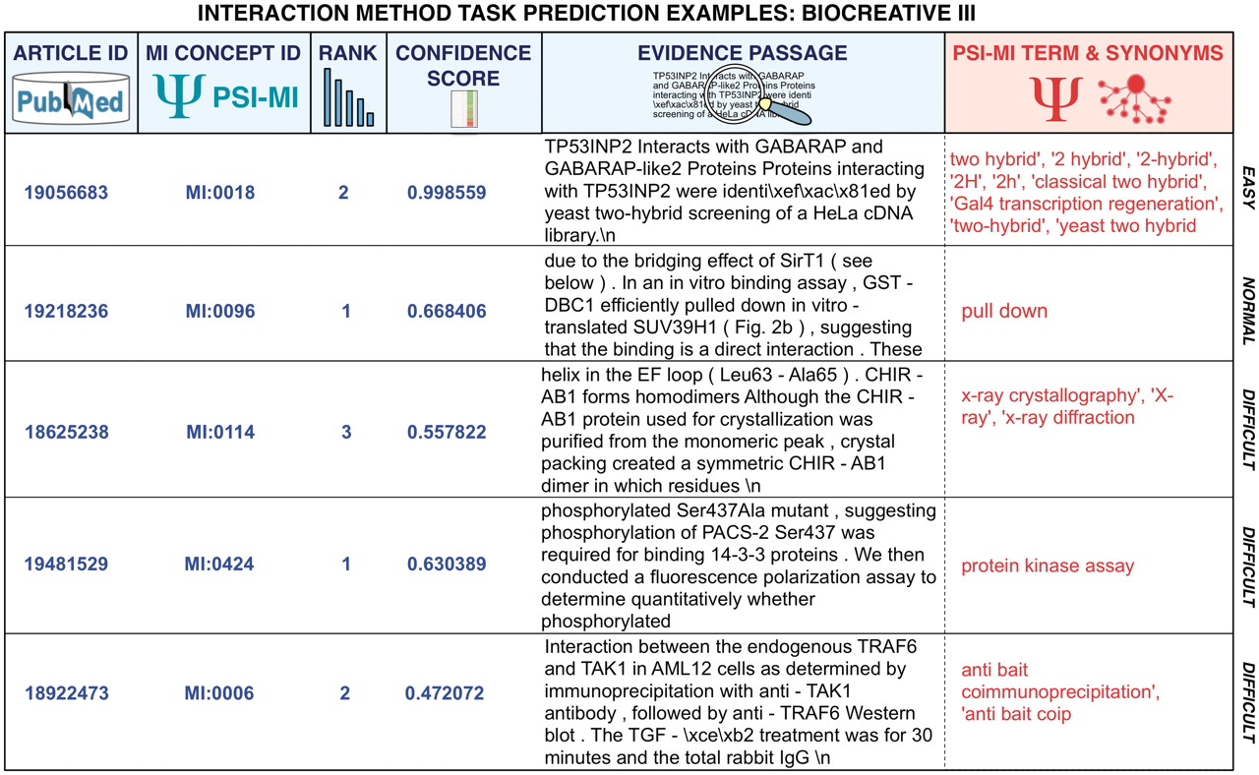
Figure 5. Representative predictions submitted for the MI task of BioCreative III of diverse degrees of difficulty for ...
Notes:
Figure 5. Representative predictions submitted for the MI task of BioCreative III of diverse degrees of difficulty for automated systems. The examples correspond to submissions from various teams. Participating teams had to return the article identifier, the concept identifier for the interaction detection method according to the MI ontology, a rank, a confidence score as well as a supporting text evidence passages extracted from the full-text article. Submissions were plain text files where each field was separated using a tabulator. This figure provides colored highlights of original predictions to better grasp the output. In red, the original term from the MI ontology and its synonyms have been added to facilitate the interpretation of the results. As can be seen some cases are rather straightforward, and could be detected by direct term lookup, while others require generating lexical variants or even more sophisticated machine learning and statistical word analysis.
Unless provided in the caption above, the following copyright applies to the content of this slide: © The Author(s) 2012. Published by Oxford University Press.This is an Open Access article distributed under the terms of the Creative Commons Attribution Non-Commercial License (http://creativecommons.org/licenses/by-nc/3.0), which permits unrestricted non-commercial use, distribution, and reproduction in any medium, provided the original work is properly cited.

