Slide 1
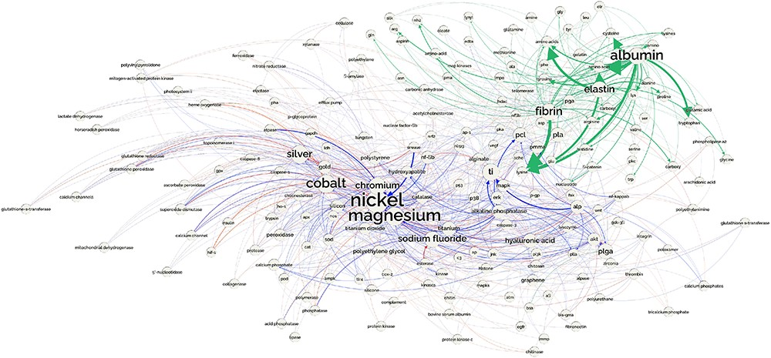
Figure 19. Network showing the part of the CEM–GPRO relations related to biomaterials extracted from the PubMed ...
Notes:
Figure 19. Network showing the part of the CEM–GPRO relations related to biomaterials extracted from the PubMed knowledge graph. part-of relations are shown in green, inhibitor in blue and activator in red.
Unless provided in the caption above, the following copyright applies to the content of this slide: © The Author(s) 2023. Published by Oxford University Press.This is an Open Access article distributed under the terms of the Creative Commons Attribution License (https://creativecommons.org/licenses/by/4.0/), which permits unrestricted reuse, distribution, and reproduction in any medium, provided the original work is properly cited.

