Slide 1
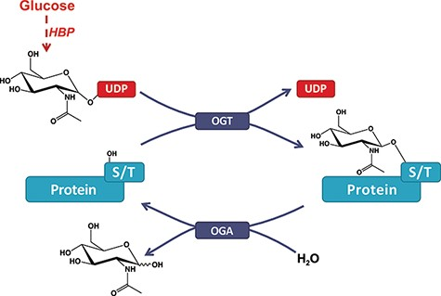
Figure 1. O-GlcNAcylation of proteins. A single β-N-acetyl-glucosamine residue is added by the O-GlcNAc transferase ...
Notes:
Figure 1. O-GlcNAcylation of proteins. A single β-N-acetyl-glucosamine residue is added by the O-GlcNAc transferase (OGT) and removed by the O-GlcNAcase (OGA). The hexosamine biosynthesis pathway drives the production of the O-GlcNAc nucleotide donor (e.g., UDP-GlcNAc) from glucose (Glc). Serine or threonine (S/T) is targeted for modification on intracellular proteins.
Unless provided in the caption above, the following copyright applies to the content of this slide: © The Author(s) 2021. Published by Oxford University Press.This is an Open Access article distributed under the terms of the Creative Commons Attribution License (http://creativecommons.org/licenses/by/4.0/), which permits unrestricted reuse, distribution, and reproduction in any medium, provided the original work is properly cited.

Slide 2
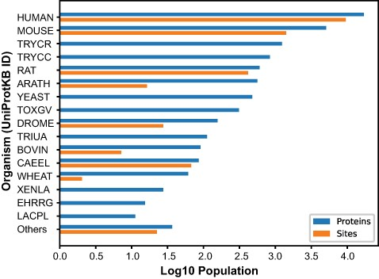
Figure 2. Number of O-GlcNAcylated proteins and sites. O-GlcNAcylated proteins (blue) and O-GlcNAc sites (orange) for ...
Notes:
Figure 2. Number of O-GlcNAcylated proteins and sites. O-GlcNAcylated proteins (blue) and O-GlcNAc sites (orange) for each organism cataloged in the O-GlcNAc Database. The Others category summarized proteins and sites from 26 organisms with <10 protein entries.
Unless provided in the caption above, the following copyright applies to the content of this slide: © The Author(s) 2021. Published by Oxford University Press.This is an Open Access article distributed under the terms of the Creative Commons Attribution License (http://creativecommons.org/licenses/by/4.0/), which permits unrestricted reuse, distribution, and reproduction in any medium, provided the original work is properly cited.

Slide 3
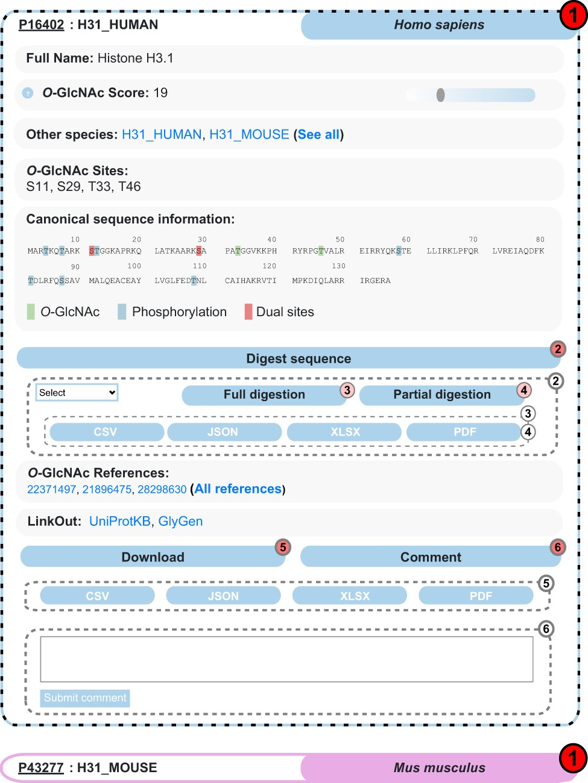
Figure 3. Example of search results for the protein Histone H3.1 in the O-GlcNAc Database. Protein entries are shown as ...
Notes:
Figure 3. Example of search results for the protein Histone H3.1 in the O-GlcNAc Database. Protein entries are shown as collapsible elements (1), and child elements can be accessed on click (dashed frame). Nested collapsible provides digest tools (2) in full (3) and partial (4) modes, download (5) and comment options (6).
Unless provided in the caption above, the following copyright applies to the content of this slide: © The Author(s) 2021. Published by Oxford University Press.This is an Open Access article distributed under the terms of the Creative Commons Attribution License (http://creativecommons.org/licenses/by/4.0/), which permits unrestricted reuse, distribution, and reproduction in any medium, provided the original work is properly cited.

Slide 4
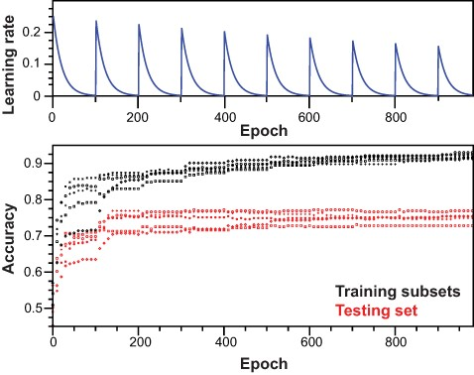
Figure 4. Training of the neural network. Top panel: scheme for learning rate cycling during training of independent ...
Notes:
Figure 4. Training of the neural network. Top panel: scheme for learning rate cycling during training of independent models. Bottom panel: for each independent model, accuracy was monitored along training epochs for training subsets and testing set.
Unless provided in the caption above, the following copyright applies to the content of this slide: © The Author(s) 2021. Published by Oxford University Press.This is an Open Access article distributed under the terms of the Creative Commons Attribution License (http://creativecommons.org/licenses/by/4.0/), which permits unrestricted reuse, distribution, and reproduction in any medium, provided the original work is properly cited.

Slide 5
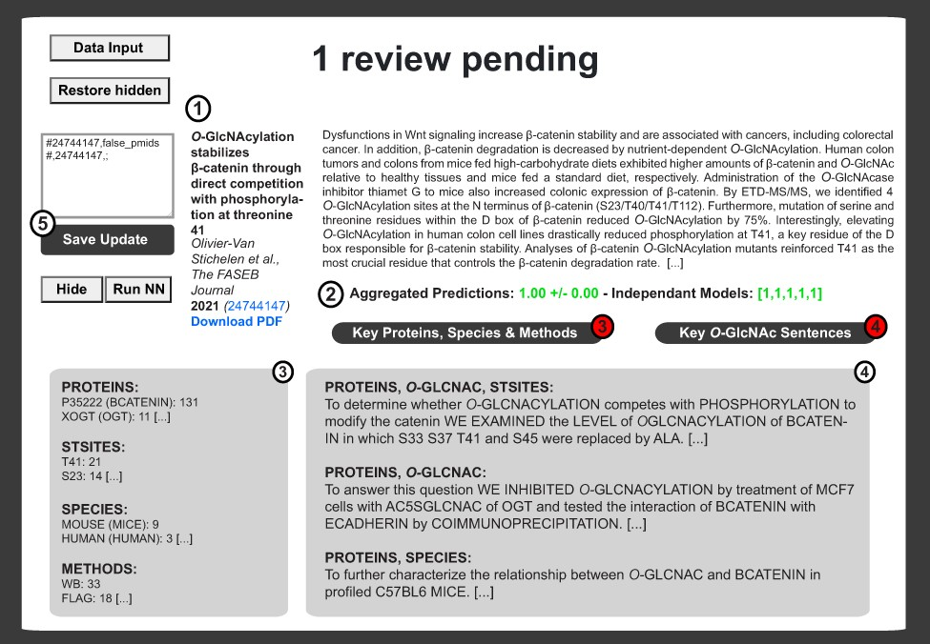
Figure 5. Example of literature report upon logistic binary classifier and automatization routines. The private ...
Notes:
Figure 5. Example of literature report upon logistic binary classifier and automatization routines. The private interface contains the literature item metadata (Authors, Title, Year, Journal, Volume, Issue, Abstract, PMID and PubMed Link) (1) as well as the prediction score from the neural network (2). Neural network decisions are presented for each model ((2) right brackets). Decisions are then average and binomial confidence interval is calculated ((2) left). In (3), extracted proteins, sites, species and methods are shown next to the number of iteration for each item. This information is complemented by sentences associated with combinations of tags relevant to O-GlcNAcylated proteins (4). An update window is available for rapid update of the master update file upon inspection of each publication (5).
Unless provided in the caption above, the following copyright applies to the content of this slide: © The Author(s) 2021. Published by Oxford University Press.This is an Open Access article distributed under the terms of the Creative Commons Attribution License (http://creativecommons.org/licenses/by/4.0/), which permits unrestricted reuse, distribution, and reproduction in any medium, provided the original work is properly cited.

Slide 6
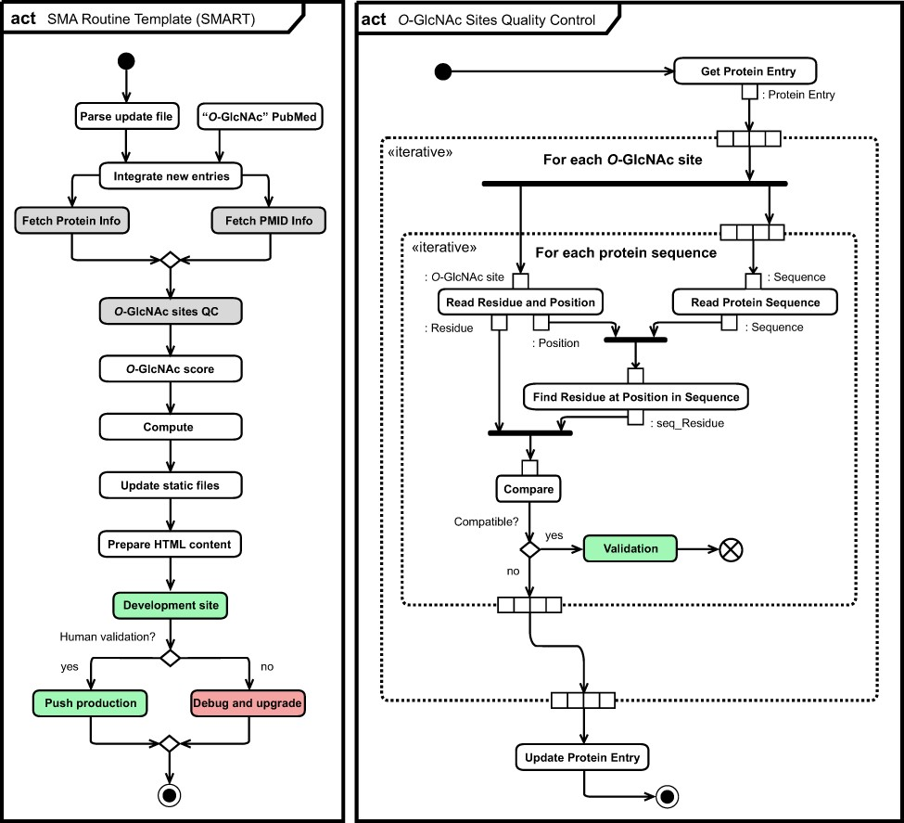
Figure 6. Unified Modeling Language (UML) (11) activity diagram (act) of the O-GlcNAc automatization and ...
Notes:
Figure 6. Unified Modeling Language (UML) (11) activity diagram (act) of the O-GlcNAc automatization and self-maintenance library. Initial state (black circle), actions (rounded rectangle), list objects (rectangle), fork and join (bold bars), decision and merge (diamond), break (crossed circle) as well as final state (black circle) are highlighted per UML conventions. Normal (green) and error (red) completion actions are also highlighted, together with actions for which specific activity diagrams for O-GlcNAc sites quality control (right panel) and for collection of information related to protein and literature are given (Figure S6).
Unless provided in the caption above, the following copyright applies to the content of this slide: © The Author(s) 2021. Published by Oxford University Press.This is an Open Access article distributed under the terms of the Creative Commons Attribution License (http://creativecommons.org/licenses/by/4.0/), which permits unrestricted reuse, distribution, and reproduction in any medium, provided the original work is properly cited.

