Slide 1
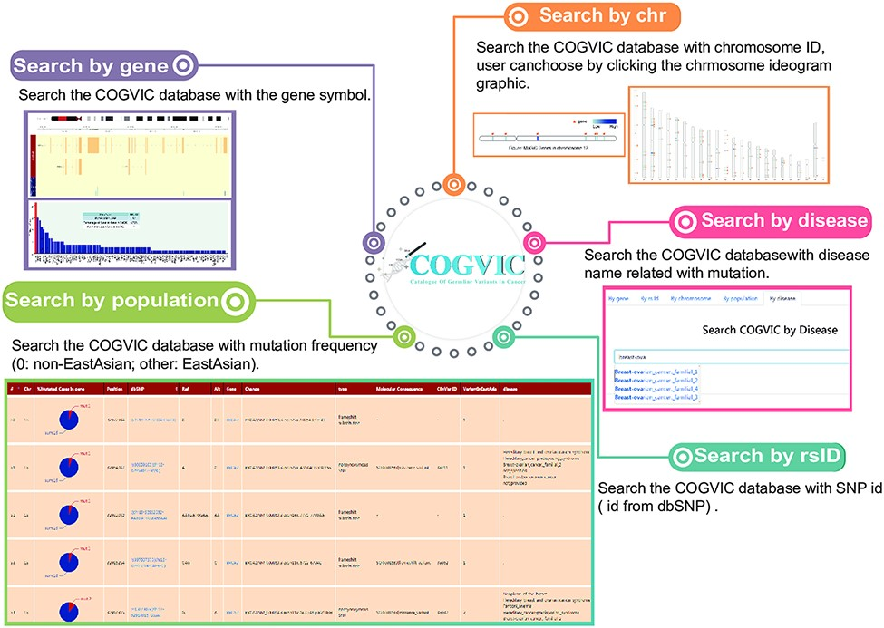
Figure 4. The main functions of the COGVIC database. This figure shows examples of outputs to specific search queries. ...
Notes:
Figure 4. The main functions of the COGVIC database. This figure shows examples of outputs to specific search queries. Search by gene: results of search by gene symbol; Search by chr: search by chromosome ID; Users can choose by clicking the chromosome ideogram graphic. Search by rsID: uses SNP rs# from dbSNP; Search by population: retrieves population-specific information mutation frequency (0: not Asian; other: Asian); Search by disease: search with disease names finds associated mutations.
Unless provided in the caption above, the following copyright applies to the content of this slide: © The Author(s) 2021. Published by Oxford University Press.This is an Open Access article distributed under the terms of the Creative Commons Attribution License (https://creativecommons.org/licenses/by/4.0/), which permits unrestricted reuse, distribution, and reproduction in any medium, provided the original work is properly cited.

