Slide 1
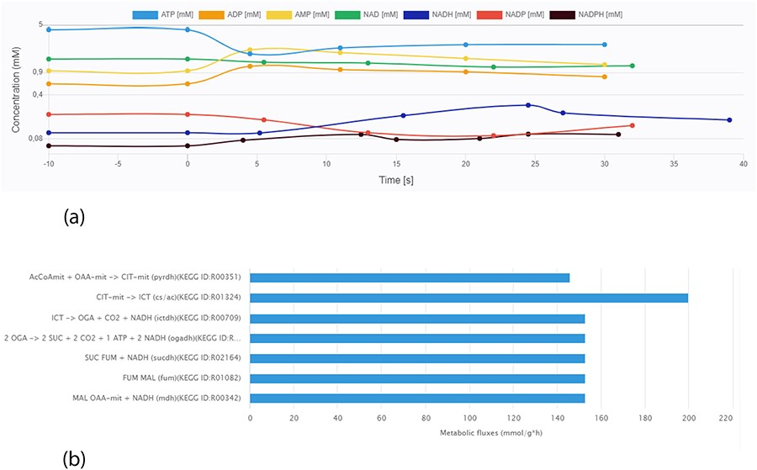
Figure 6. Screen images from different data types that the user can preview from the data sets. (a) Example of ...
Notes:
Figure 6. Screen images from different data types that the user can preview from the data sets. (a) Example of time-course data for the Data EntryID 30. (b) Example of flux distribution for the Data EntryID 73.
Unless provided in the caption above, the following copyright applies to the content of this slide: © The Author(s) 2020. Published by Oxford University Press.This is an Open Access article distributed under the terms of the Creative Commons Attribution License (http://creativecommons.org/licenses/by/4.0/), which permits unrestricted reuse, distribution, and reproduction in any medium, provided the original work is properly cited.

