Slide 1
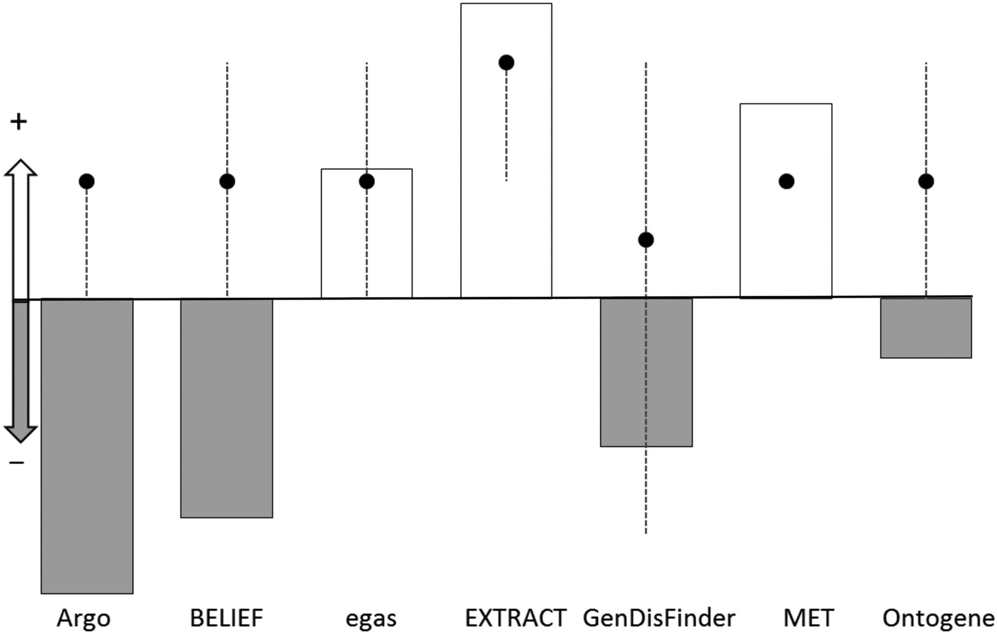
Figure 3. Plot of the NPS score (bars) and the median for the system rating for each system (dots). The y-axis ...
Notes:
Figure 3. Plot of the NPS score (bars) and the median for the system rating for each system (dots). The y-axis represents whether the NPS and median are positive (for NPS, positive means NPS > 0, for system rating median >3) or negative (for NPS, negative means NPS < 0, for system rating median <3). The NPS score is represented with bars, white and grey color indicate positive and negative scores, respectively. The median for the system rating is represented with black dots with dotted line extending from minimum to maximum value for the sample.
Unless provided in the caption above, the following copyright applies to the content of this slide: Published by Oxford University Press 2016. This work is written by US Government employees and is in the public domain in the US.

