Slide 1
Figure 1 Example of BEL statement (The ‘cat’ function representing catalytic activity was considered in our ...
Notes:
Figure 1 Example of BEL statement (The ‘cat’ function representing catalytic activity was considered in our evaluation as equivalent to ‘act’ (activity), see Table 3 for details.).
Unless provided in the caption above, the following copyright applies to the content of this slide: © The Author(s) 2016. Published by Oxford University Press. This is an Open Access article distributed under the terms of the Creative Commons Attribution License ( http://creativecommons.org/licenses/by/4.0/ ), which permits unrestricted reuse, distribution, and reproduction in any medium, provided the original work is properly cited.

Slide 2
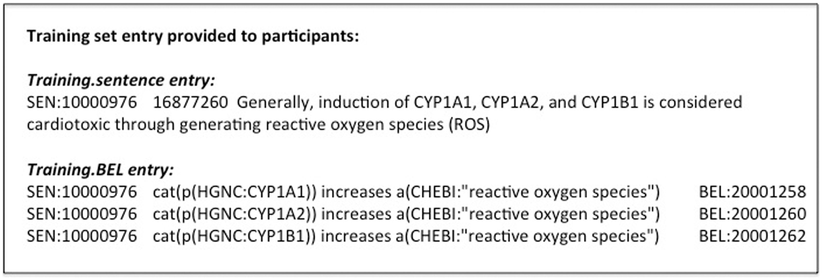
Figure 2 Training data example.
Notes:
Figure 2 Training data example.
Unless provided in the caption above, the following copyright applies to the content of this slide: © The Author(s) 2016. Published by Oxford University Press. This is an Open Access article distributed under the terms of the Creative Commons Attribution License ( http://creativecommons.org/licenses/by/4.0/ ), which permits unrestricted reuse, distribution, and reproduction in any medium, provided the original work is properly cited.

Slide 3
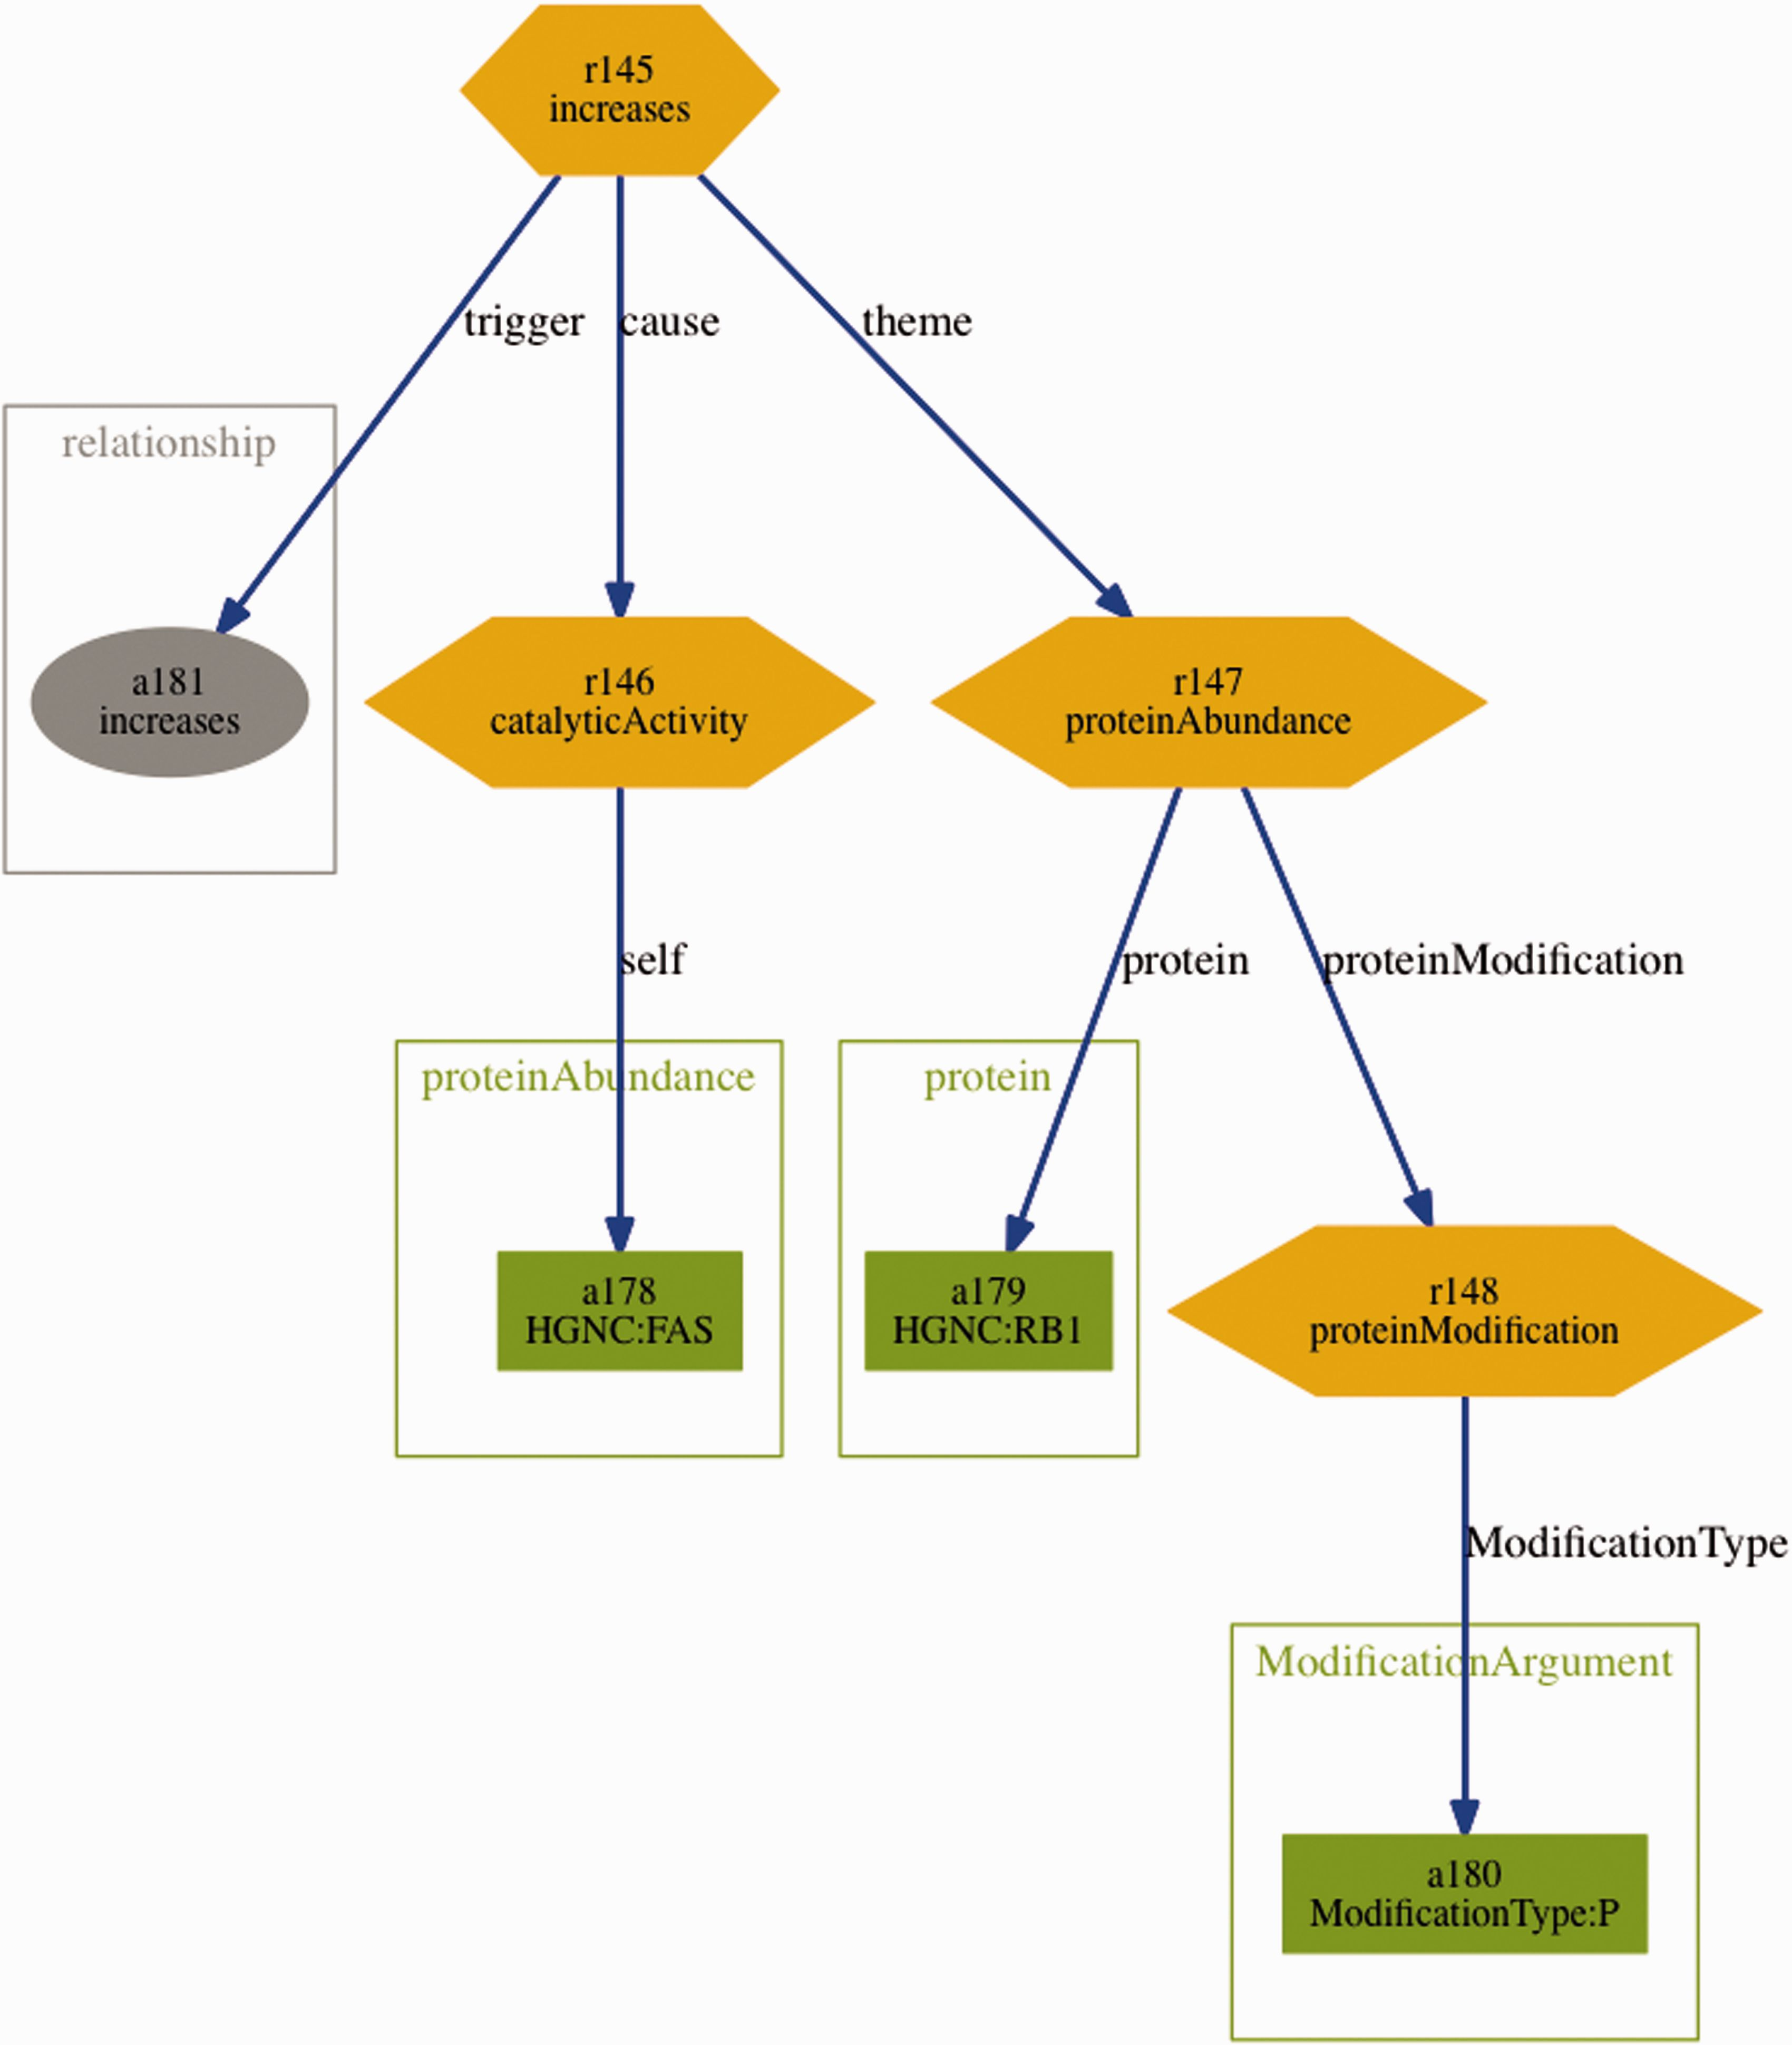
Figure 3 Visualization of the BEL statement ‘ cat(p(HGNC:FAS)) increases p(HGNC:RB1,pmod(P)) ’ derived from the ...
Notes:
Figure 3 Visualization of the BEL statement ‘ cat(p(HGNC:FAS)) increases p(HGNC:RB1,pmod(P)) ’ derived from the sentence ‘Fas stimulation of Jurkat cells is known to induce p38 kinase and we find a pronounced increase in Rb phosphorylation within 30 min of Fas stimulation’.
Unless provided in the caption above, the following copyright applies to the content of this slide: © The Author(s) 2016. Published by Oxford University Press. This is an Open Access article distributed under the terms of the Creative Commons Attribution License ( http://creativecommons.org/licenses/by/4.0/ ), which permits unrestricted reuse, distribution, and reproduction in any medium, provided the original work is properly cited.

Slide 4
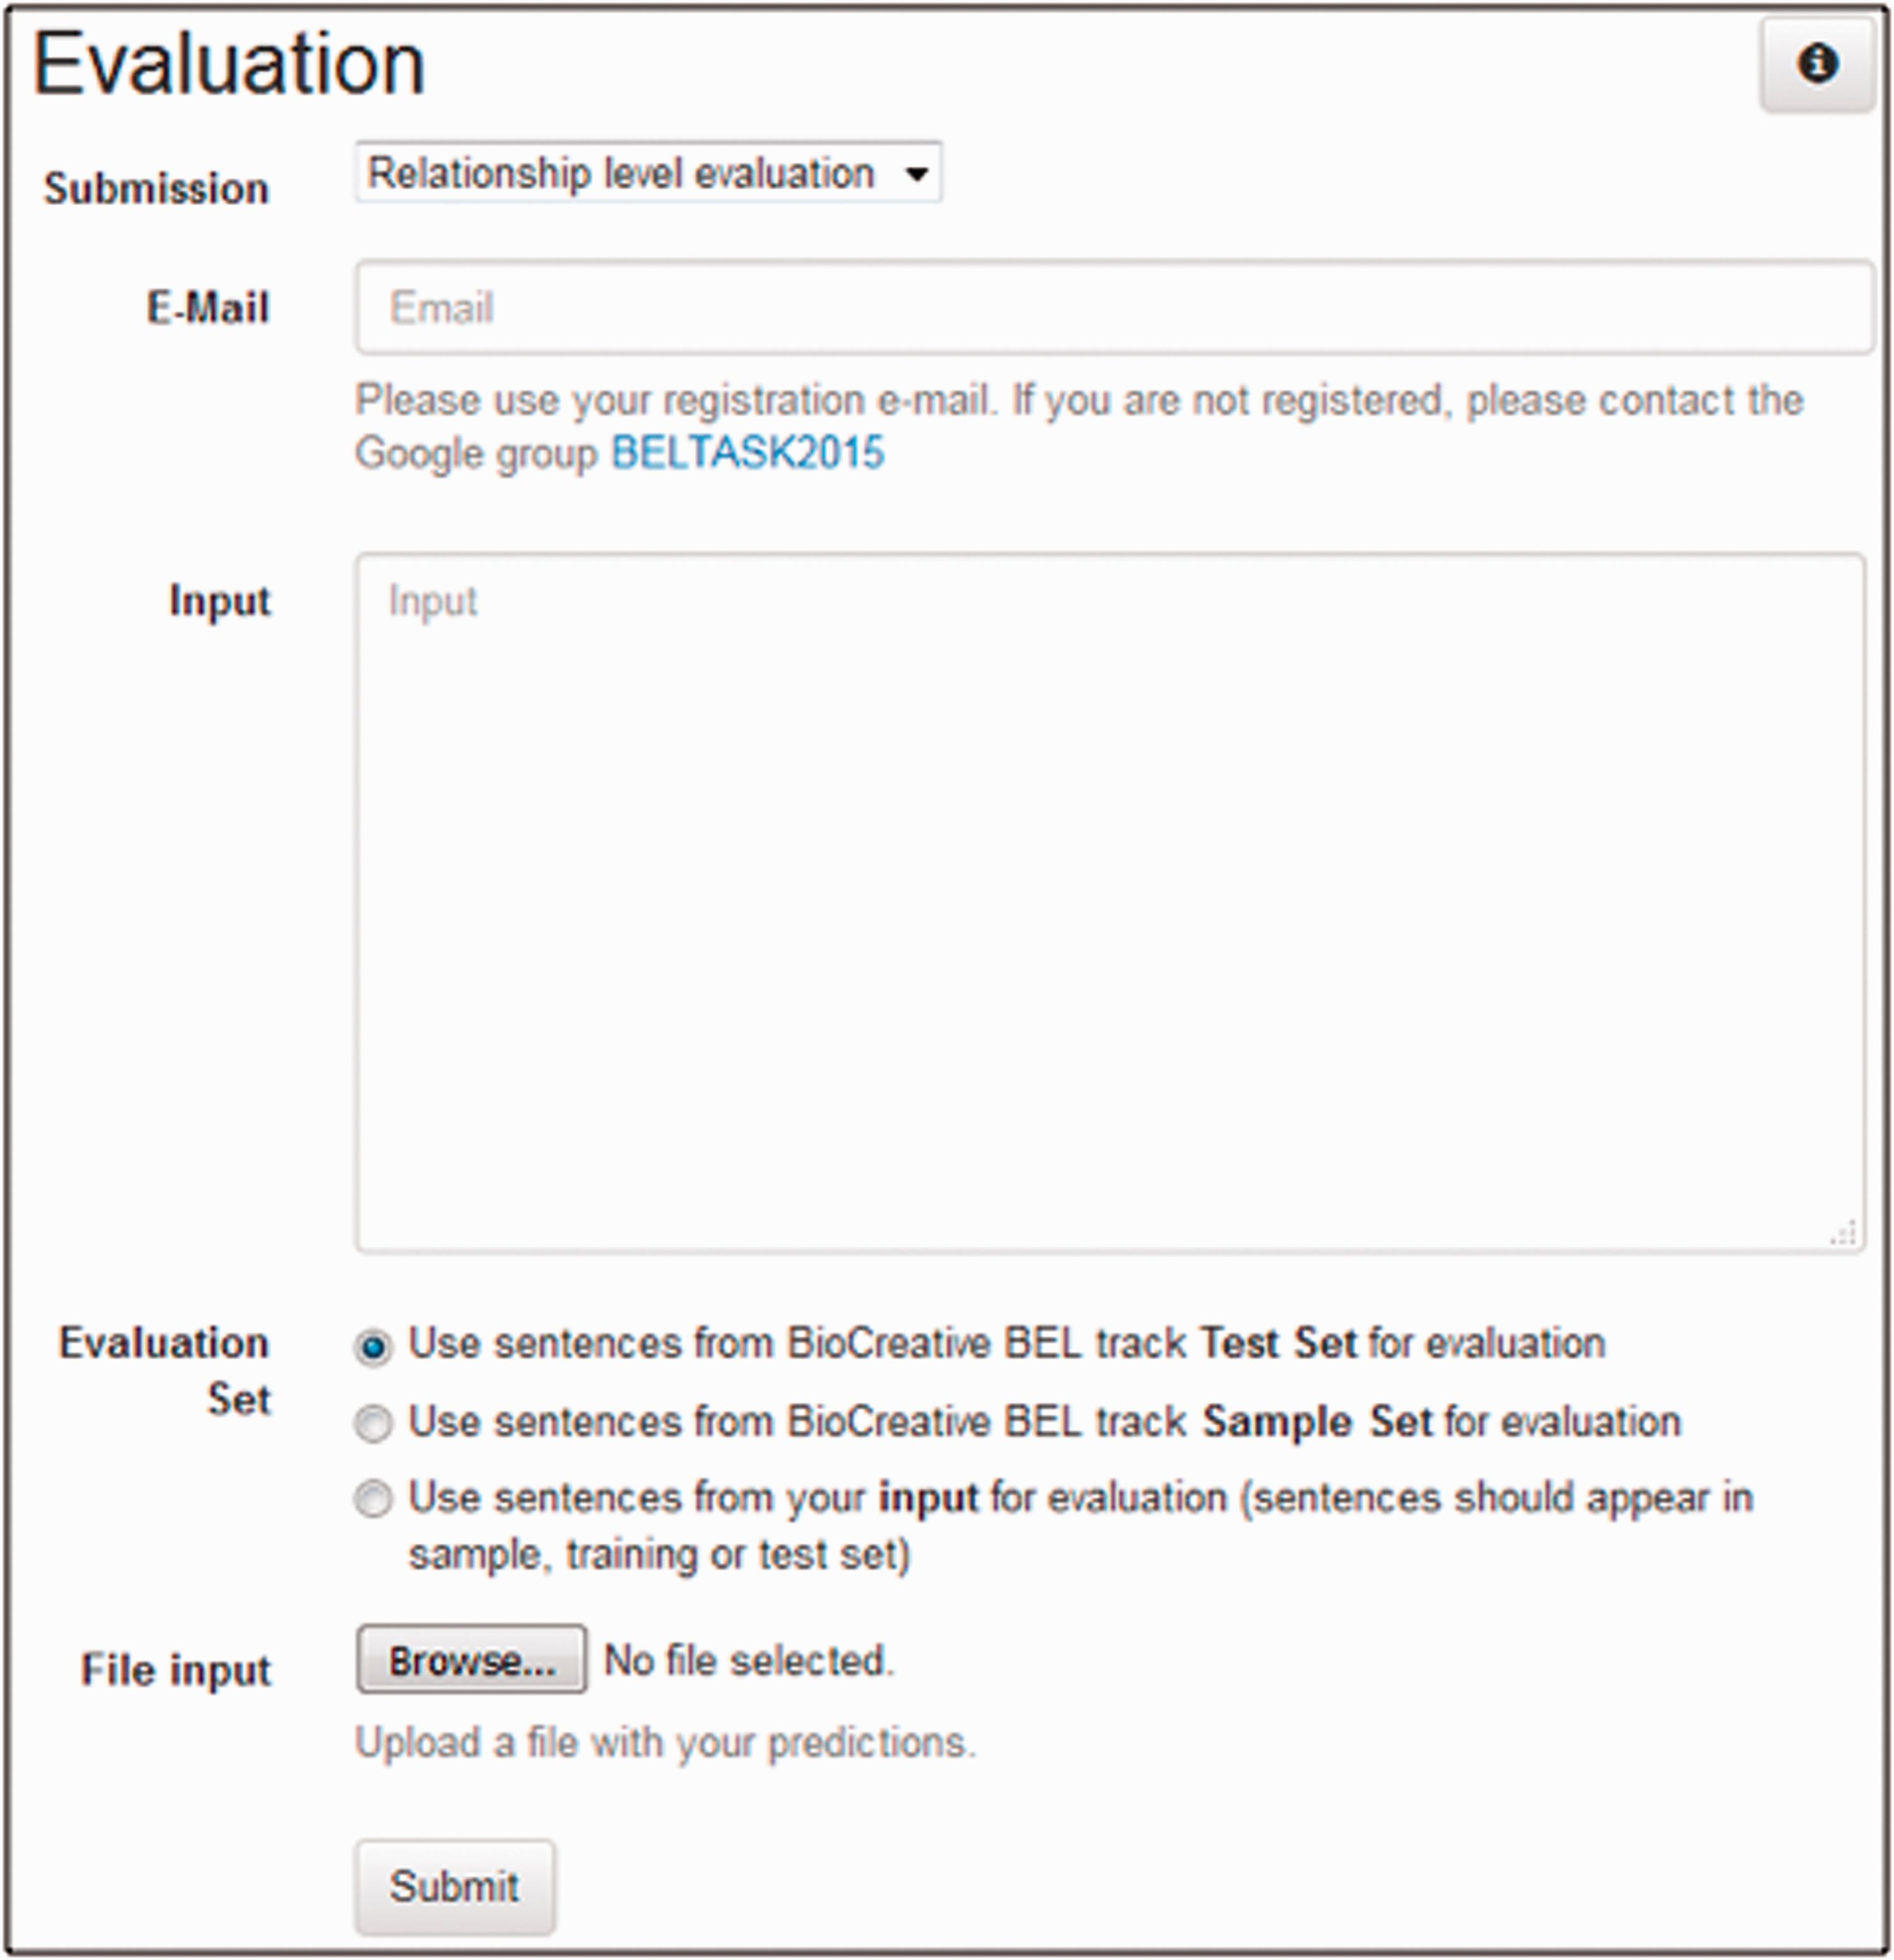
Figure 4 A screenshot of the evaluation user interface of task 1.
Notes:
Figure 4 A screenshot of the evaluation user interface of task 1.
Unless provided in the caption above, the following copyright applies to the content of this slide: © The Author(s) 2016. Published by Oxford University Press. This is an Open Access article distributed under the terms of the Creative Commons Attribution License ( http://creativecommons.org/licenses/by/4.0/ ), which permits unrestricted reuse, distribution, and reproduction in any medium, provided the original work is properly cited.

Slide 5
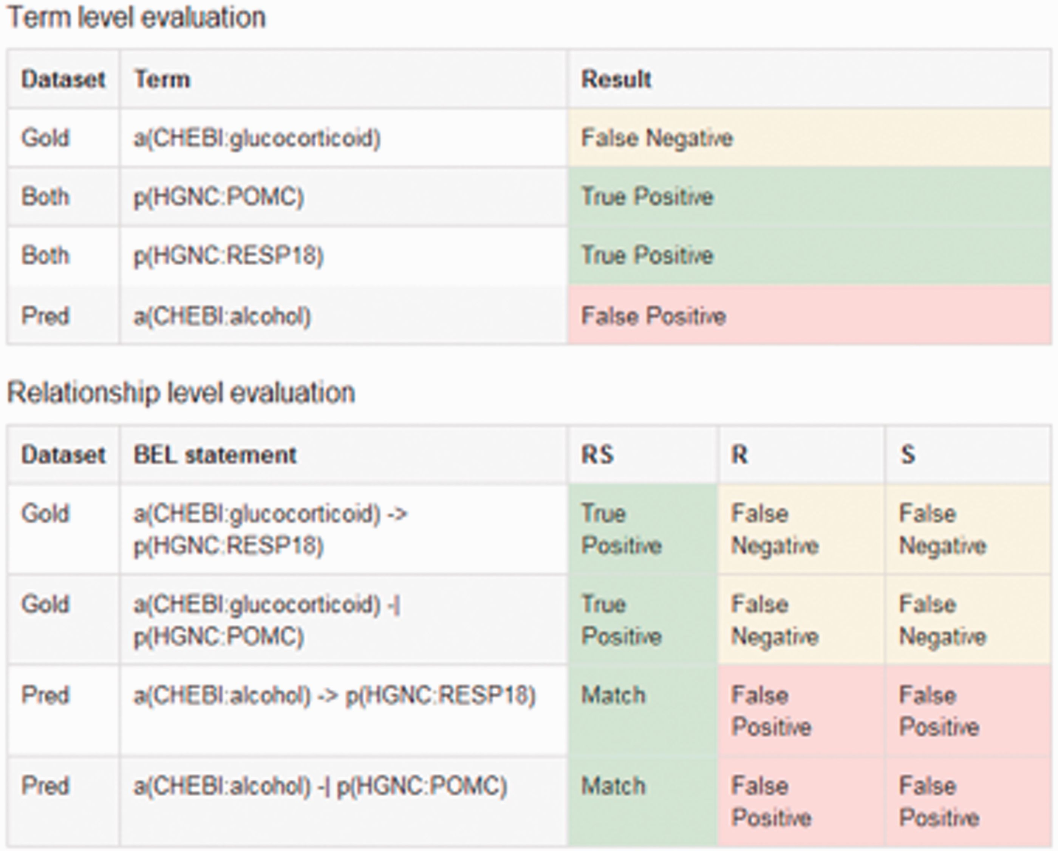
Figure 5 An example output of the sentence-based evaluation. The screenshot contains the detected true positive ...
Notes:
Figure 5 An example output of the sentence-based evaluation. The screenshot contains the detected true positive (green), false positive (red) and false negatives (yellow) entries for the term and relationship level.
Unless provided in the caption above, the following copyright applies to the content of this slide: © The Author(s) 2016. Published by Oxford University Press. This is an Open Access article distributed under the terms of the Creative Commons Attribution License ( http://creativecommons.org/licenses/by/4.0/ ), which permits unrestricted reuse, distribution, and reproduction in any medium, provided the original work is properly cited.

Slide 6
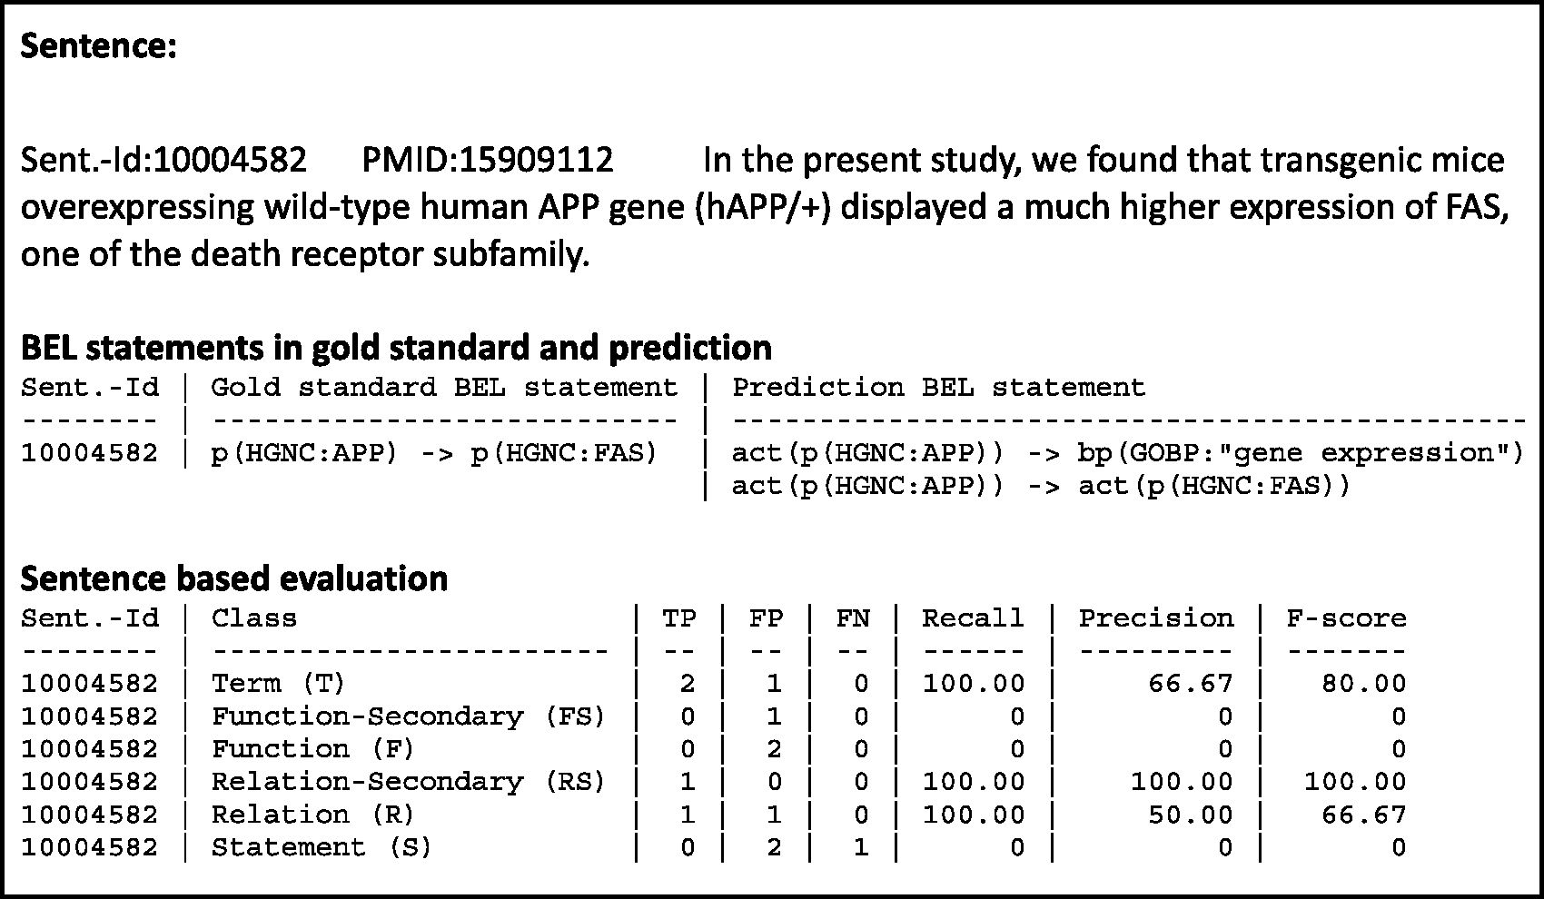
Figure 6 An example result page of a candidate evaluation. The example shows the candidate sentence, with the gold ...
Notes:
Figure 6 An example result page of a candidate evaluation. The example shows the candidate sentence, with the gold standard and the predicted BEL statements. The evaluation scores are shown for all primary and secondary levels.
Unless provided in the caption above, the following copyright applies to the content of this slide: © The Author(s) 2016. Published by Oxford University Press. This is an Open Access article distributed under the terms of the Creative Commons Attribution License ( http://creativecommons.org/licenses/by/4.0/ ), which permits unrestricted reuse, distribution, and reproduction in any medium, provided the original work is properly cited.

