Slide 1
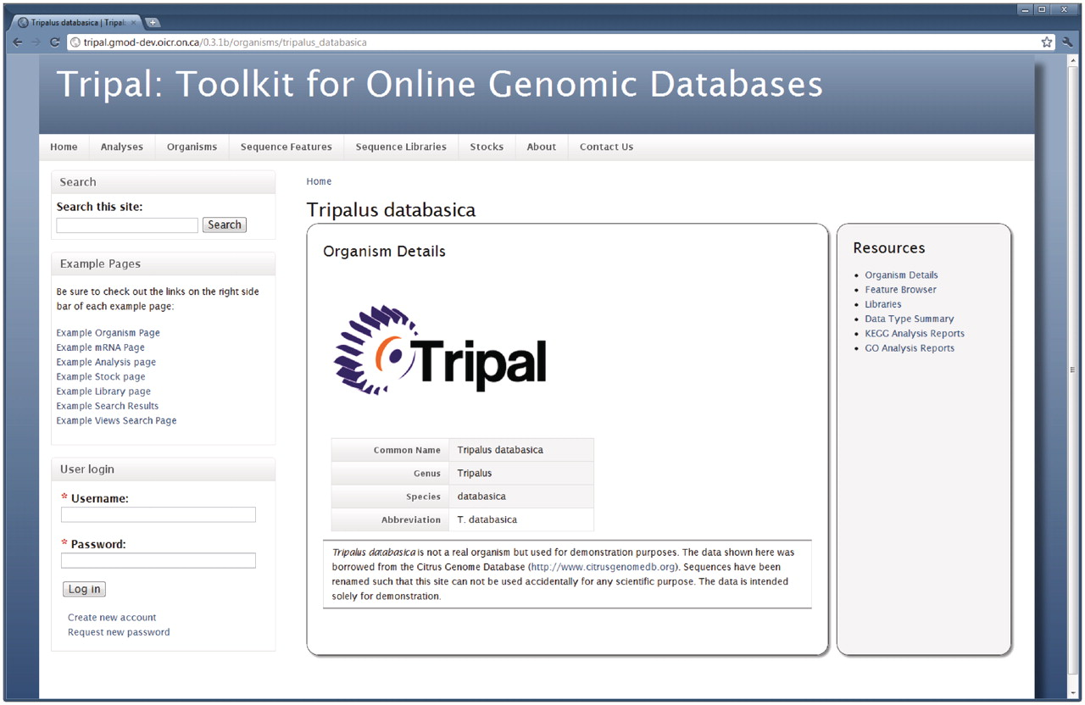
Figure 1. The Organism page. Details about an organism are presented first when visiting the Organism page. The right ...
Notes:
Figure 1. The Organism page. Details about an organism are presented first when visiting the Organism page. The right hand sidebar titled ‘Resources’ provides additional links for data related to this Organism. Through these links, visitors can use the feature browser to sort through a list of available genomic features (sequences) for this organism, view a list of feature libraries for this organism, and view reports of summarized data for the organism, including GO and KEGG reports. A search box in the top left-hand side is available for full-text searching of the site, and a login box is available for administrative and community logins. By customizing the Tripal template files, site administrators can add any number of links to the resources sidebar.
Unless provided in the caption above, the following copyright applies to the content of this slide: © The Author(s) 2011. Published by Oxford University Press.This is an Open Access article distributed under the terms of the Creative Commons Attribution Non-Commercial License (http://creativecommons.org/licenses/by-nc/3.0), which permits unrestricted non-commercial use, distribution, and reproduction in any medium, provided the original work is properly cited.

Slide 2
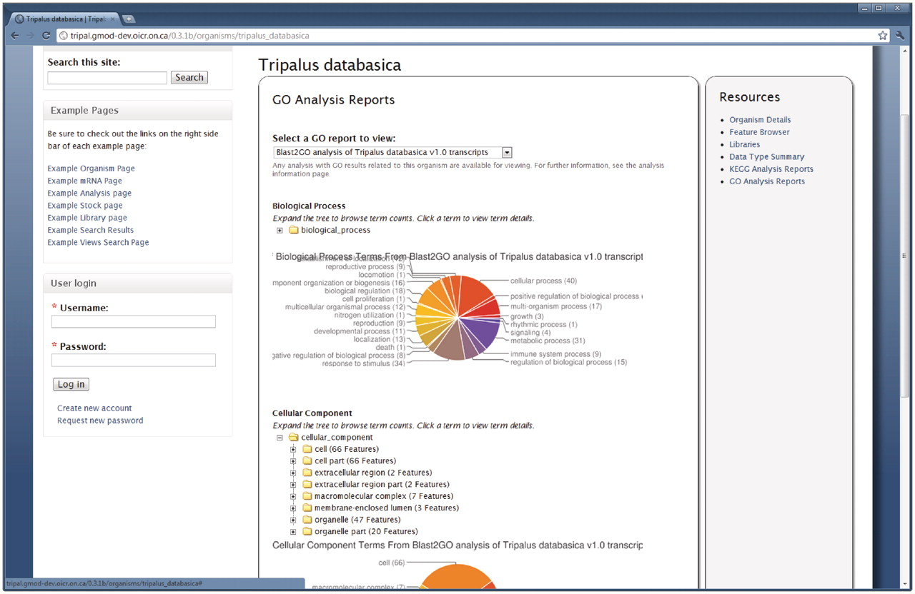
Figure 2. The GO summary on the Organism page. The Tripal Analysis GO module provides summarized reports of GO ...
Notes:
Figure 2. The GO summary on the Organism page. The Tripal Analysis GO module provides summarized reports of GO annotations for an organism. This report is available by clicking the ‘Go Analysis Reports’ link on the right sidebar of the Organism page. The report shown above is a summarized report from a Blast2GO analysis. The pie charts indicate the percentage of annotations for each of the highest level terms in each of the three branches of the GO. Additionally, expandable trees for each branch are available for browsing all of the assignments. Users can click a GO term in the tree for a description of the term and download a FASTA file of sequences annotated with a particular term.
Unless provided in the caption above, the following copyright applies to the content of this slide: © The Author(s) 2011. Published by Oxford University Press.This is an Open Access article distributed under the terms of the Creative Commons Attribution Non-Commercial License (http://creativecommons.org/licenses/by-nc/3.0), which permits unrestricted non-commercial use, distribution, and reproduction in any medium, provided the original work is properly cited.

Slide 3
Figure 3. The libraries for an organism. The Tripal Library module will automatically provide a list of libraries ...
Notes:
Figure 3. The libraries for an organism. The Tripal Library module will automatically provide a list of libraries associated with an organism. This list is available by clicking the ‘Libraries’ link on the right sidebar of the Organism page. New libraries will automatically appear in the list as they are added. Visitors can find more information about a library by visiting a library's corresponding content page, which is found by clicking on the library name in the list.
Unless provided in the caption above, the following copyright applies to the content of this slide: © The Author(s) 2011. Published by Oxford University Press.This is an Open Access article distributed under the terms of the Creative Commons Attribution Non-Commercial License (http://creativecommons.org/licenses/by-nc/3.0), which permits unrestricted non-commercial use, distribution, and reproduction in any medium, provided the original work is properly cited.

Slide 4
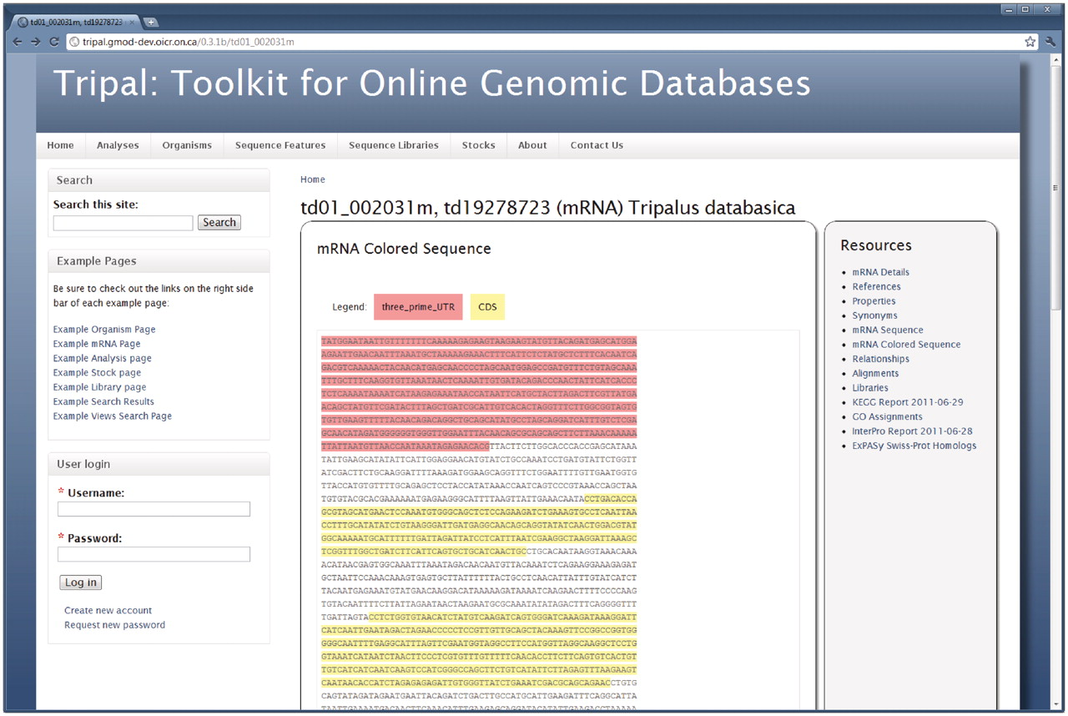
Figure 4. The feature page. Similar to the organism page, the right sidebar of the feature page provides a list of ...
Notes:
Figure 4. The feature page. Similar to the organism page, the right sidebar of the feature page provides a list of available data for a genomic sequence. Here the genomic sequence for an mRNA feature is shown. This is viewable by clicking the ‘mRNA Colored Sequence’ link. Visitors can also view synonyms, properties, alignments and external references for the feature. Library information will be viewable if the feature is derived from a library. Analyses results are also available on this page. In this example, BLAST homology results against the ExPASy Swiss-Prot database, InterProScan and KEGG/KASS results are available for viewing. Site administrators may customize which links are shown and can change the wording on many of the data views to better fit their community by editing the Tripal template files. Here the default look-and-feel is shown.
Unless provided in the caption above, the following copyright applies to the content of this slide: © The Author(s) 2011. Published by Oxford University Press.This is an Open Access article distributed under the terms of the Creative Commons Attribution Non-Commercial License (http://creativecommons.org/licenses/by-nc/3.0), which permits unrestricted non-commercial use, distribution, and reproduction in any medium, provided the original work is properly cited.

Slide 5
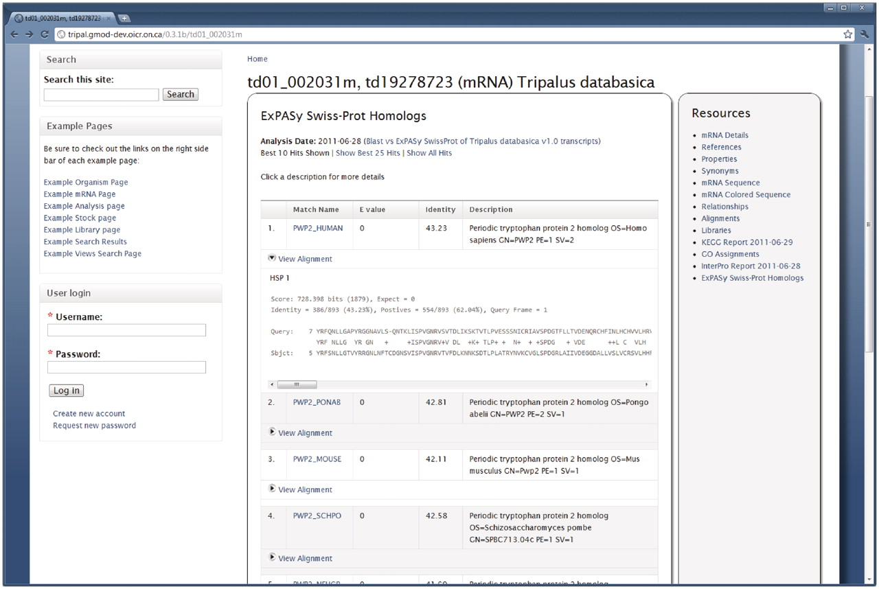
Figure 5. BLAST results for a feature. The Tripal Analysis BLAST module provides a summary of BLAST homology results on ...
Notes:
Figure 5. BLAST results for a feature. The Tripal Analysis BLAST module provides a summary of BLAST homology results on the Feature page. This example is for a feature that was compared to the ExPASy Swiss-Prot protein database. At first glance visitors view the match, e-value, percent identity and a description of the matching sequence. The actual alignment can be seen by clicking the ‘View Alignment’ link under each match. By default only the top 10 results are shown, however, visitors can choose to see the top 25 or all of the matches by clicking the appropriate links at the top of the report. The name given to the BLAST analysis is also visible at the top of the report. Visitors can find more information about this blast job by visiting the BLAST Analysis page by clicking the analysis name.
Unless provided in the caption above, the following copyright applies to the content of this slide: © The Author(s) 2011. Published by Oxford University Press.This is an Open Access article distributed under the terms of the Creative Commons Attribution Non-Commercial License (http://creativecommons.org/licenses/by-nc/3.0), which permits unrestricted non-commercial use, distribution, and reproduction in any medium, provided the original work is properly cited.

Slide 6
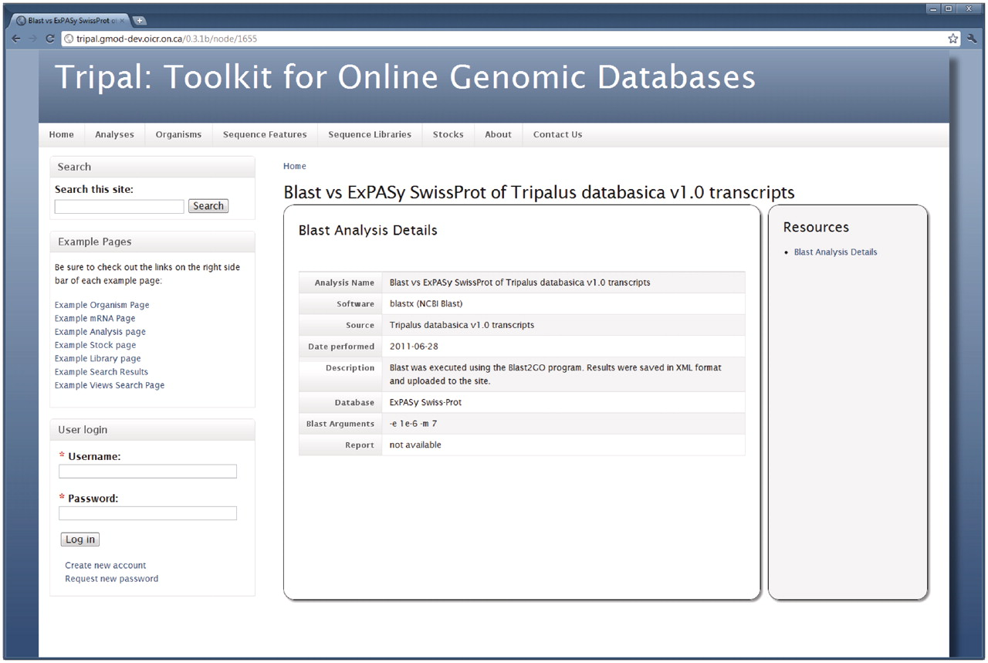
Figure 6. The Analysis page. When adding results from an analysis, content managers may provide specific details about ...
Notes:
Figure 6. The Analysis page. When adding results from an analysis, content managers may provide specific details about the analysis including the software used, the date the analysis was performed, parameters used and the data source used. This example shows information for a BLAST homology analysis, specifically the BLAST homology results shown in Figure 5.
Unless provided in the caption above, the following copyright applies to the content of this slide: © The Author(s) 2011. Published by Oxford University Press.This is an Open Access article distributed under the terms of the Creative Commons Attribution Non-Commercial License (http://creativecommons.org/licenses/by-nc/3.0), which permits unrestricted non-commercial use, distribution, and reproduction in any medium, provided the original work is properly cited.

Slide 7
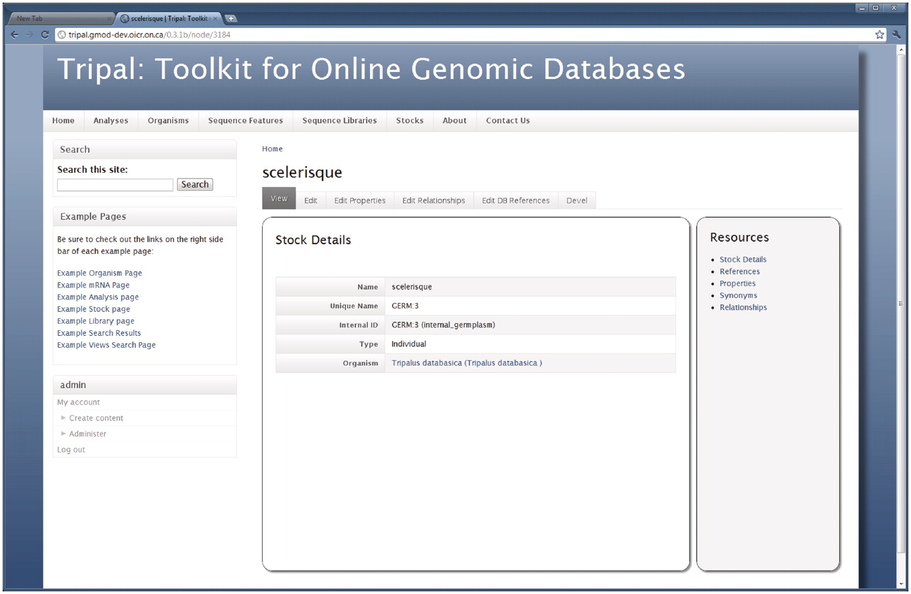
Figure 7. The Stock page. As shown, the Stock page is similar to the Organism and Feature pages in that a visitor first ...
Notes:
Figure 7. The Stock page. As shown, the Stock page is similar to the Organism and Feature pages in that a visitor first views basic details describing the stock. The right sidebar provides information for the given stock including references to the stock in other databases, additional properties for the stock (such as comments), synonyms and relationships with other stocks. The tabs above the stock details allow privileged users to edit the basic details and add, update or delete properties, references or relationships for the current stock. These tabs are not present for non-privileged visitors. As with other pages, the site administrator may tailor the look-and-feel of this page by editing the appropriate template files. In this example, the site administrator is logged on. A navigation box appears on the bottom-right hand side that provides administrative access to the site.
Unless provided in the caption above, the following copyright applies to the content of this slide: © The Author(s) 2011. Published by Oxford University Press.This is an Open Access article distributed under the terms of the Creative Commons Attribution Non-Commercial License (http://creativecommons.org/licenses/by-nc/3.0), which permits unrestricted non-commercial use, distribution, and reproduction in any medium, provided the original work is properly cited.

Slide 8
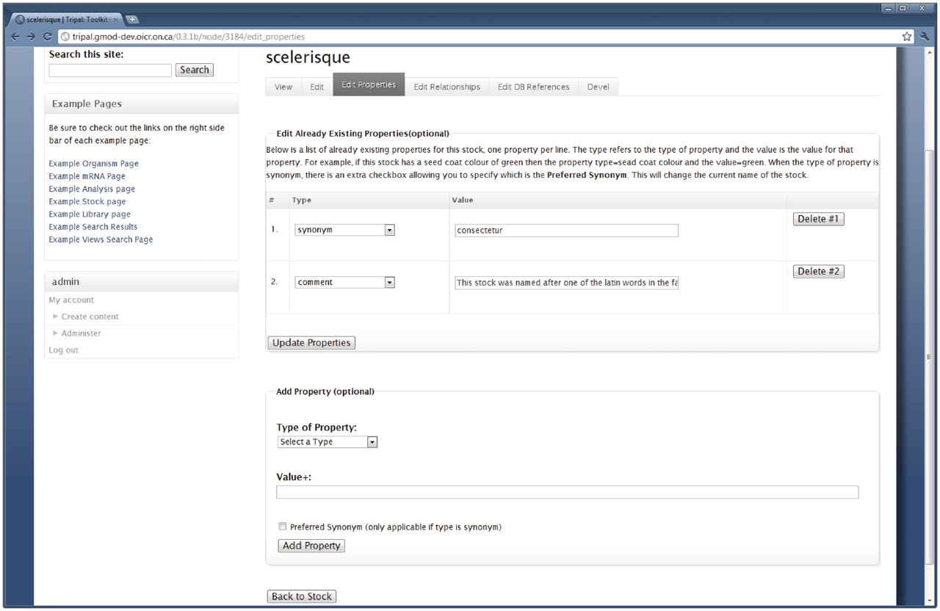
Figure 8. The interface for editing stock properties. Content managers with proper privilege may use this form to edit ...
Notes:
Figure 8. The interface for editing stock properties. Content managers with proper privilege may use this form to edit the properties of a stock. This example is for editing the stock shown in Figure 7, and is available by clicking the ‘Edit Properties’ tab at the top of the Stock page. The first fieldset lists all current properties for the stock and allows the content manager to change the property type or edit the text for the property. The content manager can also delete a property by clicking the ‘Delete’ button to the right side of the property. The second fieldset allows for adding new properties to the current stock. Editing relationships and references is done in a similar manner.
Unless provided in the caption above, the following copyright applies to the content of this slide: © The Author(s) 2011. Published by Oxford University Press.This is an Open Access article distributed under the terms of the Creative Commons Attribution Non-Commercial License (http://creativecommons.org/licenses/by-nc/3.0), which permits unrestricted non-commercial use, distribution, and reproduction in any medium, provided the original work is properly cited.

Slide 9
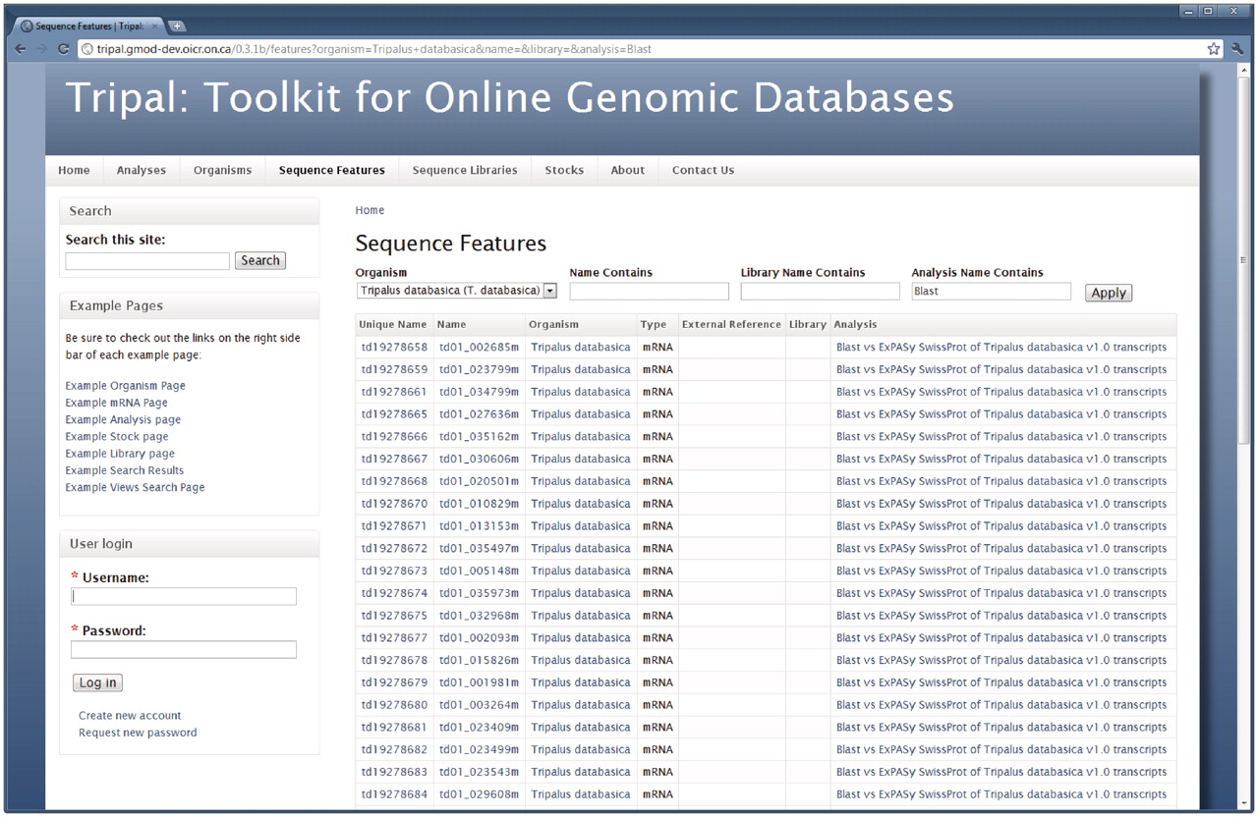
Figure 9. A Drupal Views query page. Tripal exposes the Chado database to the Drupal Views extension module. This ...
Notes:
Figure 9. A Drupal Views query page. Tripal exposes the Chado database to the Drupal Views extension module. This allows site administrators to create custom lists and search pages without the need for SQL or programming. When the Views module is installed Tripal will provide several pre-existing Views. This example shows the ‘Sequence Features’ View, which is available by clicking the ‘Sequence Features’ link in the primary menu. This View allows site visitors to search for features (sequences) within the database by filtering results by a specific organism or feature name. Visitors may also limit results to features that belong to a specific library or analysis. Here features for our example organism that are associated with a blast analysis are shown.
Unless provided in the caption above, the following copyright applies to the content of this slide: © The Author(s) 2011. Published by Oxford University Press.This is an Open Access article distributed under the terms of the Creative Commons Attribution Non-Commercial License (http://creativecommons.org/licenses/by-nc/3.0), which permits unrestricted non-commercial use, distribution, and reproduction in any medium, provided the original work is properly cited.

Slide 10
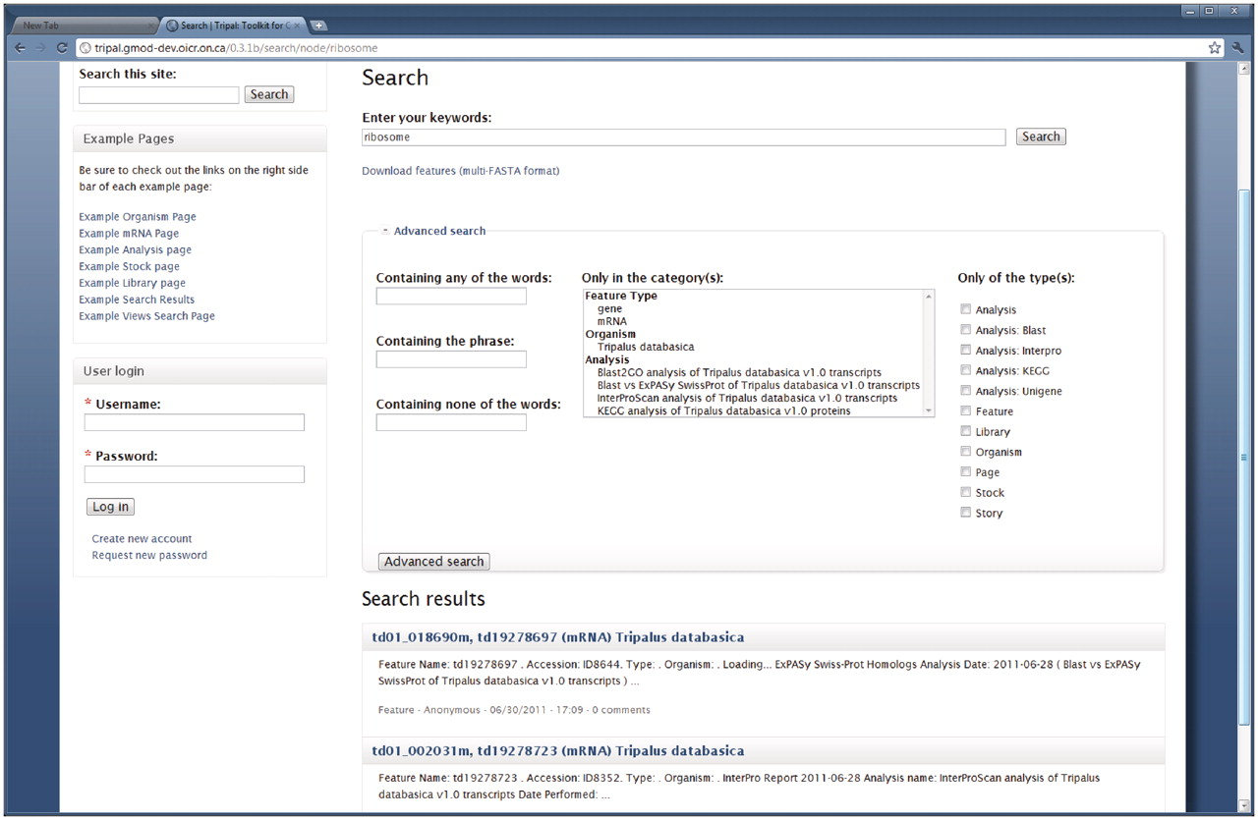
Figure 10. Full-text search page. Drupal provides a full-text searching mechanism which Tripal supports for searching ...
Notes:
Figure 10. Full-text search page. Drupal provides a full-text searching mechanism which Tripal supports for searching Chado content. The search page can be found by using the search box in the top right corner on the example website. In this example a search for the term ‘ribosome’ yielded two mRNA results. An advanced search field set is also available and shown expanded. This allows visitors to filter searches by a specific organism, feature type, analysis or Drupal content type (shown in the list along the right hand side). Users can download a FASTA file of search results by clicking the ‘Download features’ link near the top of the search page.
Unless provided in the caption above, the following copyright applies to the content of this slide: © The Author(s) 2011. Published by Oxford University Press.This is an Open Access article distributed under the terms of the Creative Commons Attribution Non-Commercial License (http://creativecommons.org/licenses/by-nc/3.0), which permits unrestricted non-commercial use, distribution, and reproduction in any medium, provided the original work is properly cited.

Slide 11
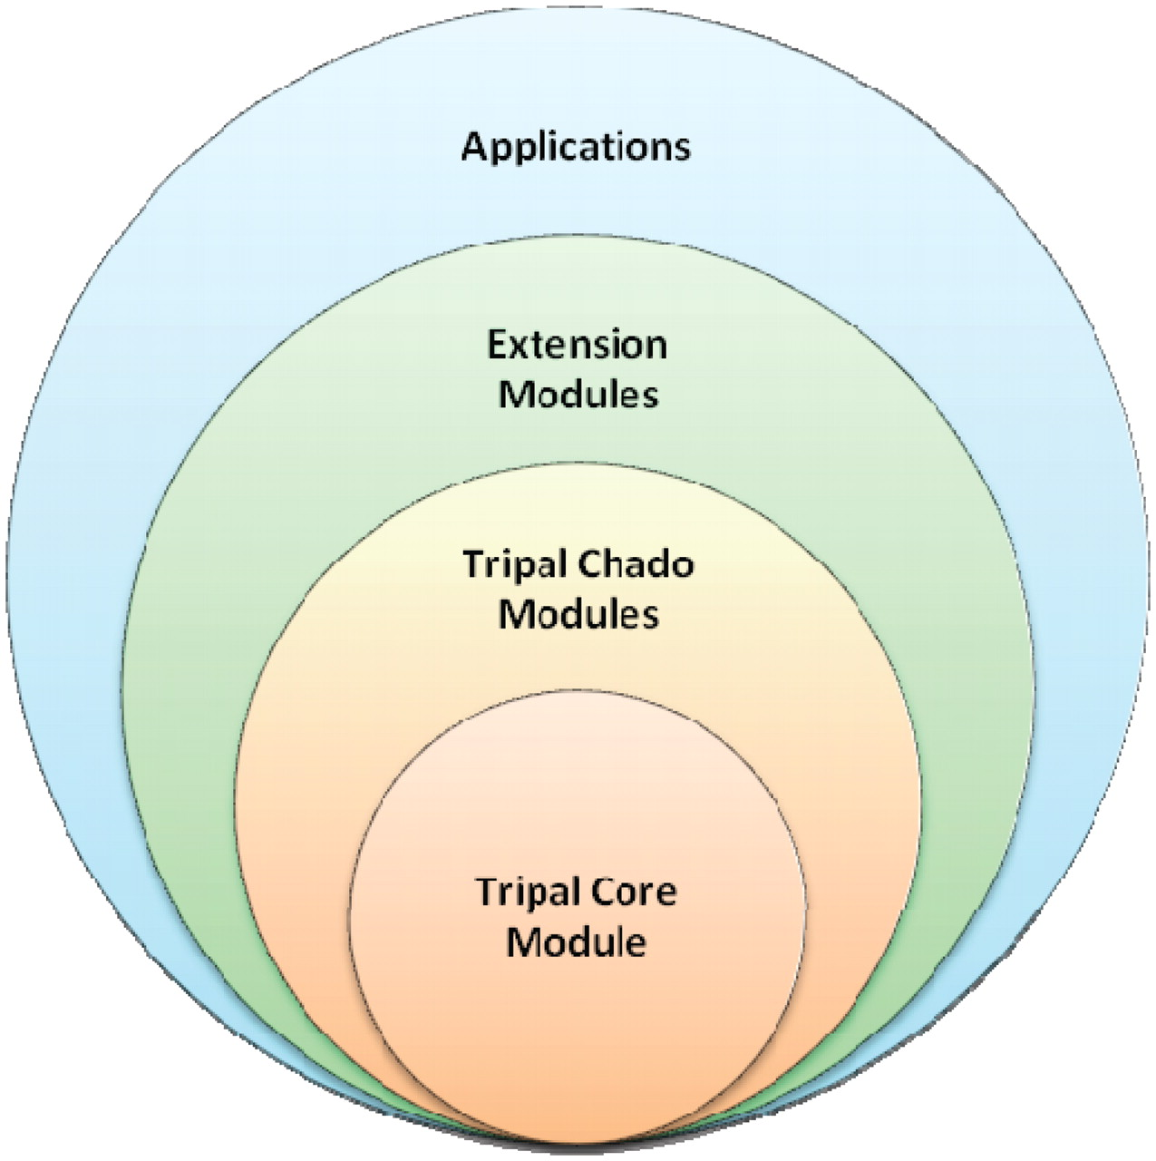
Figure 11. Tripal is designed in hierarchical layers. The baseTripal package consists of the Tripal core and Tripal ...
Notes:
Figure 11. Tripal is designed in hierarchical layers. The baseTripal package consists of the Tripal core and Tripal Chado modules. Extension modules use the Tripal Core and Tripal Chado Modules and provide additional functionality not provided by the base package. Applications use a combination of the Core, Chado and extension modules, as well as, other Drupal modules.
Unless provided in the caption above, the following copyright applies to the content of this slide: © The Author(s) 2011. Published by Oxford University Press.This is an Open Access article distributed under the terms of the Creative Commons Attribution Non-Commercial License (http://creativecommons.org/licenses/by-nc/3.0), which permits unrestricted non-commercial use, distribution, and reproduction in any medium, provided the original work is properly cited.

