Slide 1
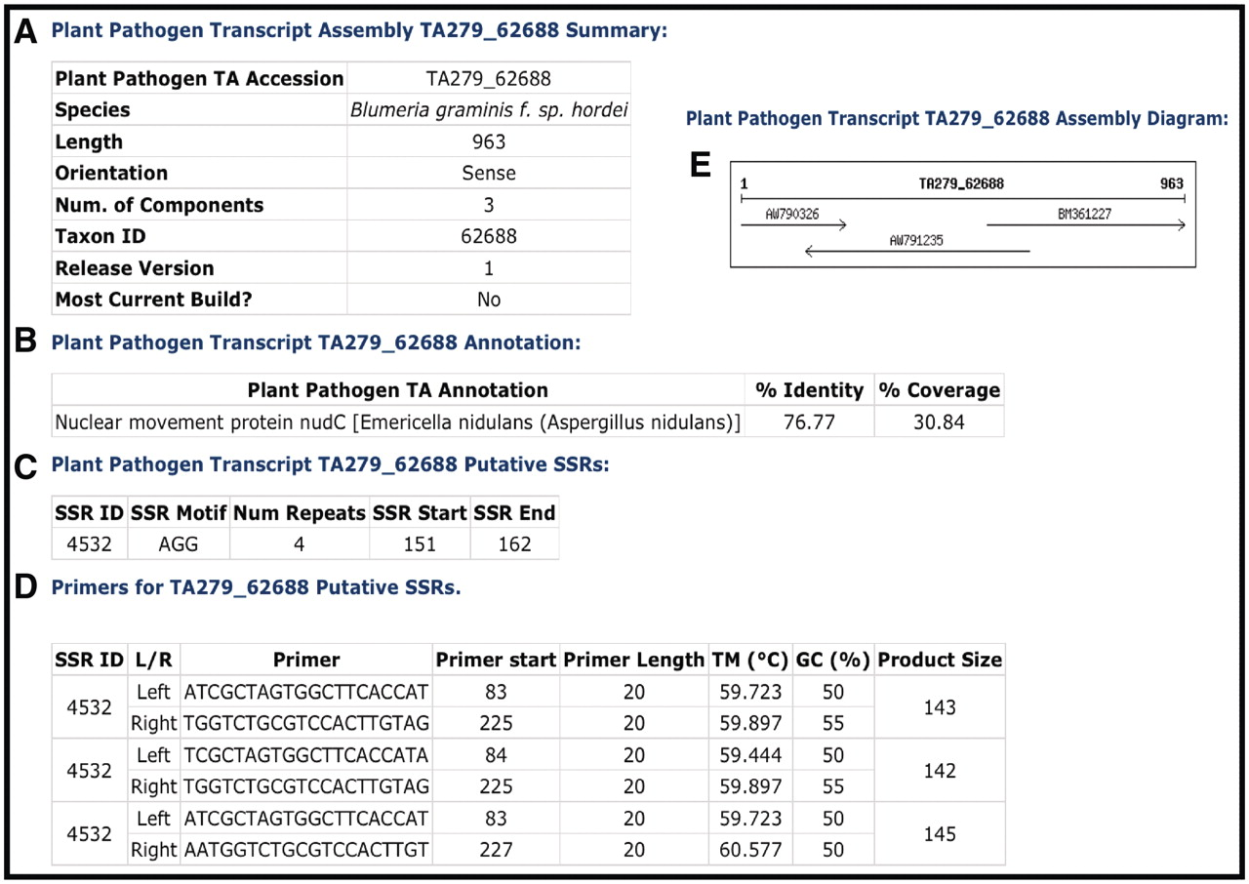
Figure 2. Example of a CPGR plant pathogen transcript assembly. (A) Summary metrics on Blumeria graminis f. sp. hordei ...
Notes:
Figure 2. Example of a CPGR plant pathogen transcript assembly. (A) Summary metrics on Blumeria graminis f. sp. hordei TA279_62688. (B) Annotation of TA279_62688. (C) Putative simple sequence repeats for TA279_62688. (D) Primers predicted with Primer3 for putative SSR 4532. (E) Assembly diagram for TA279_62688.
Unless provided in the caption above, the following copyright applies to the content of this slide: © The Author(s) 2011. Published by Oxford University Press.This is an Open Access article distributed under the terms of the Creative Commons Attribution Non-Commercial License (http://creativecommons.org/licenses/by-nc/3.0), which permits unrestricted non-commercial use, distribution, and reproduction in any medium, provided the original work is properly cited.

