Slide 1
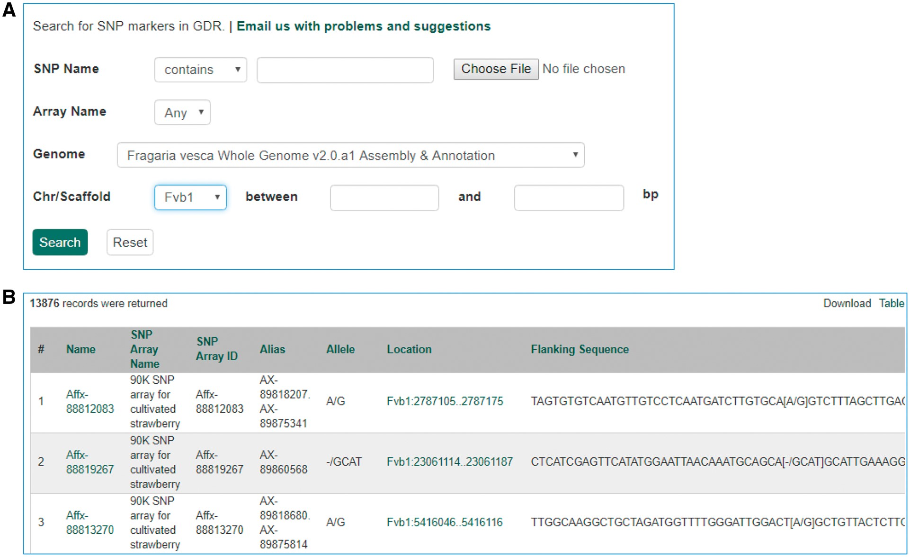
Figure 8. Search page for SNP markers in GDR. (A) SNP marker search page where users can search SNPs by name, SNP array ...
Notes:
Figure 8. Search page for SNP markers in GDR. (A) SNP marker search page where users can search SNPs by name, SNP array name and anchored genome position. (B) The returned search results include name, SNP array name, SNP array ID, aliases, alleles, genome location and flanking sequences.
Unless provided in the caption above, the following copyright applies to the content of this slide: © The Author(s) 2017. Published by Oxford University Press.This is an Open Access article distributed under the terms of the Creative Commons Attribution License (http://creativecommons.org/licenses/by/4.0/), which permits unrestricted reuse, distribution, and reproduction in any medium, provided the original work is properly cited.

