Slide 1
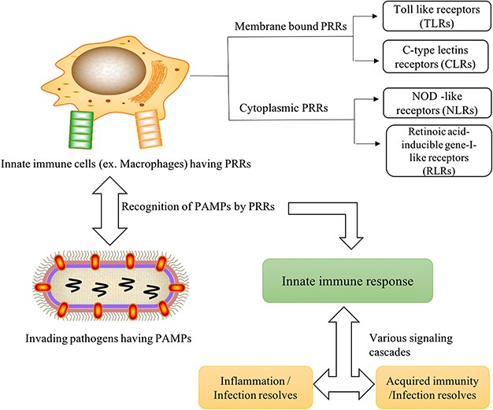
Figure 1 Graphical representation of immune mechanism through PRRs and PAMPs association after the microbial ...
Notes:
Figure 1 Graphical representation of immune mechanism through PRRs and PAMPs association after the microbial invasion.
Unless provided in the caption above, the following copyright applies to the content of this slide: © The Author(s) 2019. Published by Oxford University Press.This is an Open Access article distributed under the terms of the Creative Commons Attribution License (http://creativecommons.org/licenses/by/4.0/), which permits unrestricted reuse, distribution, and reproduction in any medium, provided the original work is properly cited.

Slide 2
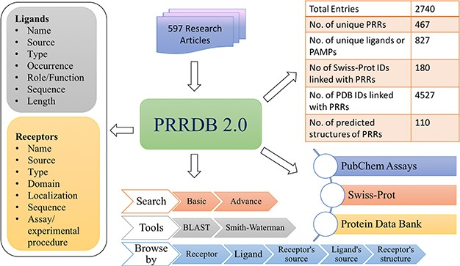
Figure 2 Architecture of PRRDB 2.0.
Notes:
Figure 2 Architecture of PRRDB 2.0.
Unless provided in the caption above, the following copyright applies to the content of this slide: © The Author(s) 2019. Published by Oxford University Press.This is an Open Access article distributed under the terms of the Creative Commons Attribution License (http://creativecommons.org/licenses/by/4.0/), which permits unrestricted reuse, distribution, and reproduction in any medium, provided the original work is properly cited.

Slide 3
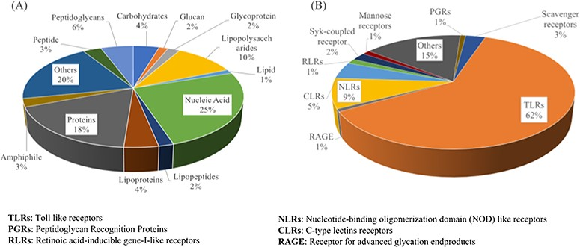
Figure 3 Distribution of various categories of PRRs (A) and ligands (B) stored in PRRDB 2.0.
Notes:
Figure 3 Distribution of various categories of PRRs (A) and ligands (B) stored in PRRDB 2.0.
Unless provided in the caption above, the following copyright applies to the content of this slide: © The Author(s) 2019. Published by Oxford University Press.This is an Open Access article distributed under the terms of the Creative Commons Attribution License (http://creativecommons.org/licenses/by/4.0/), which permits unrestricted reuse, distribution, and reproduction in any medium, provided the original work is properly cited.

Slide 4
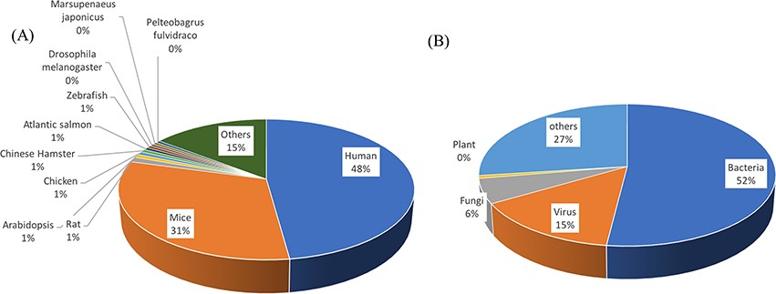
Figure 4 Distribution of source of PRRs (A) and ligands (B).
Notes:
Figure 4 Distribution of source of PRRs (A) and ligands (B).
Unless provided in the caption above, the following copyright applies to the content of this slide: © The Author(s) 2019. Published by Oxford University Press.This is an Open Access article distributed under the terms of the Creative Commons Attribution License (http://creativecommons.org/licenses/by/4.0/), which permits unrestricted reuse, distribution, and reproduction in any medium, provided the original work is properly cited.

Slide 5
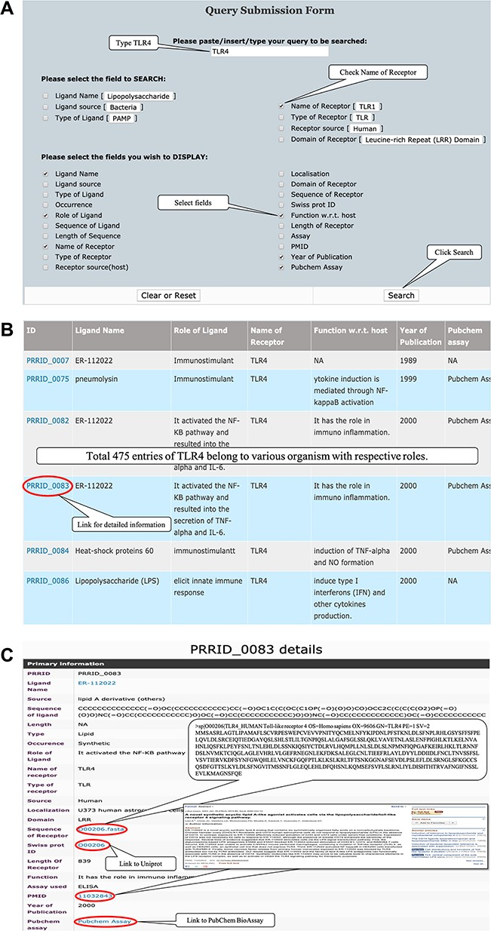
Figure 5 (A) Representative screenshot of PRRDB 2.0 demonstrating the submission of a query in simple search page. (B) ...
Notes:
Figure 5 (A) Representative screenshot of PRRDB 2.0 demonstrating the submission of a query in simple search page. (B) Screenshot of PRRDB 2.0 demonstrating the result page after submission of a query in simple search page. (C) Screenshot of PRRDB 2.0 demonstrating the detailed information page after the result page.
Unless provided in the caption above, the following copyright applies to the content of this slide: © The Author(s) 2019. Published by Oxford University Press.This is an Open Access article distributed under the terms of the Creative Commons Attribution License (http://creativecommons.org/licenses/by/4.0/), which permits unrestricted reuse, distribution, and reproduction in any medium, provided the original work is properly cited.

