Slide 1
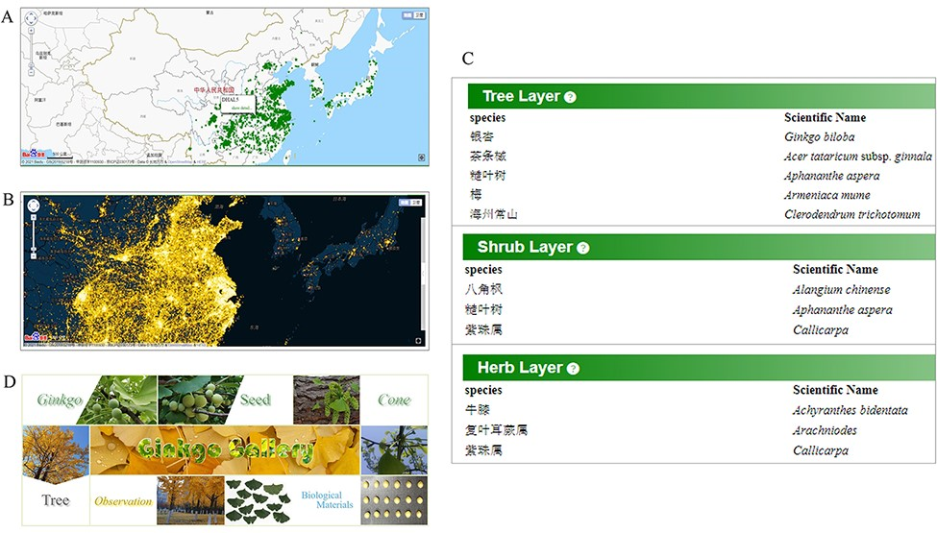
Figure 6. Comprehensive data for ginkgo conservation. Distribution map (A) of documented mature trees and heatmap (B) ...
Notes:
Figure 6. Comprehensive data for ginkgo conservation. Distribution map (A) of documented mature trees and heatmap (B) of reported trees. (C) Species list in each quadrat. (D) The gallery model collects various material type of trees.
Unless provided in the caption above, the following copyright applies to the content of this slide: © The Author(s) 2022. Published by Oxford University Press.This is an Open Access article distributed under the terms of the Creative Commons Attribution-NonCommercial License (https://creativecommons.org/licenses/by-nc/4.0/), which permits non-commercial re-use, distribution, and reproduction in any medium, provided the original work is properly cited. For commercial re-use, please contact journals.permissions@oup.com

