Slide 1
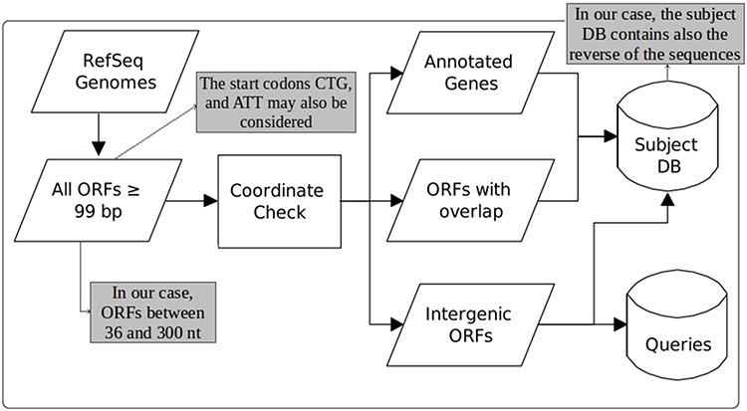
Figure 1. Construction of queries and the subject database (adapted from the work of Warren et al. (22)). The original ...
Notes:
Figure 1. Construction of queries and the subject database (adapted from the work of Warren et al. (22)). The original figure can be identified by white-background shapes. Illustrated in gray, the differences in our case are: only ORFs of length between 36 and 300 are considered; the start codons CTG and ATT may also be taken into account in addition to ATG, GTG and TTG; and the sequences that compose the subject DB are the ones coming from the three groups plus their reverse.
Unless provided in the caption above, the following copyright applies to the content of this slide: © The Author(s) 2020. Published by Oxford University Press.This is an Open Access article distributed under the terms of the Creative Commons Attribution License (http://creativecommons.org/licenses/by/4.0/), which permits unrestricted reuse, distribution, and reproduction in any medium, provided the original work is properly cited.

