Slide 1
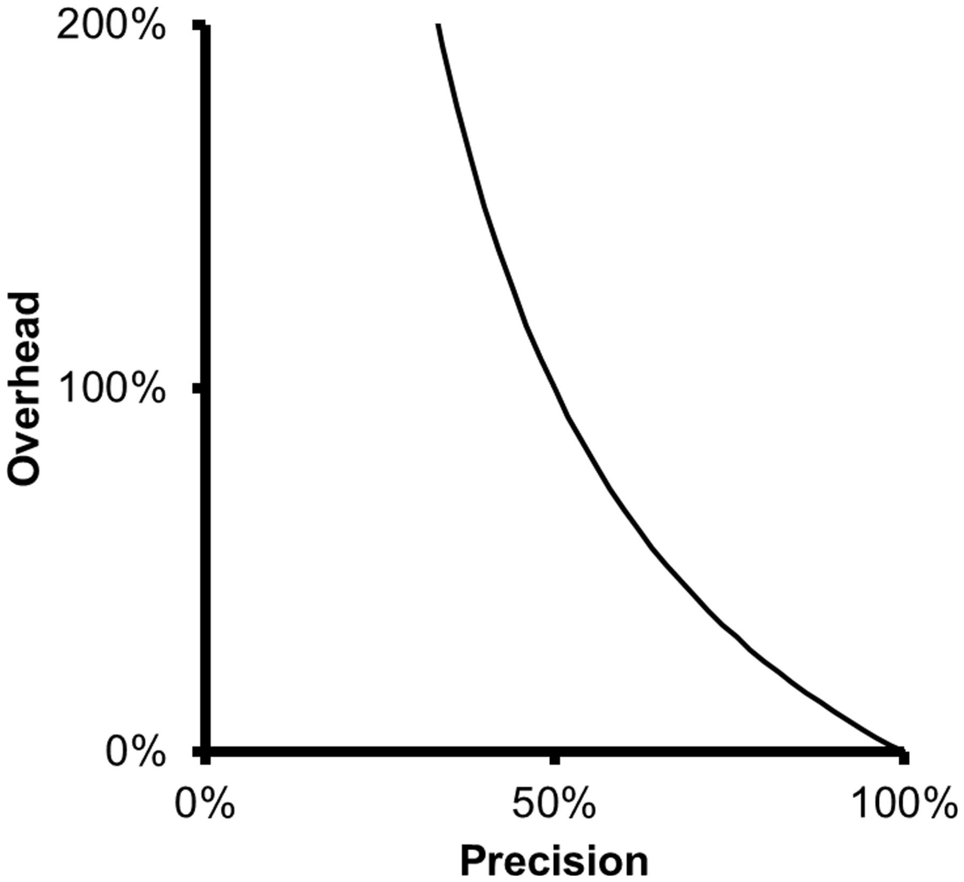
Figure 1 Relationship between precision and overhead. As precision decreases, overhead grows quickly and inversely to ...
Notes:
Figure 1 Relationship between precision and overhead. As precision decreases, overhead grows quickly and inversely to precision.
Unless provided in the caption above, the following copyright applies to the content of this slide: © The Author(s) 2015. Published by Oxford University Press. This is an Open Access article distributed under the terms of the Creative Commons Attribution License ( http://creativecommons.org/licenses/by/4.0/ ), which permits unrestricted reuse, distribution, and reproduction in any medium, provided the original work is properly cited.

Slide 2
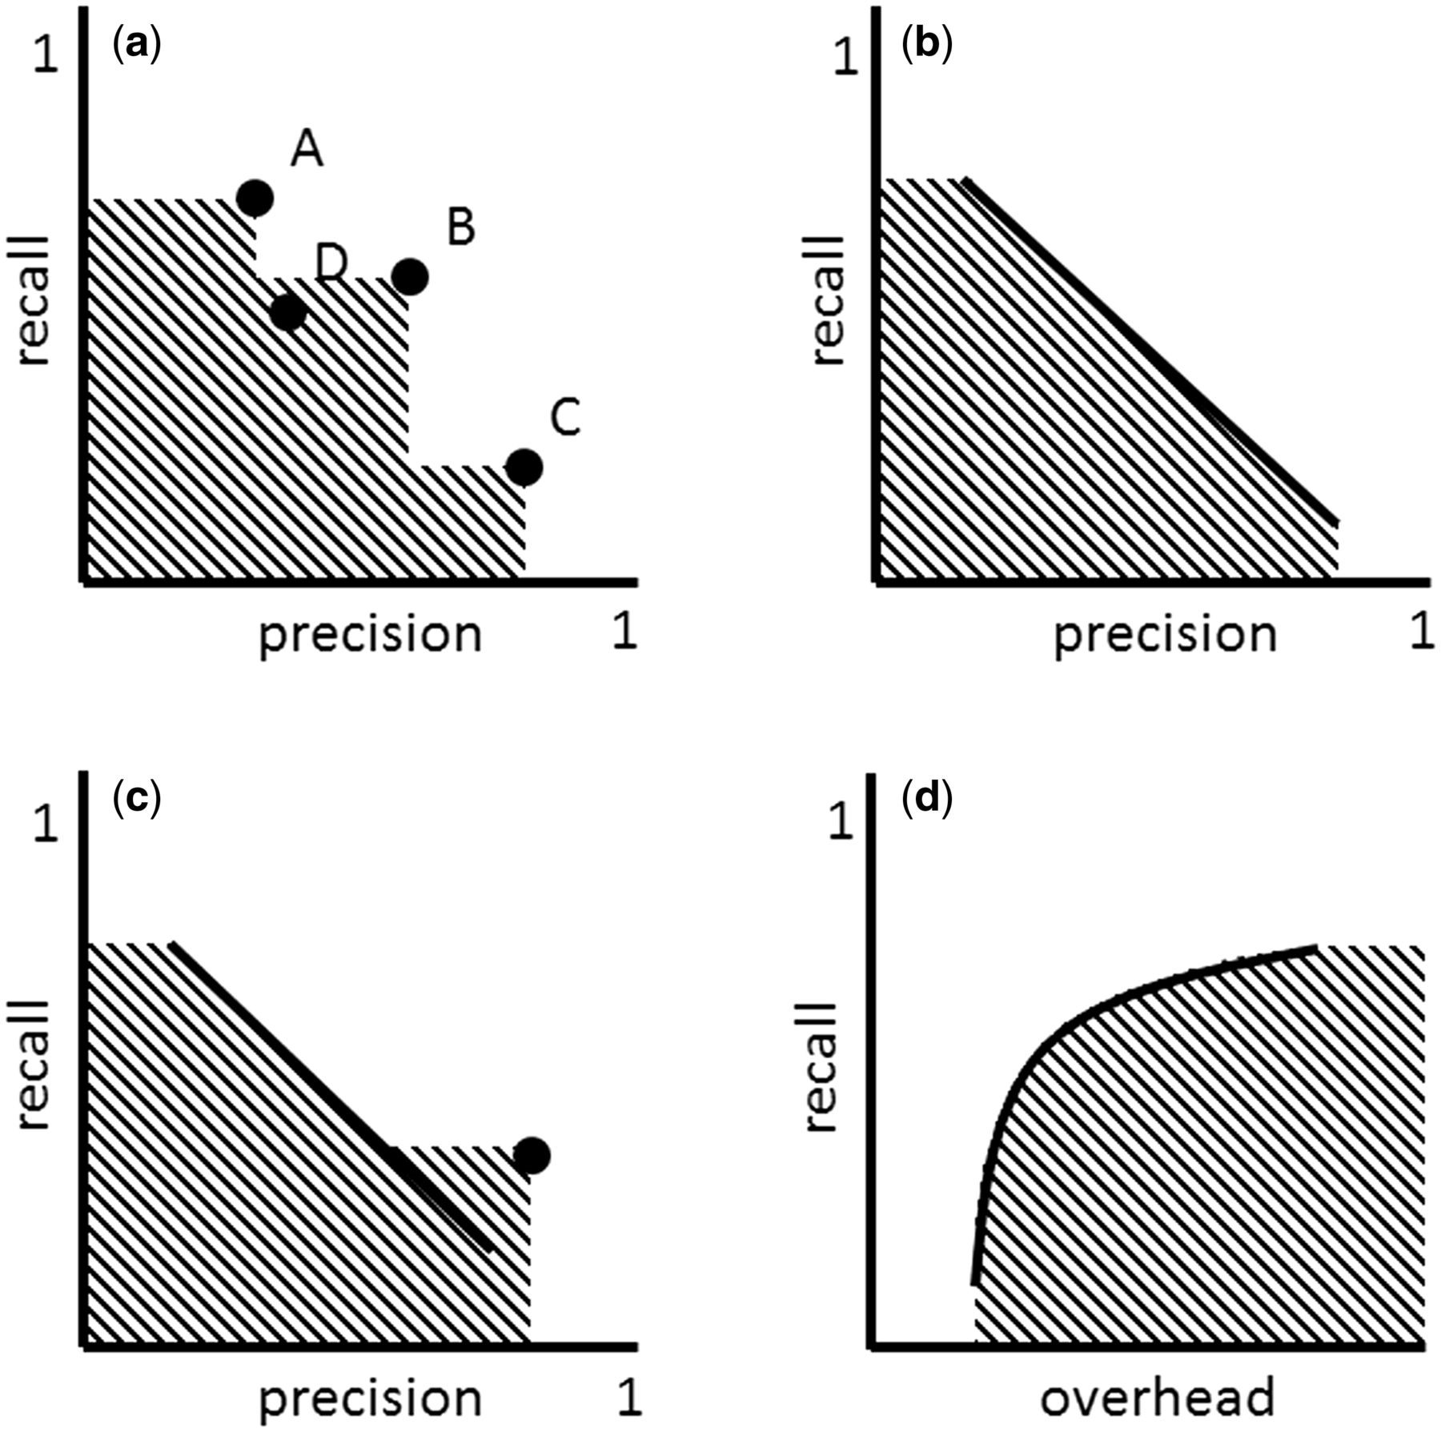
Figure 2 ( a ) ‘Multiple strategies’ approach in the precision-recall space. Strategy A can take the role of ‘high ...
Notes:
Figure 2 ( a ) ‘Multiple strategies’ approach in the precision-recall space. Strategy A can take the role of ‘high recall’ strategy, while C that of ‘high precision’ and B that of ‘compromise.’ A new strategy D is inferior to the set of strategies A, B and C, because it falls into the area covered (AC) by these strategies. ( b ) Adjustable strategy. ( c ) ‘Multiple strategies’ approach involving an adjustable strategy (defined by the line) and a non-adjustable strategy (defined by the dot). ( d ) Adjustable strategy in the overhead-recall space.
Unless provided in the caption above, the following copyright applies to the content of this slide: © The Author(s) 2015. Published by Oxford University Press. This is an Open Access article distributed under the terms of the Creative Commons Attribution License ( http://creativecommons.org/licenses/by/4.0/ ), which permits unrestricted reuse, distribution, and reproduction in any medium, provided the original work is properly cited.

