Slide 1
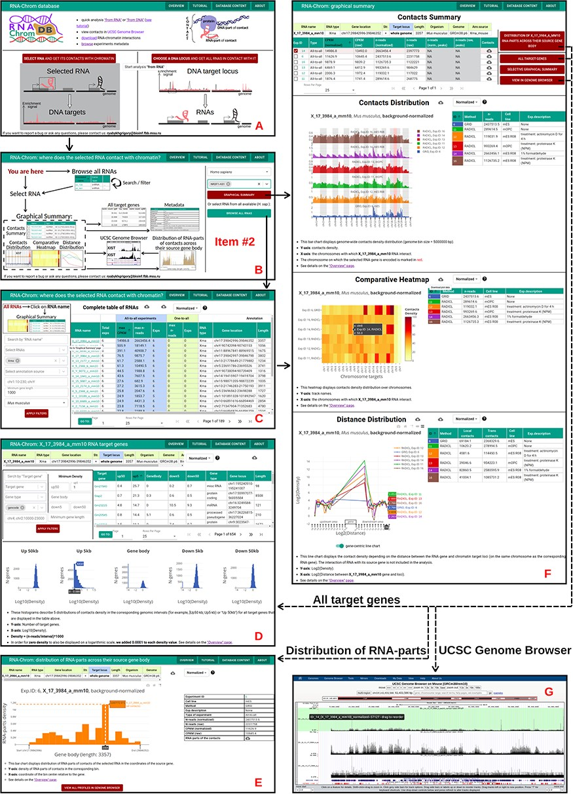
Figure 5. ‘From RNA’ analysis for X_17_3984_a_mm10 RNA (Mus musculus). The arrows reflect the workflow. A. A user ...
Notes:
Figure 5. ‘From RNA’ analysis for X_17_3984_a_mm10 RNA (Mus musculus). The arrows reflect the workflow. A. A user chooses ‘from RNA’ analysis. B. Then the user either enters the RNA name of interest in the ‘Select RNA’ field or presses ‘BROWSE ALL RNAS’ button. C. ‘Complete table of RNAs’. Here a user selects RNA for analysis. D. The ‘Graphical Summary’ page consists of the ‘Contacts Summary’ and three analytical plots. By selecting one or more contact maps of X_17_3984_a_mm10 RNA in the ‘Contacts Summary’ table, a user continues to analyze them by clicking on one of the four buttons located to the right of the table. E. ‘All target genes’ page displays the association of contacts with genes and their upstream and downstream regions. By applying several filters, a user downloads a list of target genes. From this point, the user can switch to ‘from DNA’ analysis. To do this, the user clicks on the target gene of interest. F. Distribution of X_17_3984_a_mm10 RNA-parts across their source gene body (may reflect the exon–intron structure, the multiple isoforms of the transcribed gene, etc.) A user can send distributions for all experiments to the UCSC Genome Browser for a more detailed study or download them. G. A user sends X_17_3984_a_mm10 contact maps (DNA-parts) to the UCSC Genome Browser if they want to view them in the higher resolution or visually match them to genomic annotations (gene sets, epigenetic marks, etc.) or data (ChIP-seq, Hi-C, etc.)
Unless provided in the caption above, the following copyright applies to the content of this slide: © The Author(s) 2023. Published by Oxford University Press.This is an Open Access article distributed under the terms of the Creative Commons Attribution License (https://creativecommons.org/licenses/by/4.0/), which permits unrestricted reuse, distribution, and reproduction in any medium, provided the original work is properly cited.

