Slide 1
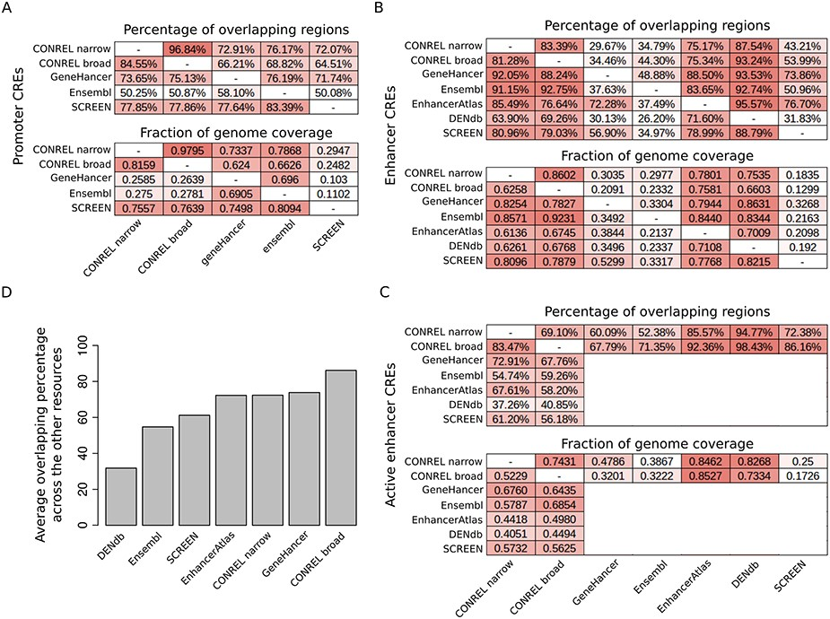
Figure 5. Comparison of CONREL CREs with other regulatory elements resources. (A) One-to-one comparison between CONREL, ...
Notes:
Figure 5. Comparison of CONREL CREs with other regulatory elements resources. (A) One-to-one comparison between CONREL, GeneHancer, Ensembl and SCREEN promoters. Each cell in the top matrix indicates the percentage of promoters annotated in the corresponding row resource that have an overlapping with the promoters annotated in the corresponding column resource. Each cell in the bottom matrix indicates the fraction of the genome covered by the promoters annotated in the corresponding row resource that is also captured by the promoters annotated in the corresponding column resource. (B) One-to-one comparison between CONREL, GeneHancer, Ensembl, EnhancerAtlas, DENdb and SCREEN enhancers. (C) One-to-one comparison between CONREL active enhancer and GeneHancer, Ensembl, EnhancerAtlas, DENdb and SCREEN enhancers. (D) Average percentage of CONREL active enhancer and GeneHancer, Ensembl, EnhancerAtlas, DENdb and SCREEN enhancers that have overlapping with each of the other resources.
Unless provided in the caption above, the following copyright applies to the content of this slide: © The Author(s) 2020. Published by Oxford University Press.This is an Open Access article distributed under the terms of the Creative Commons Attribution License (http://creativecommons.org/licenses/by/4.0/), which permits unrestricted reuse, distribution, and reproduction in any medium, provided the original work is properly cited.

