Slide 1
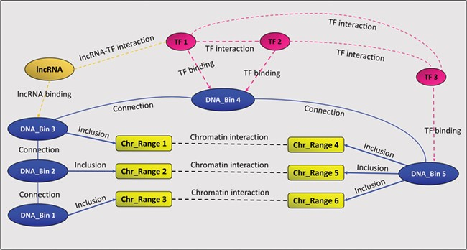
Figure 1 A GREG regulatory landscape. A regulatory landscape contains DNA bins (blue), which are ‘connected’ between ...
Notes:
Figure 1 A GREG regulatory landscape. A regulatory landscape contains DNA bins (blue), which are ‘connected’ between them. DNA-binding proteins or TF (red) ‘bind’ the DNA bins and ‘interact’ with other proteins (red). DNA bins (blue) also ‘include’ some DNA ranges (yellow), which, in time, ‘interact’ with other ranges through chromatin–chromatin interactions (black). lncRNAs (orange) can interact with both bins and proteins.
Unless provided in the caption above, the following copyright applies to the content of this slide: © The Author(s) 2020. Published by Oxford University Press.This is an Open Access article distributed under the terms of the Creative Commons Attribution License (http://creativecommons.org/licenses/by/4.0/), which permits unrestricted reuse, distribution, and reproduction in any medium, provided the original work is properly cited.

