Slide 1
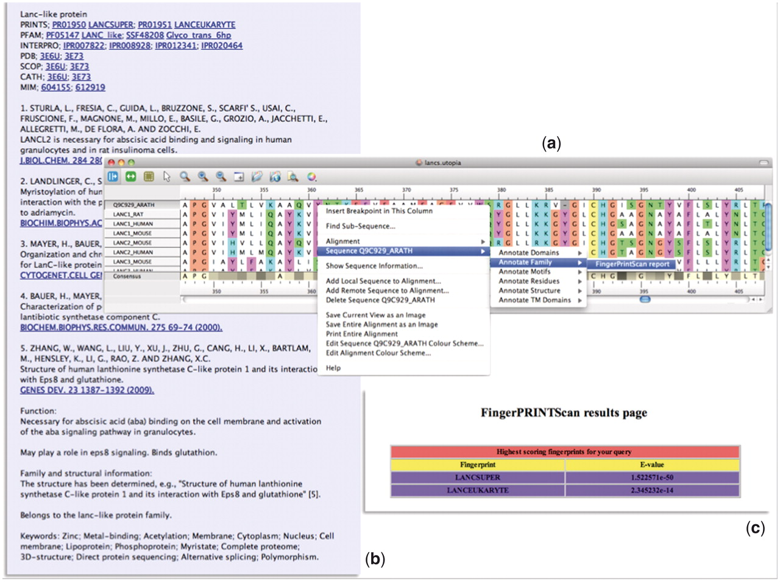
Figure 5. Illustration of the PRECIS and FingerPRINTScan Web-service plugins integrated within Utopia’s CINEMA ...
Notes:
Figure 5. Illustration of the PRECIS and FingerPRINTScan Web-service plugins integrated within Utopia’s CINEMA alignment editor: (a) shows an alignment of sequence Q9C929_ARATH with LanC-like proteins, with the context-sensitive menu invoking a Web-service plugin; (b) shows the report generated for this group of sequences by the PRECIS plugin; and (c) shows the FingerPRINTScan-plugin result for a PRINTS search with Q9C929_ARATH, which diagnoses the sequence as a eurkaryotic LanC-like protein belonging to the LanC-like superfamily.
Unless provided in the caption above, the following copyright applies to the content of this slide: © The Author(s) 2012. Published by Oxford University Press.This is an Open Access article distributed under the terms of the Creative Commons Attribution Non-Commercial License (http://creativecommons.org/licenses/by-nc/3.0), which permits unrestricted non-commercial use, distribution, and reproduction in any medium, provided the original work is properly cited.

