Slide 1
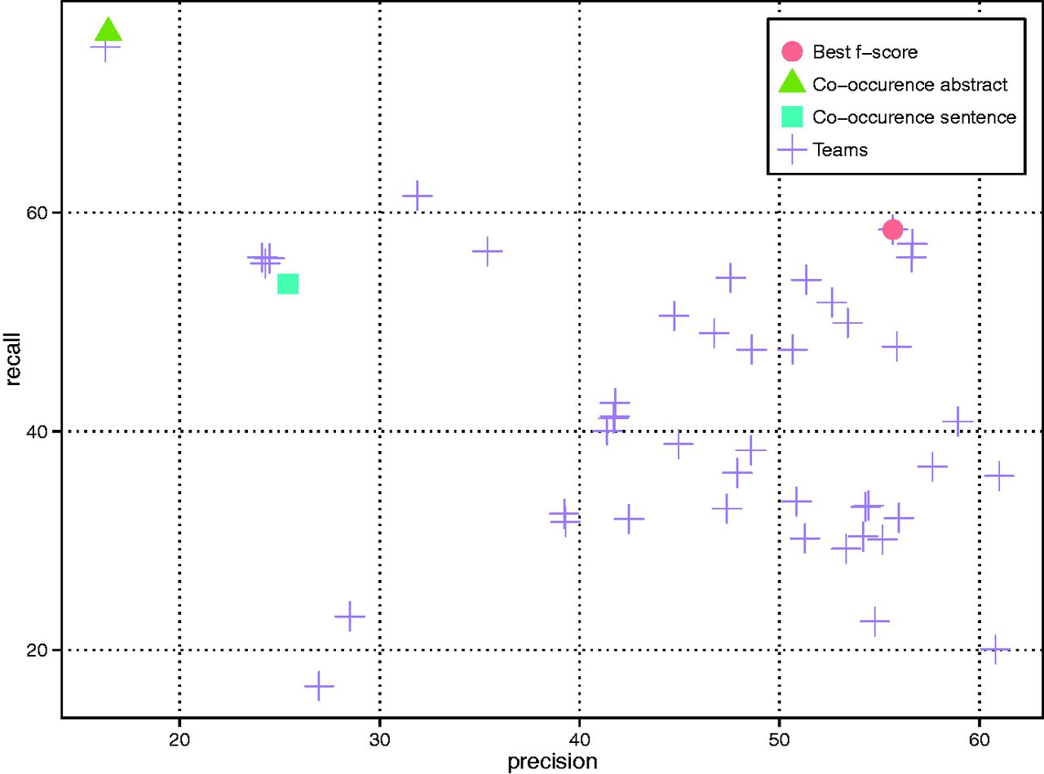
Figure 3. CID results of all teams as well as two variants of the co-occurrence baseline method (i.e. abstract- and ...
Notes:
Figure 3. CID results of all teams as well as two variants of the co-occurrence baseline method (i.e. abstract- and sentence-level).
Unless provided in the caption above, the following copyright applies to the content of this slide: Published by Oxford University Press 2016. This work is written by US Government employees and is in the public domain in the US.

