Slide 1
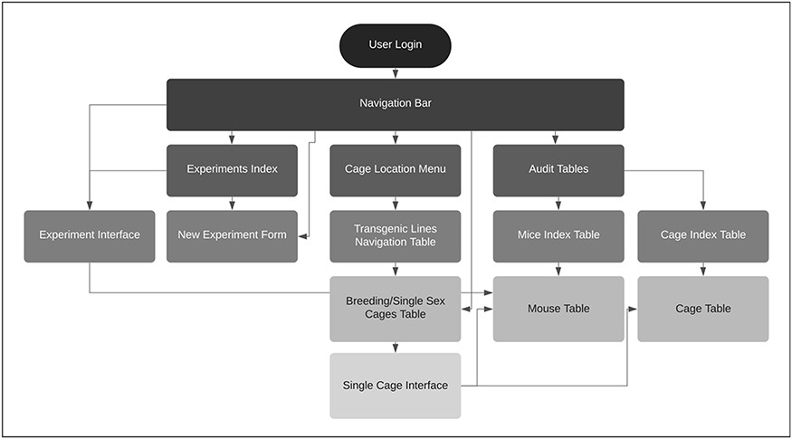
Figure 1. TopoDB website architecture.
Notes:
Figure 1. TopoDB website architecture.
Unless provided in the caption above, the following copyright applies to the content of this slide: © The Author(s) 2020. Published by Oxford University Press.This is an Open Access article distributed under the terms of the Creative Commons Attribution License (http://creativecommons.org/licenses/by/4.0/), which permits unrestricted reuse, distribution, and reproduction in any medium, provided the original work is properly cited.

Slide 2
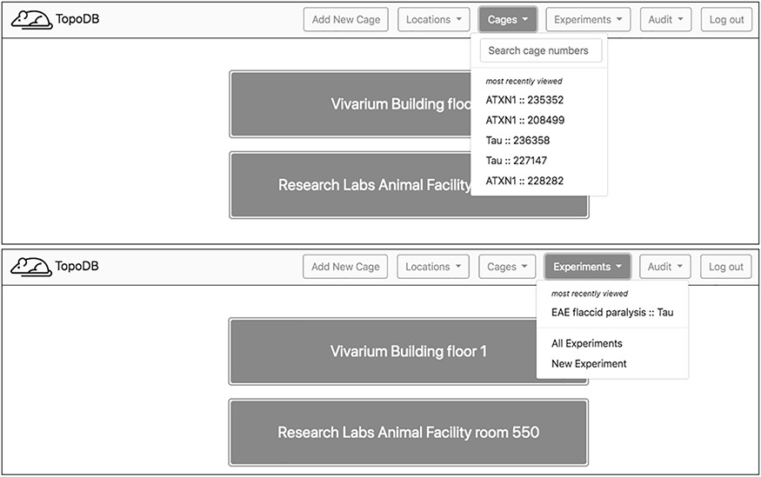
Figure 2. Upon login, a home page showing the top level of cage organization—Locations—is shown. A navigation bar at ...
Notes:
Figure 2. Upon login, a home page showing the top level of cage organization—Locations—is shown. A navigation bar at the top of each page enables users to quickly access recently visited cages and experiments. A search box also assists in finding specific cages.
Unless provided in the caption above, the following copyright applies to the content of this slide: © The Author(s) 2020. Published by Oxford University Press.This is an Open Access article distributed under the terms of the Creative Commons Attribution License (http://creativecommons.org/licenses/by/4.0/), which permits unrestricted reuse, distribution, and reproduction in any medium, provided the original work is properly cited.

Slide 3
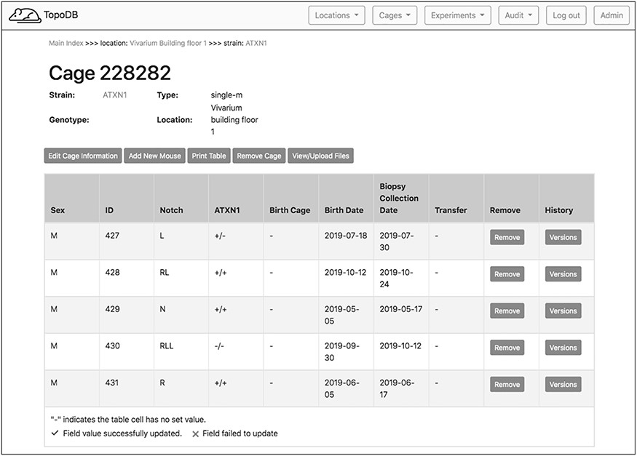
Figure 3. The single cage view in TopoDB summarizes all the principle information about the animals housed in each cage ...
Notes:
Figure 3. The single cage view in TopoDB summarizes all the principle information about the animals housed in each cage of the colony. This includes the sex, the unique identification number, the corresponding identification code (such as ear punches or ear tags), the date of birth and the biopsy collection date. The possible transfer date from or to another cage is also displayed in this interface.
Unless provided in the caption above, the following copyright applies to the content of this slide: © The Author(s) 2020. Published by Oxford University Press.This is an Open Access article distributed under the terms of the Creative Commons Attribution License (http://creativecommons.org/licenses/by/4.0/), which permits unrestricted reuse, distribution, and reproduction in any medium, provided the original work is properly cited.

Slide 4
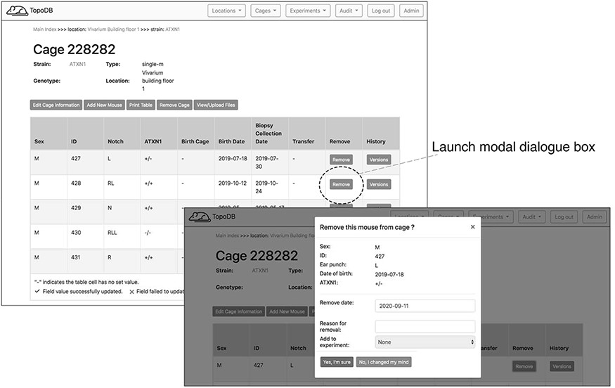
Figure 4. Dedicated buttons in the single cage view activate specific functionality. Here the form for recording the ...
Notes:
Figure 4. Dedicated buttons in the single cage view activate specific functionality. Here the form for recording the removal of a mouse from the colony (for experimentation or other reasons) is presented as a modal overlaying the single cage view.
Unless provided in the caption above, the following copyright applies to the content of this slide: © The Author(s) 2020. Published by Oxford University Press.This is an Open Access article distributed under the terms of the Creative Commons Attribution License (http://creativecommons.org/licenses/by/4.0/), which permits unrestricted reuse, distribution, and reproduction in any medium, provided the original work is properly cited.

Slide 5
Figure 5. This single cage interface allows attaching valuable metadata that are associated with the animals in the ...
Notes:
Figure 5. This single cage interface allows attaching valuable metadata that are associated with the animals in the cage. They can include the genotyping results of a specific transgenic line, the vendor’s documentation for founder mice or the cryopreservation details.
Unless provided in the caption above, the following copyright applies to the content of this slide: © The Author(s) 2020. Published by Oxford University Press.This is an Open Access article distributed under the terms of the Creative Commons Attribution License (http://creativecommons.org/licenses/by/4.0/), which permits unrestricted reuse, distribution, and reproduction in any medium, provided the original work is properly cited.

Slide 6
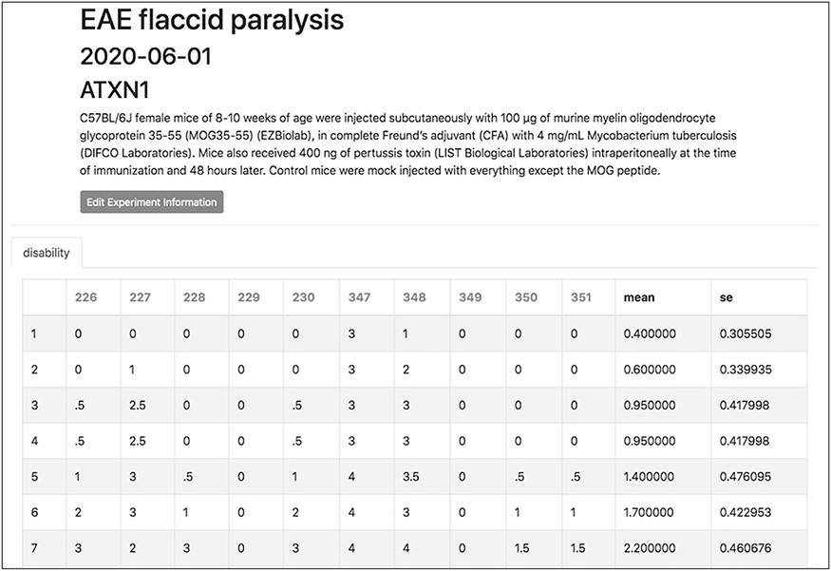
Figure 6. The experiment interface of TopoDB allows the efficient organization and storage of experimental data points. ...
Notes:
Figure 6. The experiment interface of TopoDB allows the efficient organization and storage of experimental data points. In this example, the EAE scores collected on a cohort of 10 mice up to 11 days postimmunization are organized in a spreadsheet format. The individual mouse ID numbers are displayed on the top row. Mean values and SEs are also automatically calculated for each day.
Unless provided in the caption above, the following copyright applies to the content of this slide: © The Author(s) 2020. Published by Oxford University Press.This is an Open Access article distributed under the terms of the Creative Commons Attribution License (http://creativecommons.org/licenses/by/4.0/), which permits unrestricted reuse, distribution, and reproduction in any medium, provided the original work is properly cited.

Slide 7
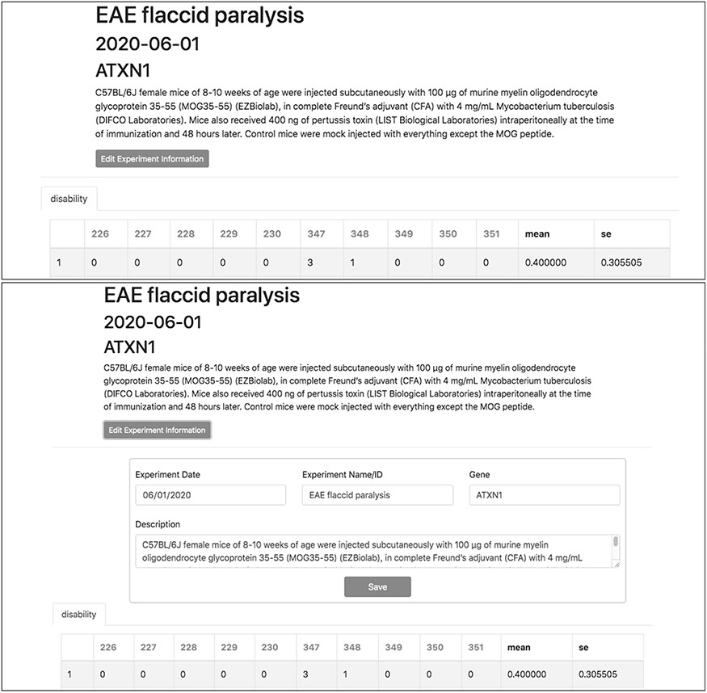
Figure 7. Experiment metadata can be edited by clicking the ‘Edit Experiment Information’ button in the experiment ...
Notes:
Figure 7. Experiment metadata can be edited by clicking the ‘Edit Experiment Information’ button in the experiment interface. ‘Accordian’-like elements, invisible until activated by the user, keep pages uncluttered, avoid time-consuming navigation and provide utility.
Unless provided in the caption above, the following copyright applies to the content of this slide: © The Author(s) 2020. Published by Oxford University Press.This is an Open Access article distributed under the terms of the Creative Commons Attribution License (http://creativecommons.org/licenses/by/4.0/), which permits unrestricted reuse, distribution, and reproduction in any medium, provided the original work is properly cited.

Slide 8
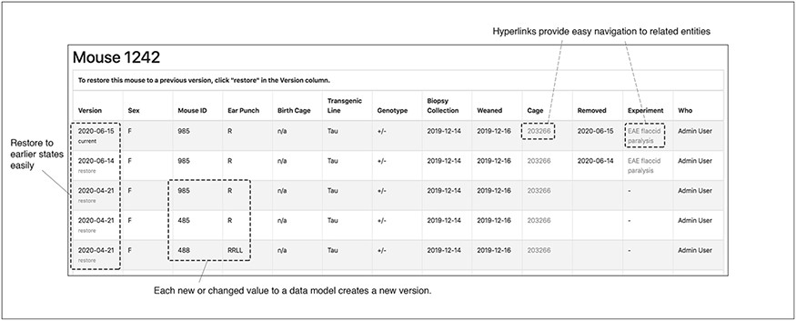
Figure 8. The audit interface records all the modifications submitted for each mouse in TopoDB in chronological order. ...
Notes:
Figure 8. The audit interface records all the modifications submitted for each mouse in TopoDB in chronological order. This feature allows the easy identification of incorrectly input data and the efficient recovery of the correct information from previous versions stored in the database.
Unless provided in the caption above, the following copyright applies to the content of this slide: © The Author(s) 2020. Published by Oxford University Press.This is an Open Access article distributed under the terms of the Creative Commons Attribution License (http://creativecommons.org/licenses/by/4.0/), which permits unrestricted reuse, distribution, and reproduction in any medium, provided the original work is properly cited.

