Slide 1
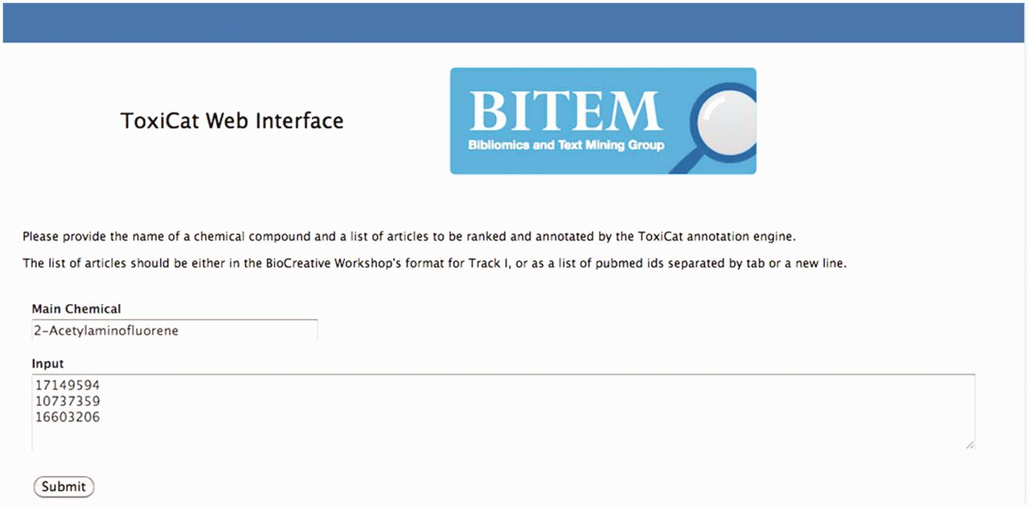
Figure 3 In this figure, 2-acetylaminofluorene is provided as input chemical compound together with a list of articles ...
Notes:
Figure 3 In this figure, 2-acetylaminofluorene is provided as input chemical compound together with a list of articles (PMIDs) selected in Figure 2. Users can go directly to this page if the PMIDs have been obtained from other sources.
Unless provided in the caption above, the following copyright applies to the content of this slide: © The Author(s) 2012. Published by Oxford University Press.This is an Open Access article distributed under the terms of the Creative Commons Attribution License (http://creativecommons.org/licenses/by-nc/3.0/), which permits non-commercial reuse, distribution, and reproduction in any medium, provided the original work is properly cited. For commercial re-use, please contact journals.permissions@oup.com.

