Slide 1
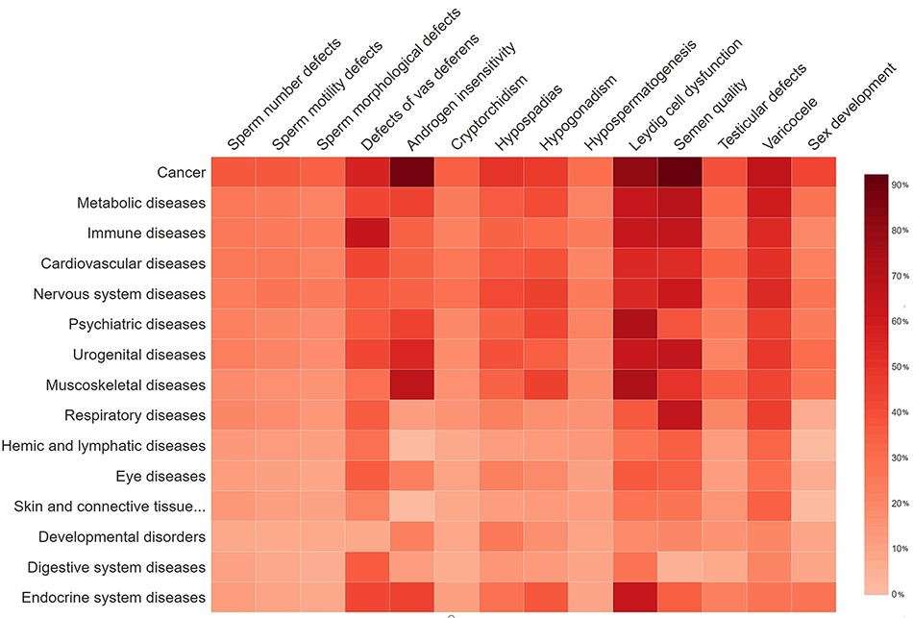
Figure 7. The percentage of gene overlap between disease subgroups in MIK and other disease classes.
Notes:
Figure 7. The percentage of gene overlap between disease subgroups in MIK and other disease classes. Higher the percentage of the gene overlap the darker the shade of red.
Unless provided in the caption above, the following copyright applies to the content of this slide: © The Author(s) 2021. Published by Oxford University Press.This is an Open Access article distributed under the terms of the Creative Commons Attribution License (http://creativecommons.org/licenses/by/4.0/), which permits unrestricted reuse, distribution, and reproduction in any medium, provided the original work is properly cited.

