Slide 1
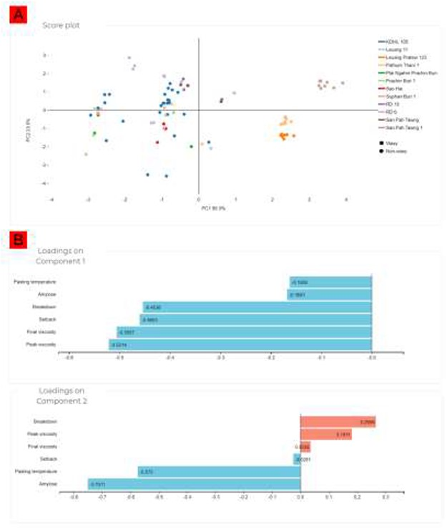
Figure 4. PLS-DA of the Thai rice cultivars. (A) Score plot showing the separation between the cultivars. (B) Loading ...
Notes:
Figure 4. PLS-DA of the Thai rice cultivars. (A) Score plot showing the separation between the cultivars. (B) Loading plots indicating the influences of each starch parameter on the separation of the cultivars.
Unless provided in the caption above, the following copyright applies to the content of this slide: © The Author(s) 2020. Published by Oxford University Press.This is an Open Access article distributed under the terms of the Creative Commons Attribution License (http://creativecommons.org/licenses/by/4.0/), which permits unrestricted reuse, distribution, and reproduction in any medium, provided the original work is properly cited.

