Slide 1
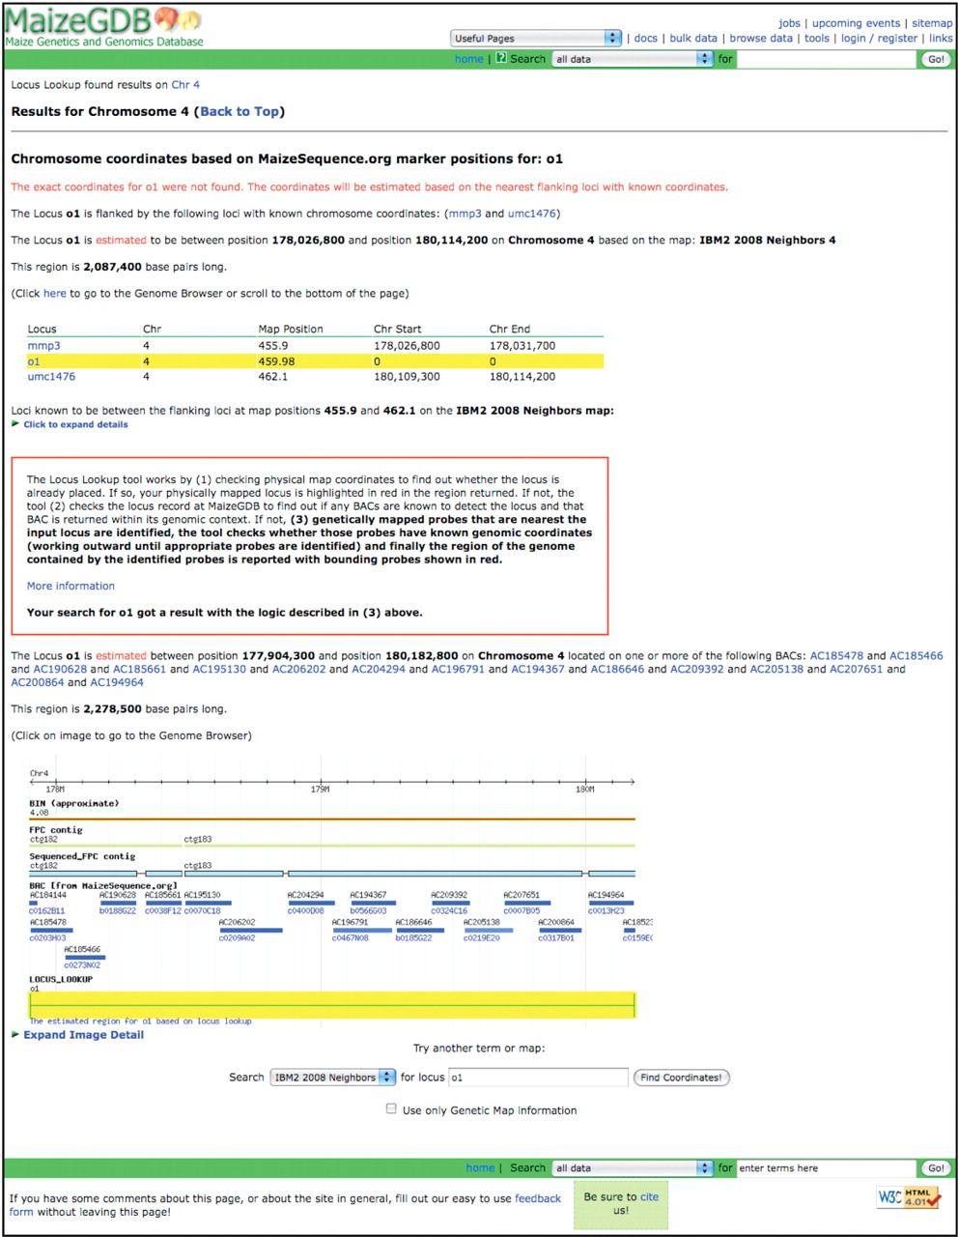
Figure 3. The result page for the approximate genomic coordinates for the opaque endosperm1 (o1) locus when the Locus ...
Notes:
Figure 3. The result page for the approximate genomic coordinates for the opaque endosperm1 (o1) locus when the Locus Lookup tool is used.
Unless provided in the caption above, the following copyright applies to the content of this slide: Published by Oxford University Press 2009.This is Open Access article distributed under the terms of the Creative Commons Attribution Non-Commercial License (http://creativecommons.org/licenses/by-nc/2.5/uk/) which permits unrestricted non-commercial use, distribution, and reproduction in any medium, provided the original work is properly cited.

