Slide 1
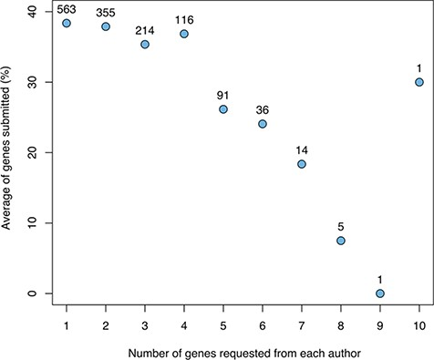
Figure 2 The relationship between the number of genes for which a given author was asked to provide snapshots and the ...
Notes:
Figure 2 The relationship between the number of genes for which a given author was asked to provide snapshots and the average fraction of genes for which snapshots were returned (not including authors sent a spreadsheet with many genes). The numbers above the data points indicate the number of authors in each category.
Unless provided in the caption above, the following copyright applies to the content of this slide: © The Author(s) 2020. Published by Oxford University Press.This is an Open Access article distributed under the terms of the Creative Commons Attribution License (http://creativecommons.org/licenses/by/4.0/), which permits unrestricted reuse, distribution, and reproduction in any medium, provided the original work is properly cited.

