Slide 1
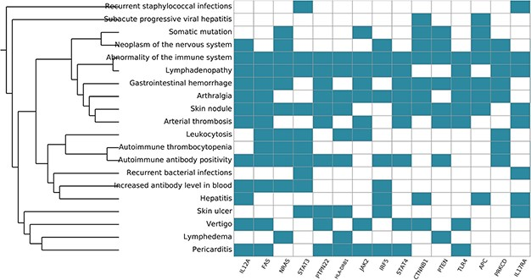
Figure 8 Systemic functional analysis of the RA map using HPO terms. Heat map of the top 15 priority genes and their ...
Notes:
Figure 8 Systemic functional analysis of the RA map using HPO terms. Heat map of the top 15 priority genes and their systemic interpretation using BioInfoMiner and HPO terms.
Unless provided in the caption above, the following copyright applies to the content of this slide: © The Author(s) 2020. Published by Oxford University Press.This is an Open Access article distributed under the terms of the Creative Commons Attribution License (http://creativecommons.org/licenses/by/4.0/), which permits unrestricted reuse, distribution, and reproduction in any medium, provided the original work is properly cited.

