Slide 1
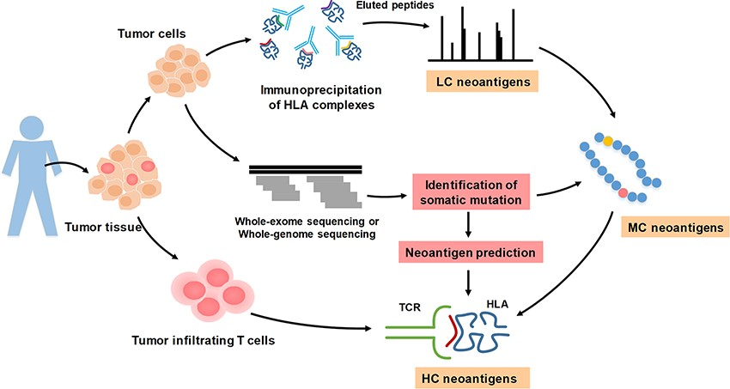
Figure 1 The illustration of high confidence, medium confidence and low confidence neoantigens based on validation ...
Notes:
Figure 1 The illustration of high confidence, medium confidence and low confidence neoantigens based on validation approaches.
Unless provided in the caption above, the following copyright applies to the content of this slide: © The Author(s) 2020. Published by Oxford University Press.This is an Open Access article distributed under the terms of the Creative Commons Attribution License (http://creativecommons.org/licenses/by/4.0/), which permits unrestricted reuse, distribution, and reproduction in any medium, provided the original work is properly cited.

Slide 2
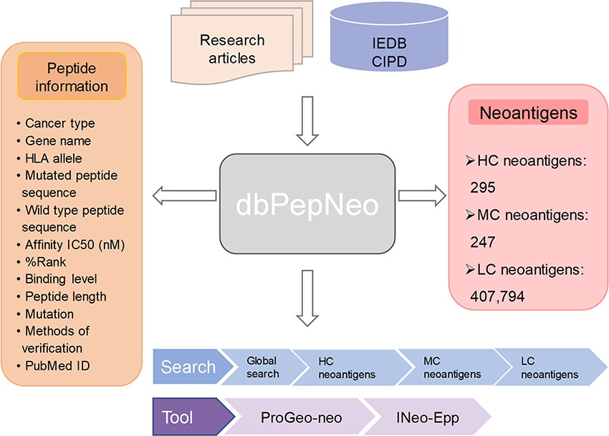
Figure 2 Architecture of dbPepNeo. CIPD: Cancer Immunity Peptide Database; LC: low confidence; MC: medium confidence; ...
Notes:
Figure 2 Architecture of dbPepNeo. CIPD: Cancer Immunity Peptide Database; LC: low confidence; MC: medium confidence; HC: high confidence.
Unless provided in the caption above, the following copyright applies to the content of this slide: © The Author(s) 2020. Published by Oxford University Press.This is an Open Access article distributed under the terms of the Creative Commons Attribution License (http://creativecommons.org/licenses/by/4.0/), which permits unrestricted reuse, distribution, and reproduction in any medium, provided the original work is properly cited.

Slide 3
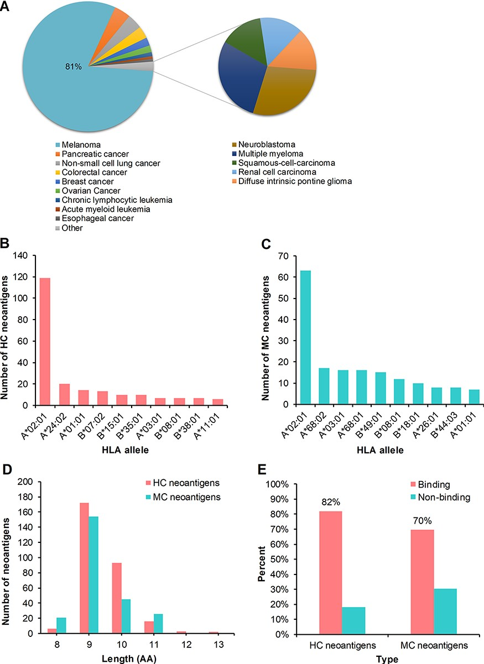
Figure 3 Statistics analysis of the collected peptides in dbPepNeo. (A) Distribution of high confidence neoantigens. ...
Notes:
Figure 3 Statistics analysis of the collected peptides in dbPepNeo. (A) Distribution of high confidence neoantigens. (B) Top 10 HLA alleles matched with high confidence neoantigens. (C) Top 10 HLA alleles matched with medium confidence neoantigens. (D) The number of medium confidence neoantigens and high confidence neoantigens based on the length of amino acid. (E) Affinity prediction with NetMHCpan of medium confidence neoantigens and high confidence neoantigens.
Unless provided in the caption above, the following copyright applies to the content of this slide: © The Author(s) 2020. Published by Oxford University Press.This is an Open Access article distributed under the terms of the Creative Commons Attribution License (http://creativecommons.org/licenses/by/4.0/), which permits unrestricted reuse, distribution, and reproduction in any medium, provided the original work is properly cited.

Slide 4
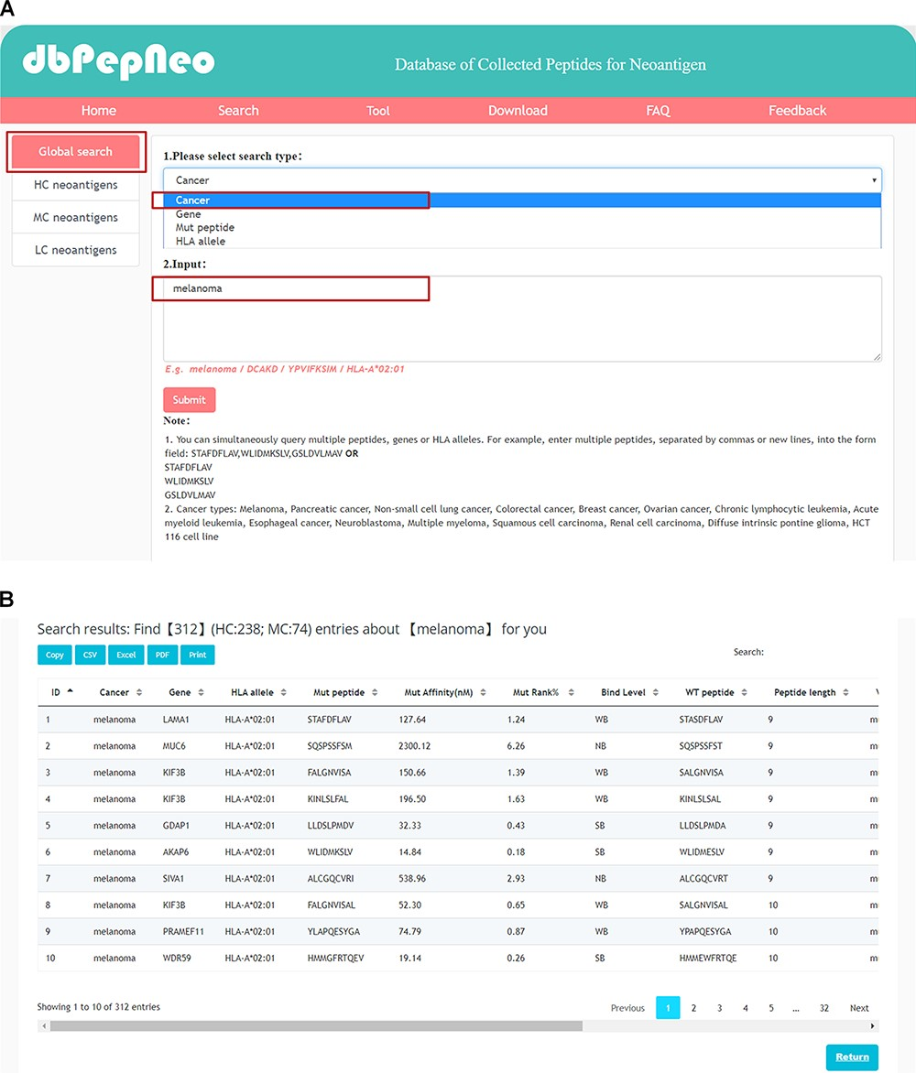
Figure 4 Searching and results presentation in dbPepNeo. (A) The workflow of searching in dbPepNeo. (B) Results of ...
Notes:
Figure 4 Searching and results presentation in dbPepNeo. (A) The workflow of searching in dbPepNeo. (B) Results of melanoma under the search of cancer type. Cancer: cancer type; Gene: gene name; HLA allele: HLA allele; Mut peptide: mutated peptide sequence; Mut affinity (nM): mutated peptide affinity IC50 (nM), the predicted binding affinity between mutant peptide and HLA allele by NetMHCpan (v4.0); Mut %Rank: %Rank of mutated peptide, the predicted binding affinity between mutant peptide and HLA allele by NetMHCpan (v4.0); Mut binding level: binding level between mutant peptide and HLA allele; WT peptide: wild type peptide sequence; Peptide length: the number of amino acids contained in the peptide; Mutation: amino acid change; Verification: method of experimental verification; Reference: the supporting literature link; ‘/’: information not provided in the original article is marked as ‘/’.
Unless provided in the caption above, the following copyright applies to the content of this slide: © The Author(s) 2020. Published by Oxford University Press.This is an Open Access article distributed under the terms of the Creative Commons Attribution License (http://creativecommons.org/licenses/by/4.0/), which permits unrestricted reuse, distribution, and reproduction in any medium, provided the original work is properly cited.

