Slide 1
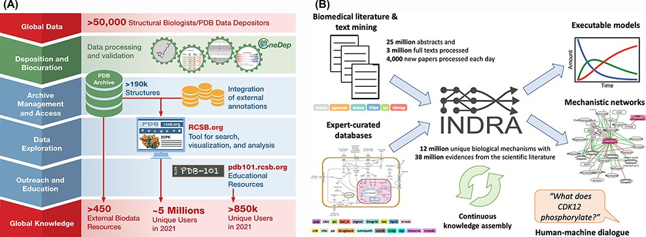
Figure 2. (A) RCSB PDB converts global data into global knowledge. (B) INDRA performs knowledge assembly from the ...
Notes:
Figure 2. (A) RCSB PDB converts global data into global knowledge. (B) INDRA performs knowledge assembly from the biomedical literature and expert-curated databases into a knowledge base of mechanistic statements that can be converted into models and networks and queried through human–machine dialogue.
Unless provided in the caption above, the following copyright applies to the content of this slide: © The Author(s) 2022. Published by Oxford University Press.This is an Open Access article distributed under the terms of the Creative Commons Attribution-NonCommercial License (https://creativecommons.org/licenses/by-nc/4.0/), which permits non-commercial re-use, distribution, and reproduction in any medium, provided the original work is properly cited. For commercial re-use, please contact journals.permissions@oup.com

