Slide 1
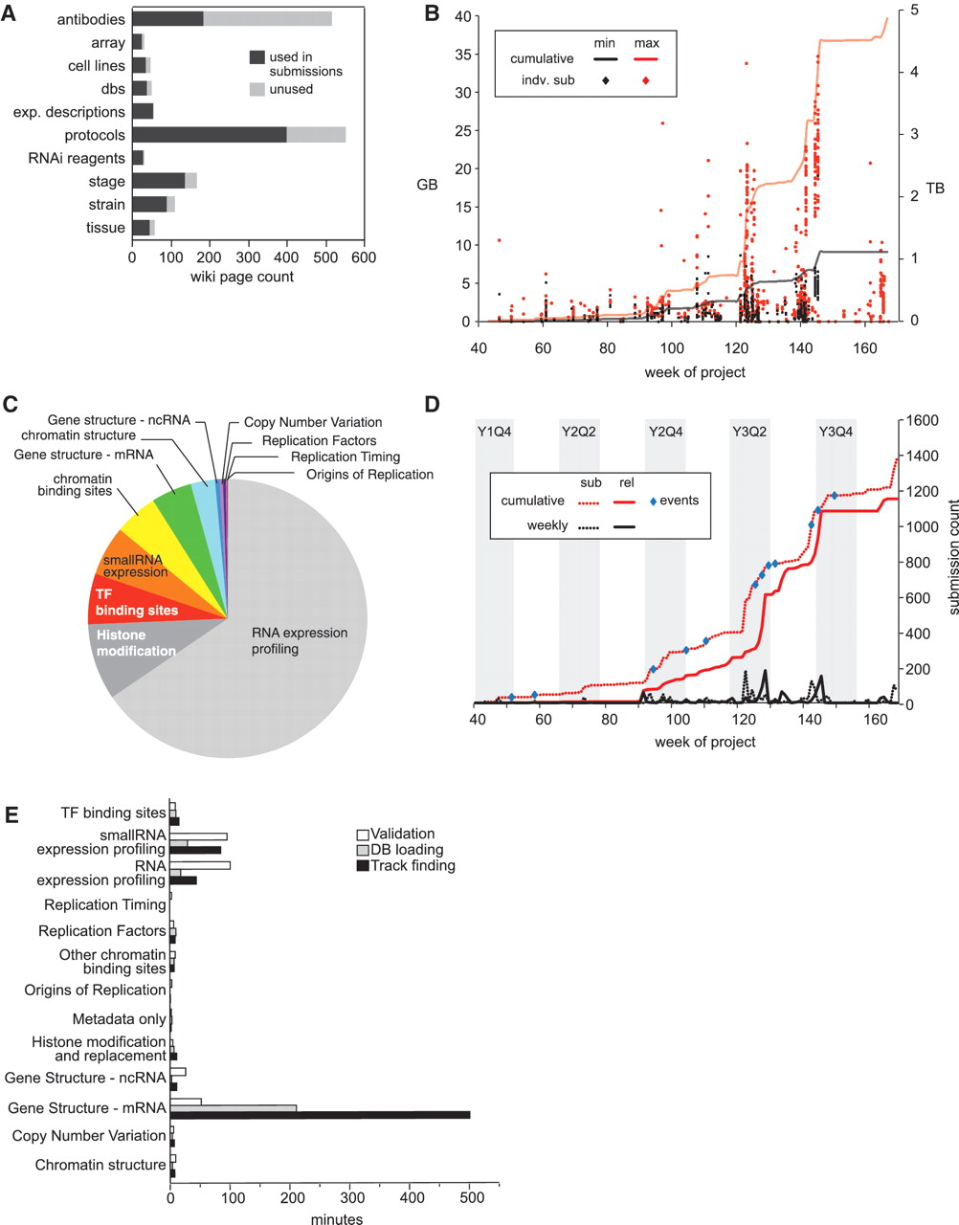
Figure 4. modENCODE data submission statistics. (A) Distribution of wiki page types. Number of wiki pages used in ...
Notes:
Figure 4. modENCODE data submission statistics. (A) Distribution of wiki page types. Number of wiki pages used in released submissions (dark gray) out of the total set, which have been entered in the wiki. The unused set of wiki pages may be used in future submissions. Data were only from released data sets, and not those superseded, deprecated or rejected. (B) Distribution of submission package sizes. Scatterplot of individual package sizes (in GB, scale on left) are overlaid with the cumulative size of all modENCODE data (in TB, scale on right), over the course of the project. Black indicates the size of the files uploaded into the system by data providers, and is the minimal set required for backup; red indicates the total size of a processed submission, including gbrowse tracks, chadoxml and all versions of uploaded data, and is the maximum size required to maintain a complete history. (C) Composition of modENCODE data types. These are based on the cumulative submission file sizes in each category, including data sets that have been superseded, replaced and rejected. (D) Number of submissions over time. Plot reveals spikes in data submission. Dotted lines indicate when submissions were initially created; solid lines indicate when submissions were released in the pipeline. Red lines show cumulative counts; black lines show the number of counts per week. Events, such as scientific meetings or data freezes are indicated with blue circles. Project quarters are indicated (Year 1 Quarter 4 is abbreviated Y1Q4). All data, including superseded, replaced and rejected submissions, are shown. (E) Pipeline processing times grouped by data type. Average processing times (in minutes) for the three pipeline steps (validation, database loading and track finding) are shown for each type of data in released data sets.
Unless provided in the caption above, the following copyright applies to the content of this slide: © The Author(s) 2011. Published by Oxford University Press.This is Open Access article distributed under the terms of the Creative Commons Attribution Non-Commercial License (http://creativecommons.org/licenses/by-nc/2.5), which permits unrestricted non-commercial use, distribution, and reproduction in any medium, provided the original work is properly cited.

