Slide 1
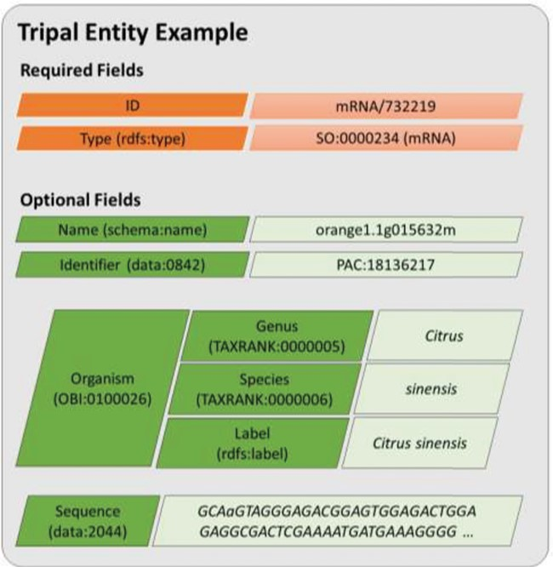
Figure 2 A diagram representing an entity model in Tripal v3. Each field consists of a key–value pair where the key ...
Notes:
Figure 2 A diagram representing an entity model in Tripal v3. Each field consists of a key–value pair where the key must be defined using a controlled vocabulary term. The ID and type fields are required while all other are optional. Fields may have a single value or be a nested array of key–value pairs where keys must also use controlled vocabulary terms. This example includes real field data for the transcript named, orange1.1g015632m from the Citrus Genome Database.
Unless provided in the caption above, the following copyright applies to the content of this slide: © The Author(s) 2019. Published by Oxford University Press.This is an Open Access article distributed under the terms of the Creative Commons Attribution License (http://creativecommons.org/licenses/by/4.0/), which permits unrestricted reuse, distribution, and reproduction in any medium, provided the original work is properly cited.

